Slide 1
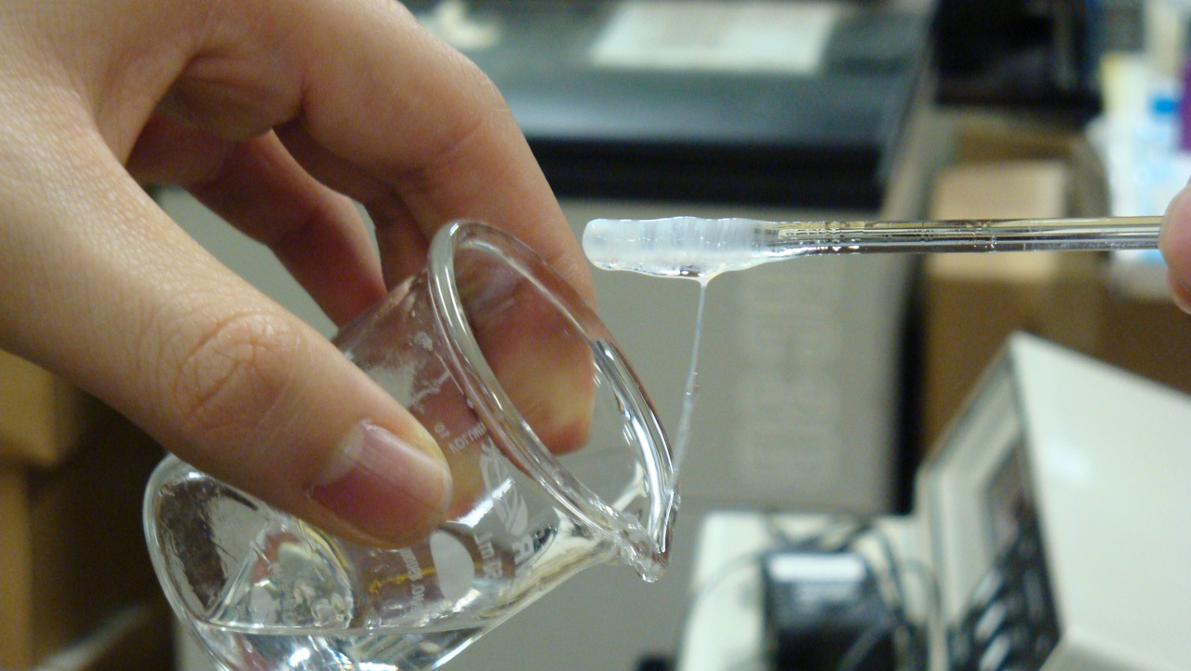
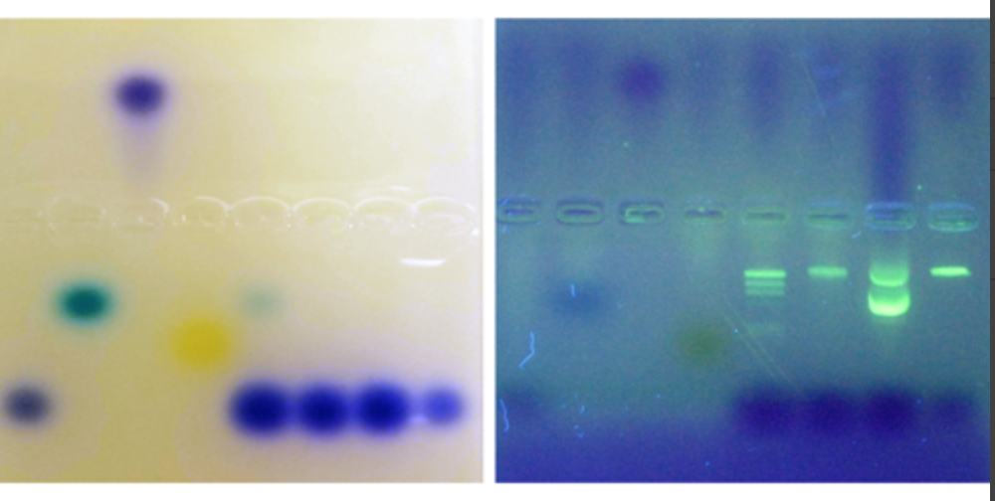
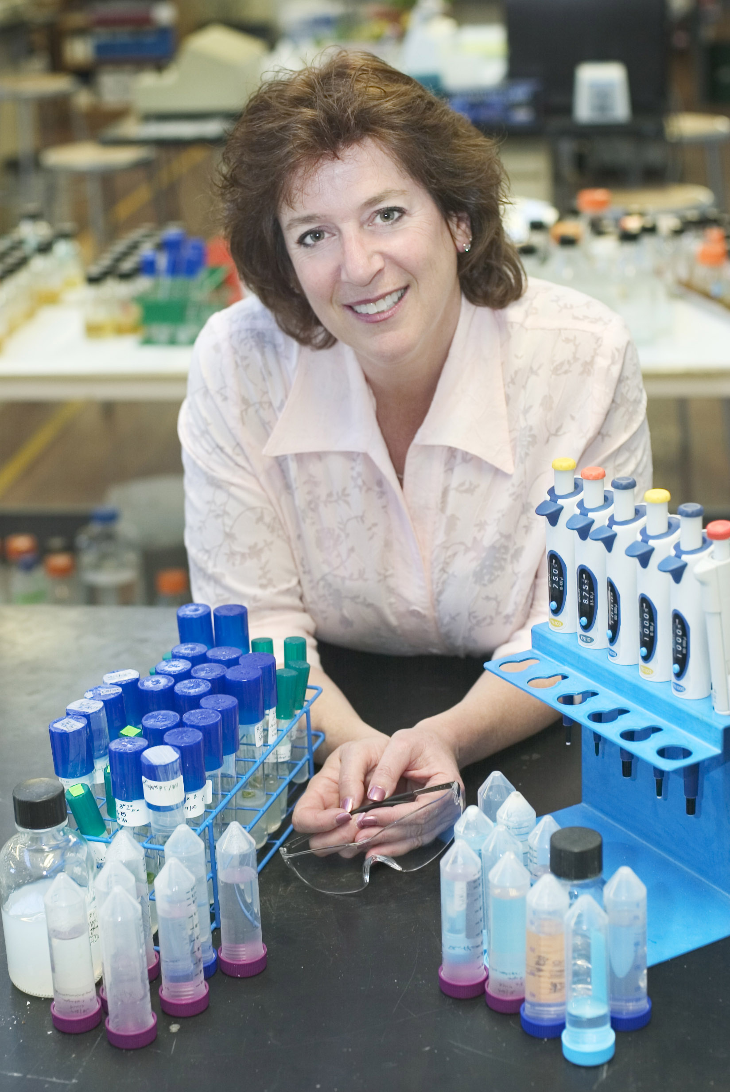
Increase Student Interest in Bioscience
Biotechnology Basics™ by Ellyn Daugherty
Get students excited about doing real, applied science
Ellyn Daugherty
Biotechnology: Science for the New Millennium, 2e
Ellyn@BiotechEd.com
www.BiotechEd.com
Wanna make cheese? Turn to PPT slide #6 >>>>

Slide 2
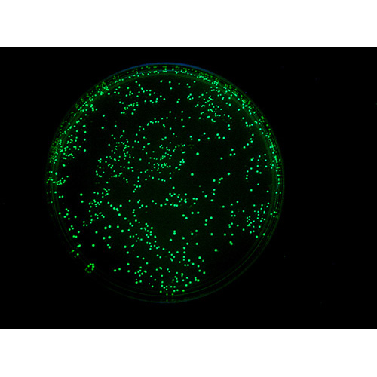
Why Teach Biotech in Biology Courses?
Biology students are inherently interested in lab work and it's applications.
Biotechnology is one of the fastest growing industries with plenty of careers in the science and business of biotech.
High interest introductory molecular biology and research and diagnostics used in medicine, agriculture, industry, and environmental applications.
Students learn organization, self-directedness, attention to detail, responsibility and workplace etiquette = laboratory and life skills.
Students are better prepared for AP courses, research projects and college majors in science.
Seeing value and interest in the curriculum often leads to the development of stand-alone or pathway biotechnology programs.

Slide 3
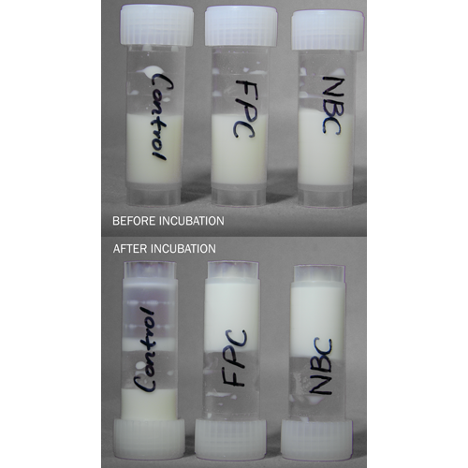
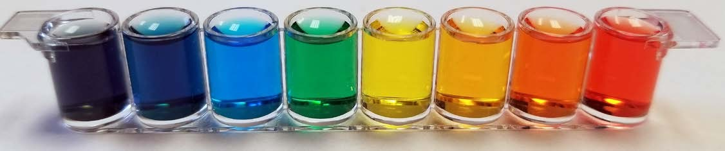
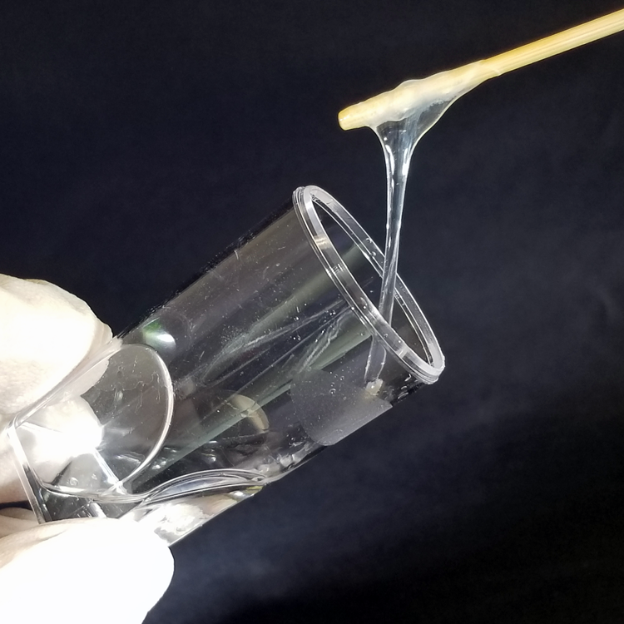
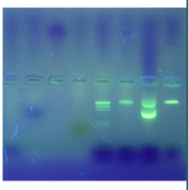
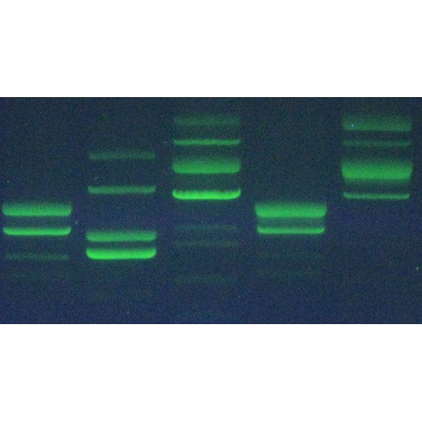
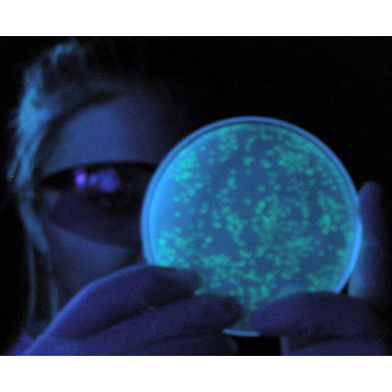
Biotechnology Basics™ by Ellyn Daugherty
kits providing the consumable materials and protocol for
Cheese Biotechnology
Micropipeting Mastery
DNA Spooling with a Twist
Gel Box Science
Crime Scene DNA Gels
Genetic Engineering

Slide 4
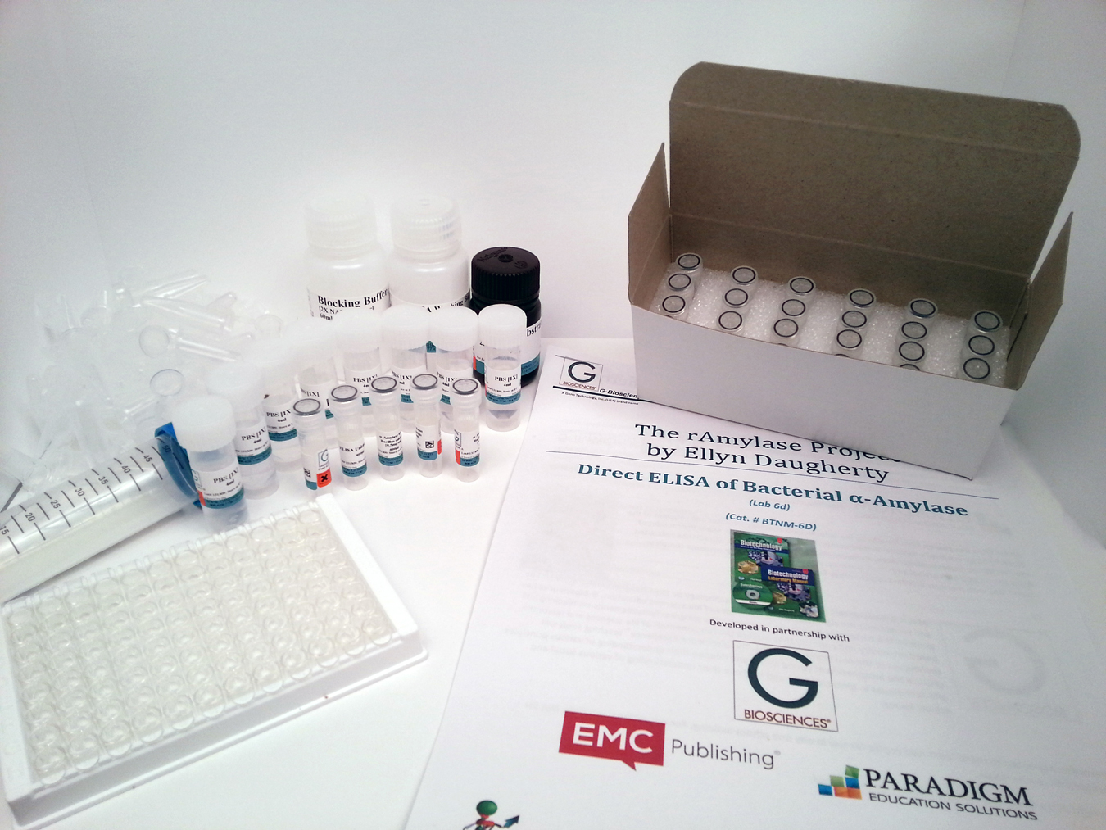
G-Biosciences’ BBED Lab Kits
Written by a teacher for teachers
Kits are designed for 8 lab groups
Majority of reagents are pre-aliquotted for easy distribution to student groups and to save teacher prep time
Kits often save time and money
Protocol is downloadable from G-Biosciences website
Increases the options for student biotech lab skill development

Slide 5
What a Biotech Unit in Biology Might Look Like
“What is Biotechnology?” Internet Activity (on BiotechEd.com)
  Cheese Biotechnology Lab Kit BTNM-1C
Biotechnology Utilizes Tiny Amounts of Reagents
  Micropipeting Mastery Lab Kit BBED-3B
DNA is the Flash and Proteins are the Cash of Biotechnology
  DNA Spooling with a Twist Lab Kit BTNM-4B
DNA Analysis Using Gel Electrophoresis
  Gel Box Science Lab Kit BBED-3B
  Crime Scene DNA Gels Lab Kit BBED-4M
Manipulating Protein Production Through Genetic Engineering
  Genetic Engineering Lab Kit BBED-309
Bioethics and Career Exploration (on BiotechEd.com)

Slide 6
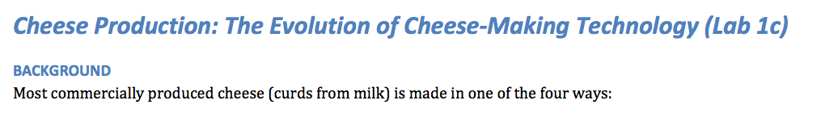
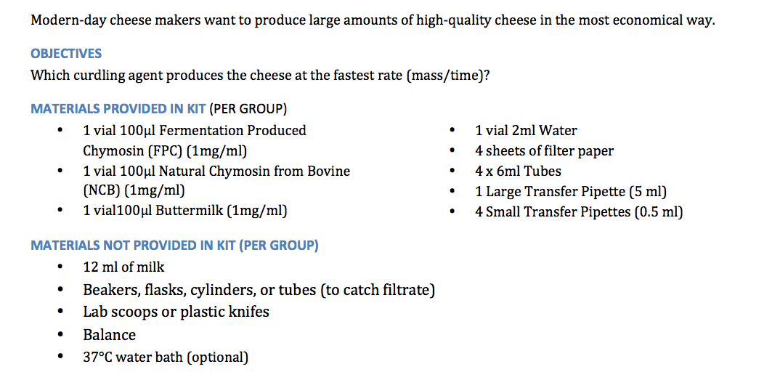
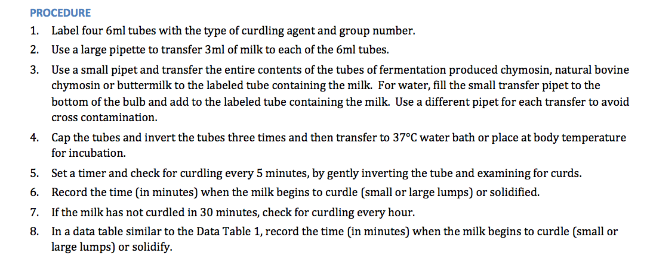
Kit # BTNM-1c
< Hypothesis?
See what curdling agent you got.
Use the pipet to add all the curdling agent. Invert 3x to mix.
Record the time to curdling. Gently check each 5 min.
You will do just 1 tube>>>>>>>>>>>>>>

Slide 7
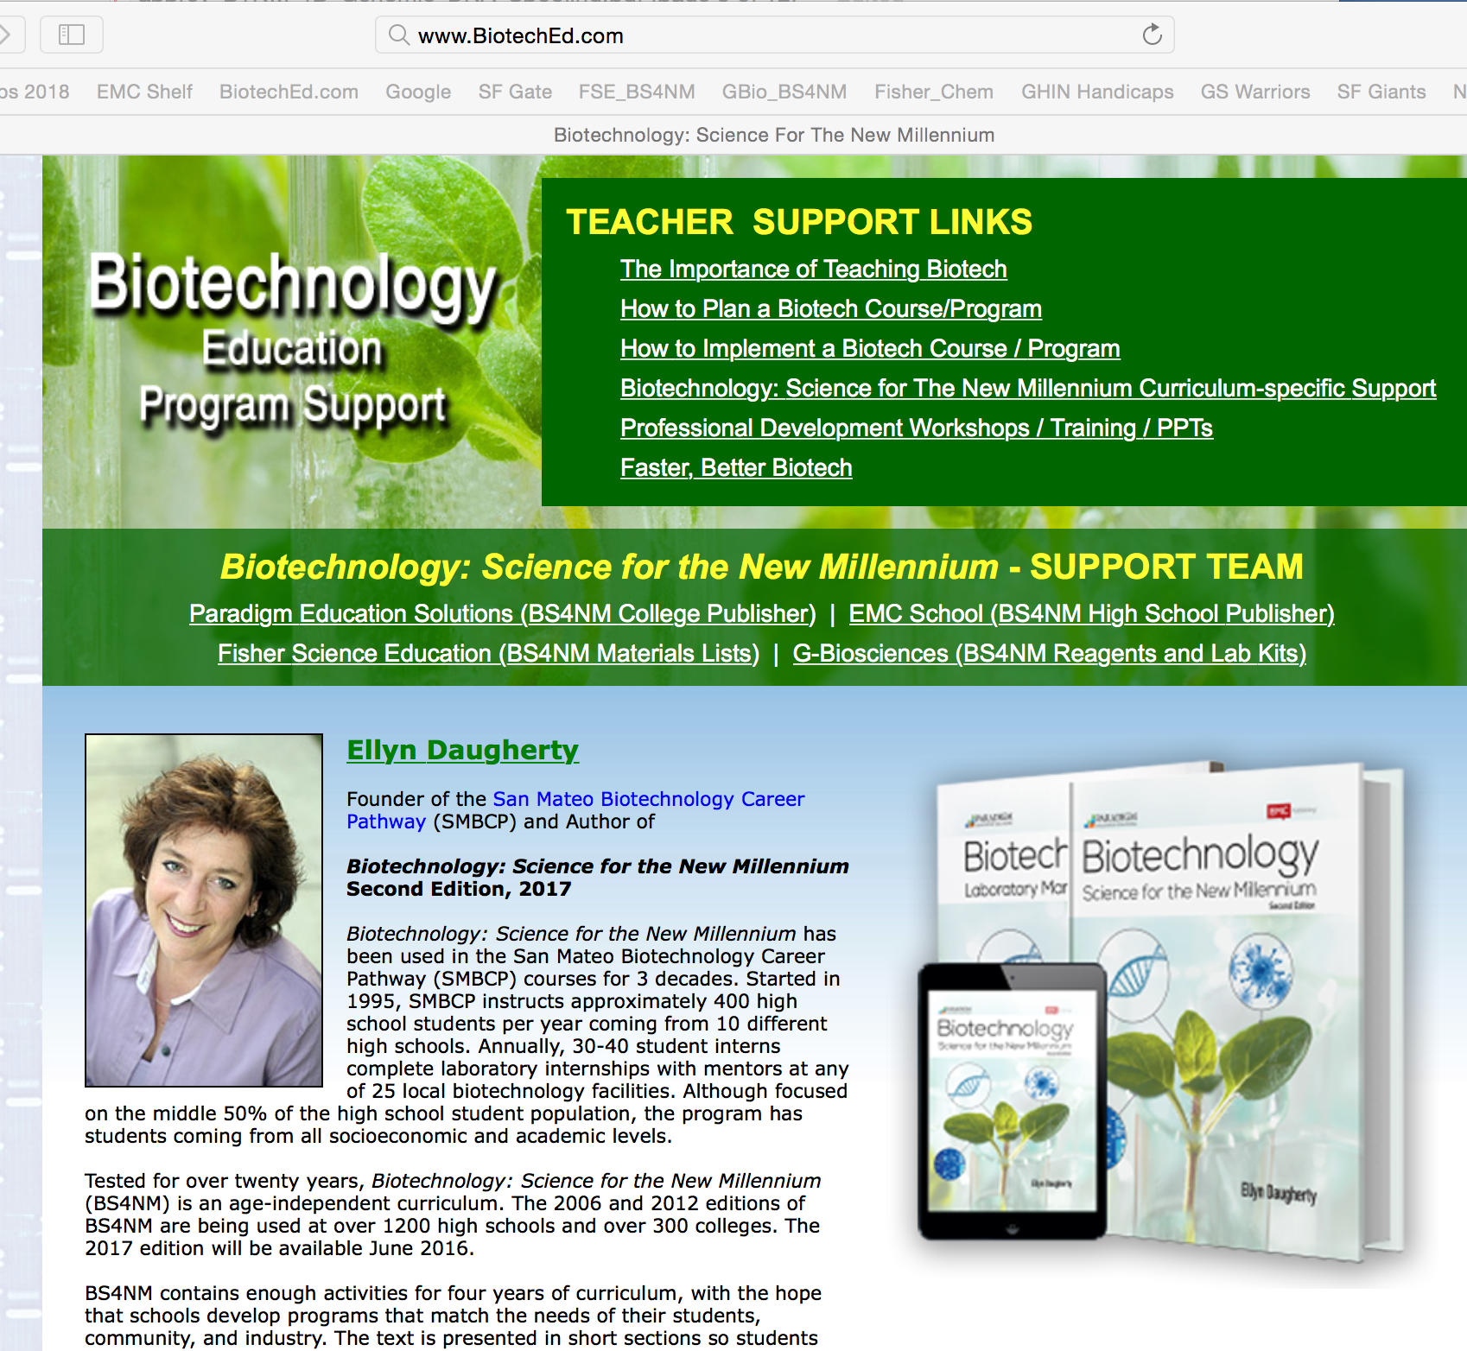
FSE
G-Bio
    BS4NM and BBED Lab Kits available from G-Biosciences
    www.gbiosciences.com/BTNM
    All BS4NM and BBED materials are available through Fisher Science Education
    www.FisherEdu.com/BS4NM

Slide 8
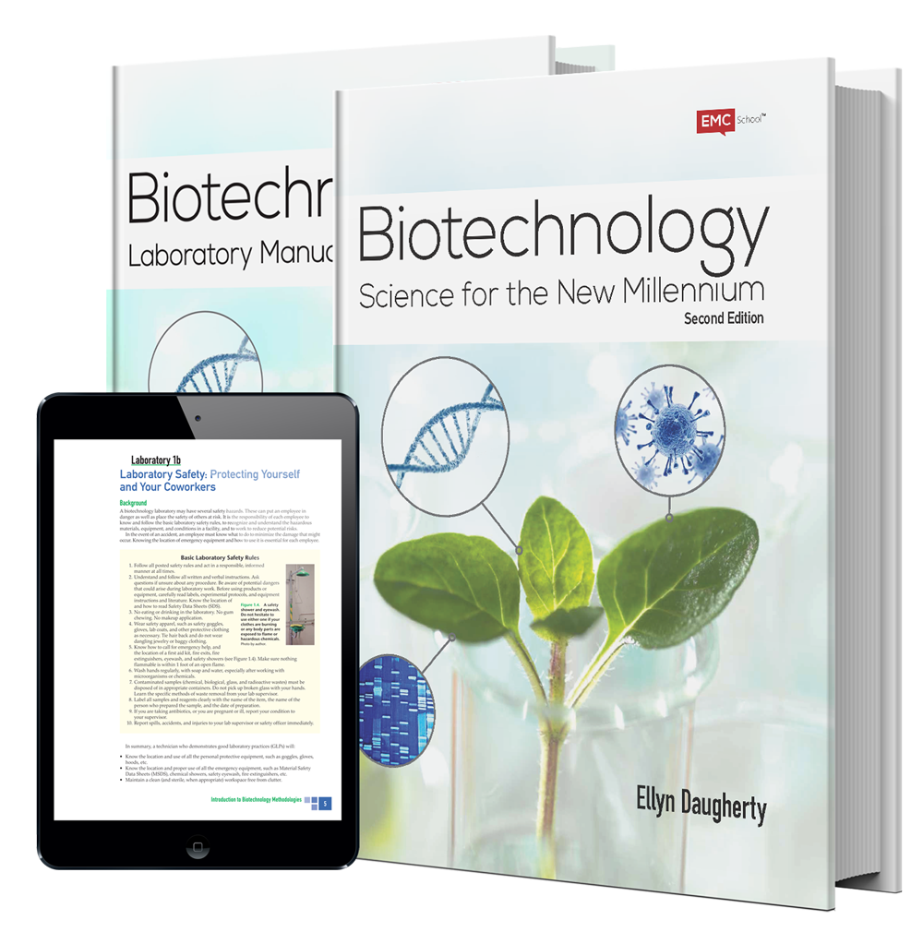
Biotechnology;
Science for the New Millennium 2e ©2017
The most current, complete, flexible, innovative and well-supported biotechnology/bioscience curriculum
Textbook
Laboratory Manual
Lab Kits/Lab Materials
Instructor’s Guide
Course Planner (Lesson Plans)
Biotech Digital Resources
Websites
Educator Support
Ellyn Daugherty
Ellyn@BiotechEd.com www.BiotechEd.com
To request preview copies of BS4NM:
http://bit.ly/BiotechS4NM

Slide 9
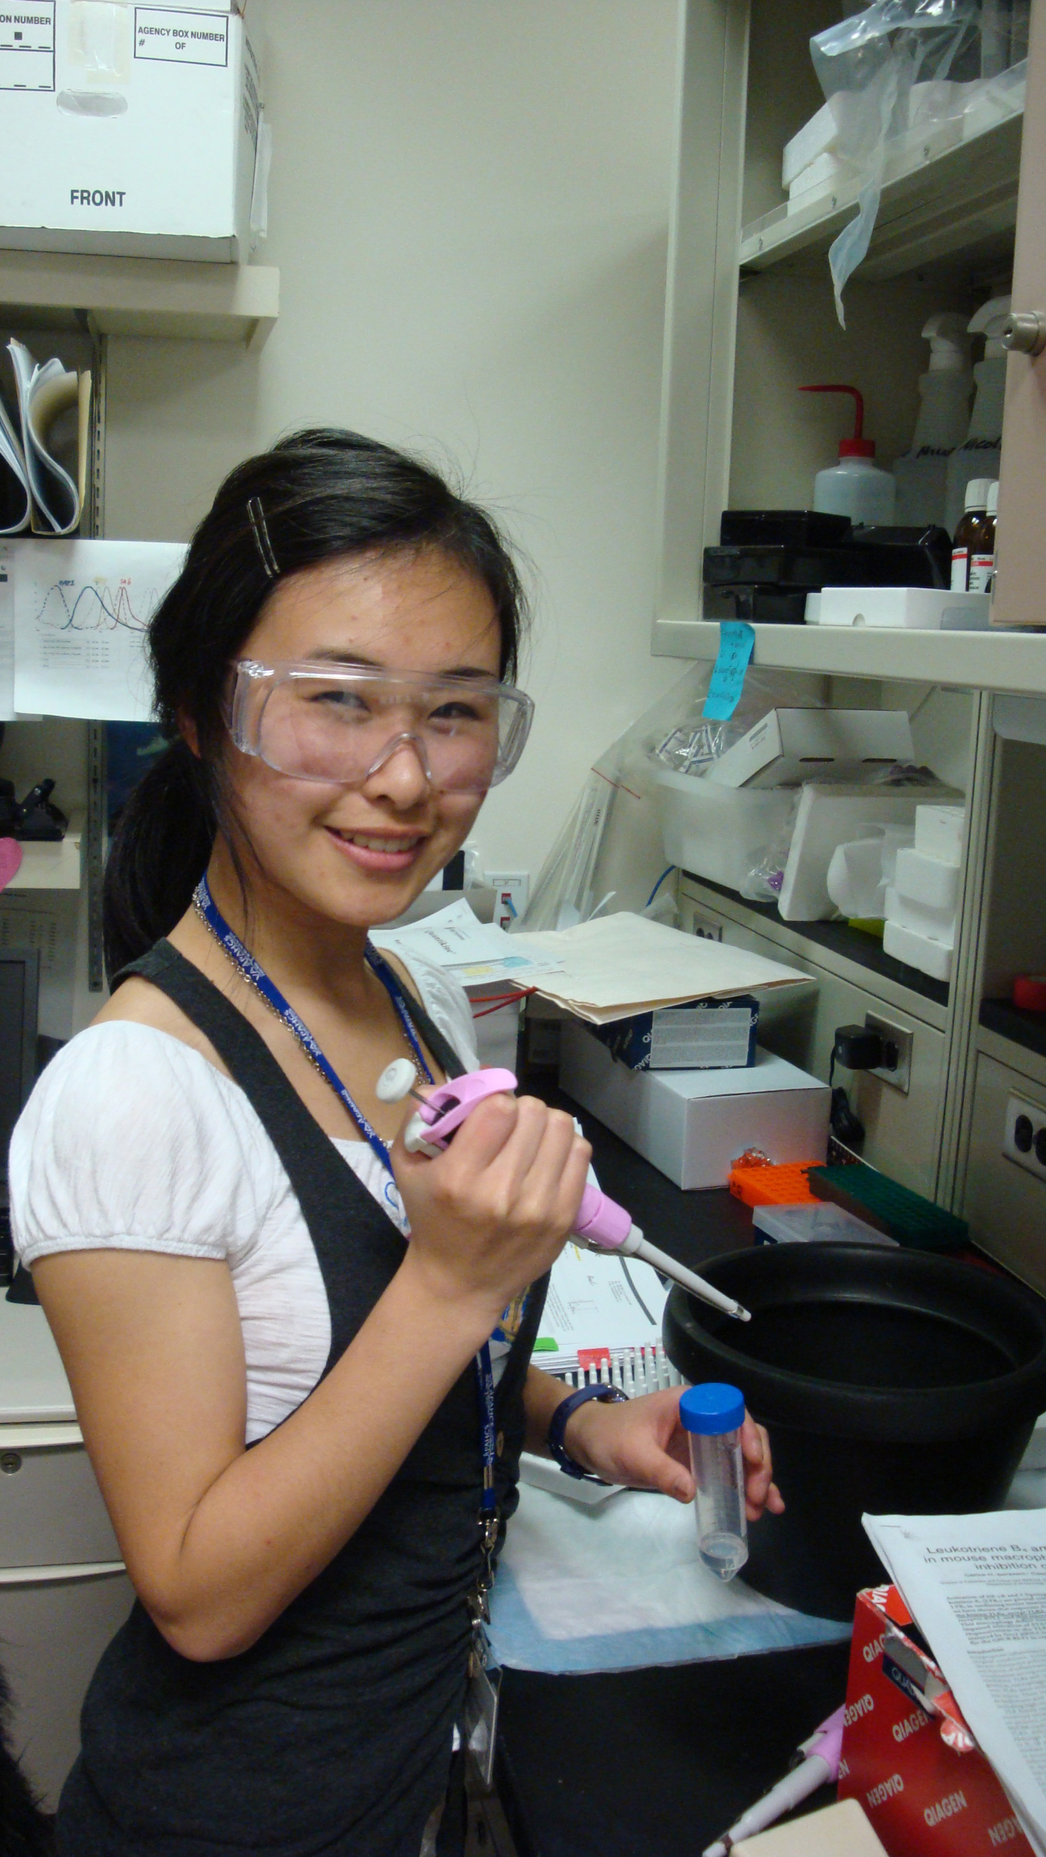
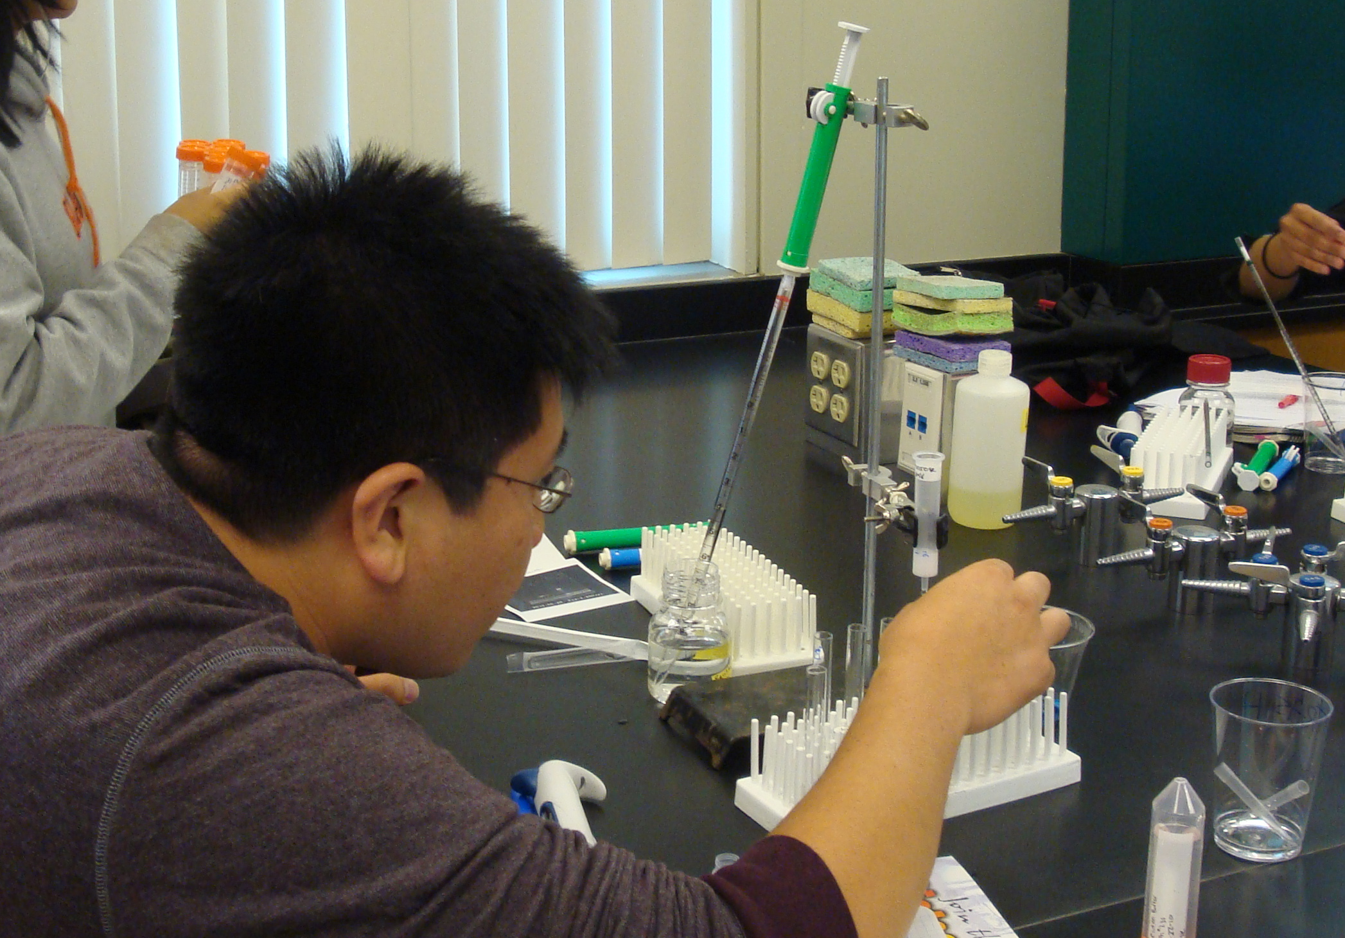
Biotechnology for Everyone
Unless biology educators give their students experiences in the processes of biotechnology, how are students supposed to know they are interested in biotech careers and how can they be expected to make academic decisions that lead them to those careers.
Biotechnology coursework increases the numbers of scientists, research associates, lab technicians, and science-literate citizens sorely needed in our rapidly changing science-based society
Biotechnology Basics™ by Ellyn Daugherty
helps educators bring a 3-week unit of introductory biotech activities into biology courses where time and funding is often limited.

