Slide 1
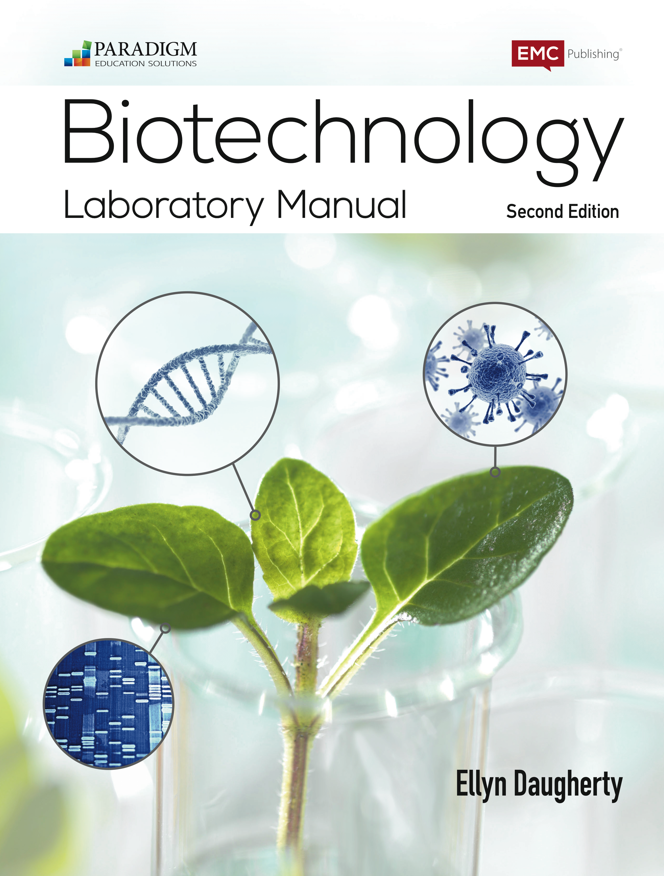
DNA is the Flash of Biotech
B:S4NM - The rAmylase Project Kits
Lab 8b Restriction Digestion to Verify pAmylase Plasmid Kit # BTNM-8b
While you wait, please:
1) Read the front and back of the lab sheet
2) Not an expert micropipeter? Ask someone near you to review with you.
3) Do Step 1 – Label tubes.
Ellyn Daugherty
ellyn@BiotechEd.com
www.BiotechEd.com
Colin Heath
G-Biosciences
cheath@gbiosciences.com

Slide 2



Amylase is a
commercially important biotech product
Amylase is an enzyme that catalyzes starch digestion to sugar. Used to:
Remove starch in products
Produce sugar from starch
Processing of cellulostic biofuel

Slide 3


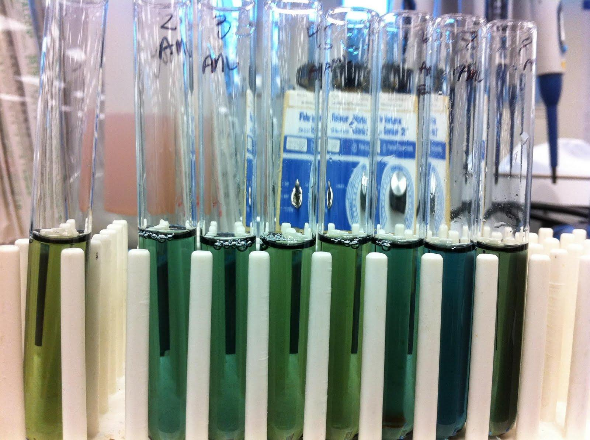
The goal of The rAmylase Project is to
Learn how to assay for amylase, a protein of commercial interest (amylase)
Genetically engineer cells to produce amylase (using pAmylase2014)
Grow transformed cells to volumes where amylase is purified and assayed

Slide 4

The rAmylase Project
Curricular model of rDNA/protein Business
Chapters 1-5 Basic SLOP
Lab 5f Characterizing Proteins by PAGE
Lab 6c Assaying for Amylase Activity
Lab 6d Direct ELISA of Bacterial Amylase
Lab 6e Western Blot to Identify Amylase
Lab 7g Amylase Concentration Assay
Lab 8b pAmy Plasmid Restriction Digest
Lab 8c pAmylaseTransformation of E. coli
Lab 8g Miniprep for pAmylase Isolation
Lab 9c Amylase Ion-Ex Chromatography
Lab 13h Amylase Gene PCR

Slide 7
____
5 min

Slide 8
How do the restriction digestions look?
Do the bands (1660, 2335 bp ?) on the gel show that the sample DNA has only one each of the HindIII and EcoRI restriction sites?
How does this confirm the presence of pAmylase2014?

Slide 9
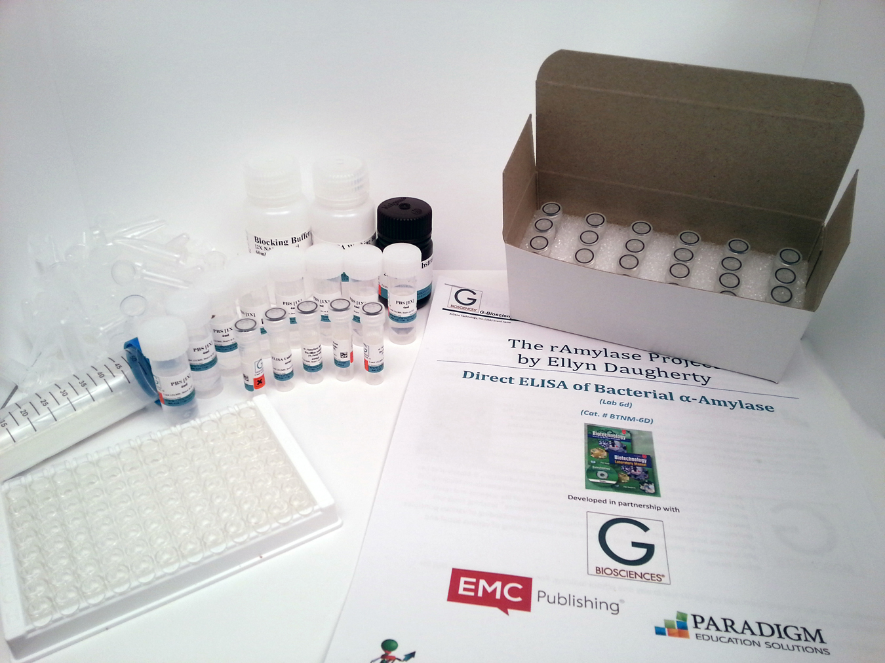
G-Biosciences’ BS4NM Laboratory Kits
Lab 8b
Restriction Digestion of pAmylase2014
G-Bio’s BTNM-8b kit
BS4NM “The rAmylase Project”
Models the production of a real biotech product, rAmylase.
10 G-Bio The rAmylase Project Kits
http://www.gbiosciences.com/BTSNM.aspx
    Lab Kits from G-Biosciences,
    available through
    FSE or G-Bio,
    give educators options for
    student biotech
    lab skill development.

Slide 10
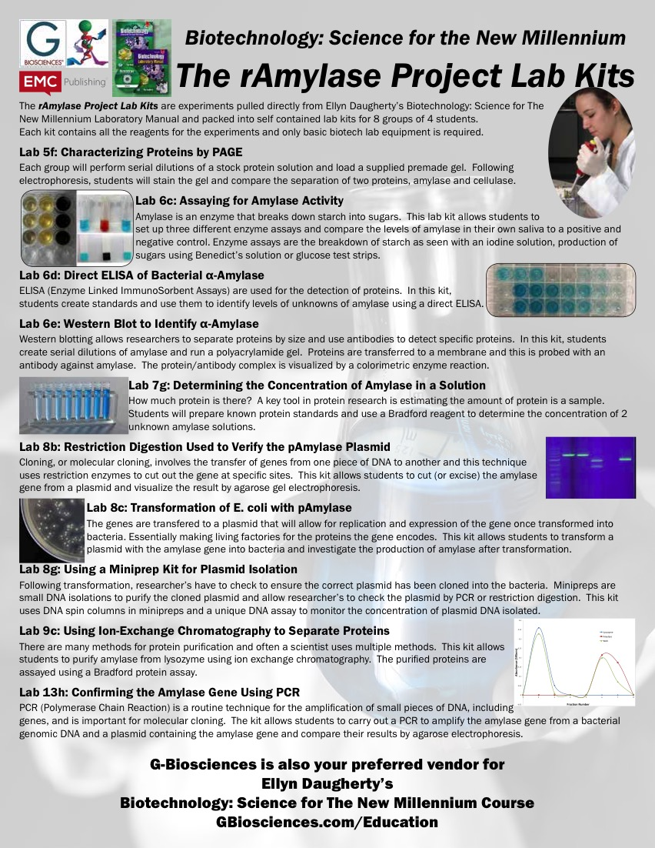

Slide 11
BS4NM/Fisher Science Education/
G-Biosciences Education Materials Lists
https://www.fishersci.com/content/dam/fishersci/en_US/documents/programs/education/brochures-and-catalogs/catalogs/thermo-scientific-biotech-list-science-catalog.pdf
FSE/GBio/BS4NMN Lab Materials Support Team:
Colin Heath, G-Biosciences, Research and Devlopment, cheath@gbiosciences.com
Lacey Cirinelli, Fisher Science Education Product Support, lacey.cirinelli@thermofisher.com
Ellyn Daugherty, BS4NM Author, ellyn@BiotechEd.com

Slide 12
Biotechnology Curricular Support
www.BiotechEd.com

