Slide 1
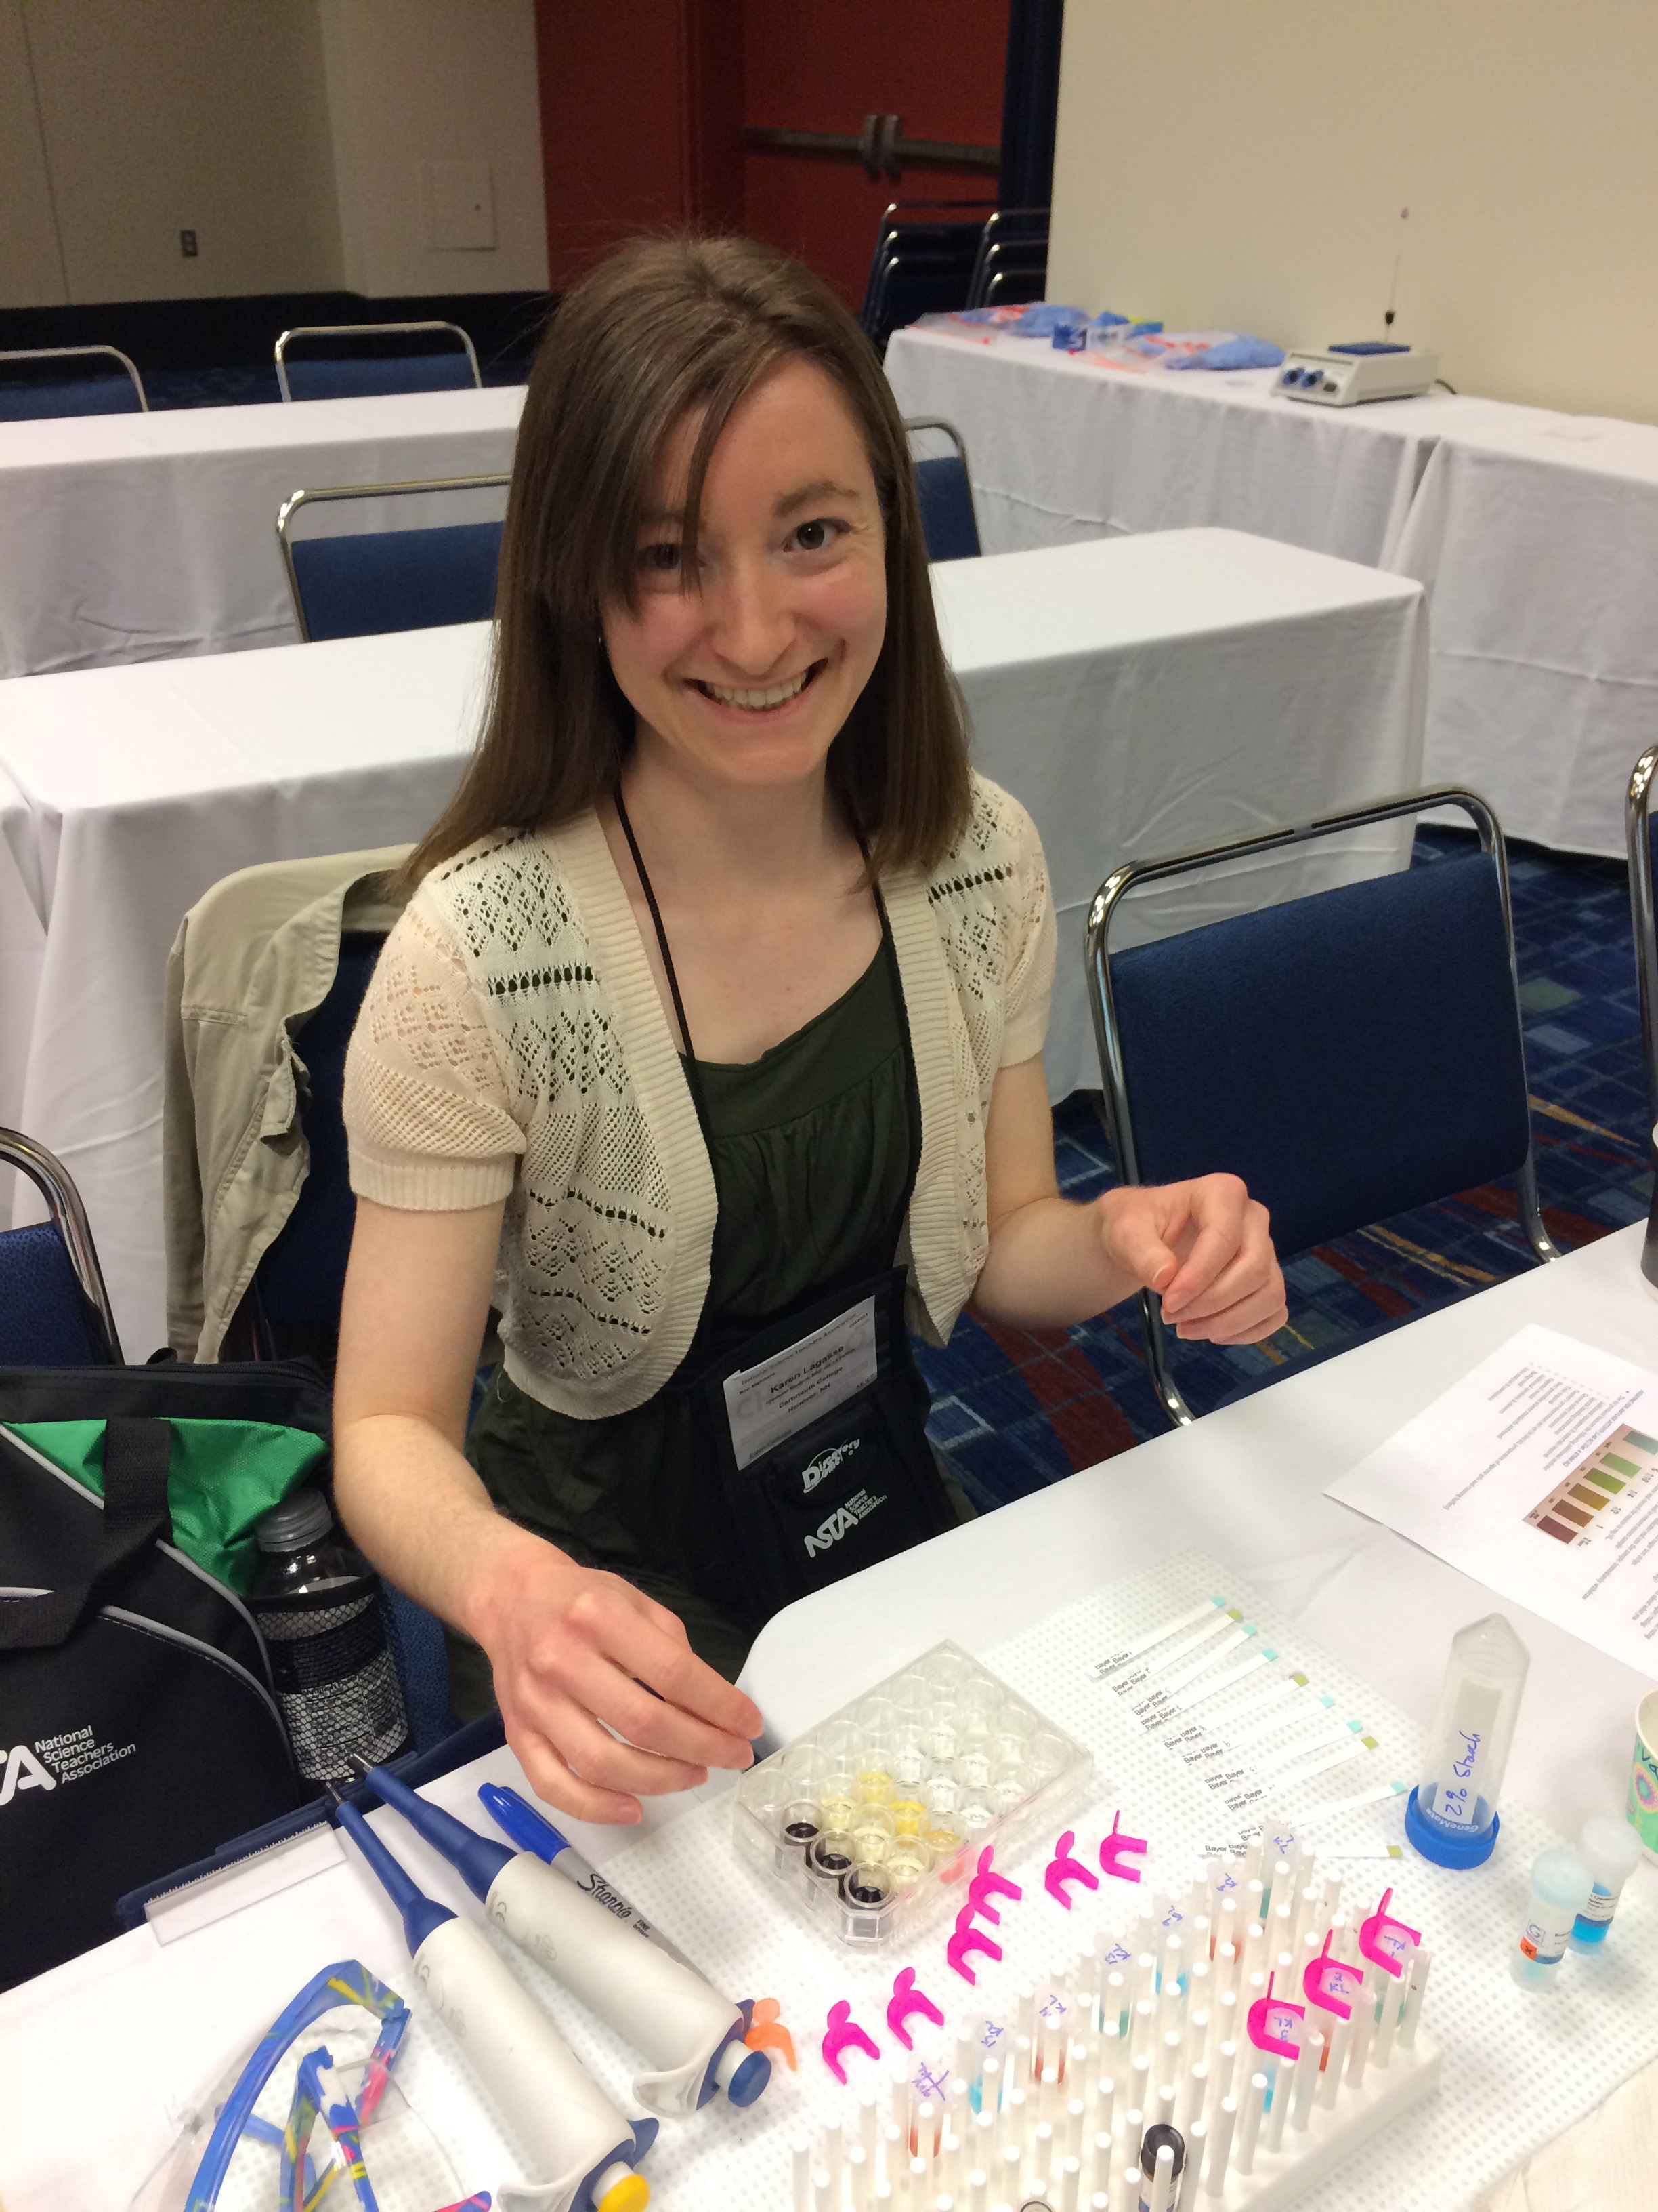
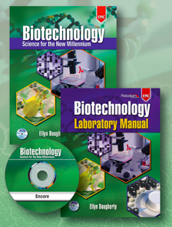
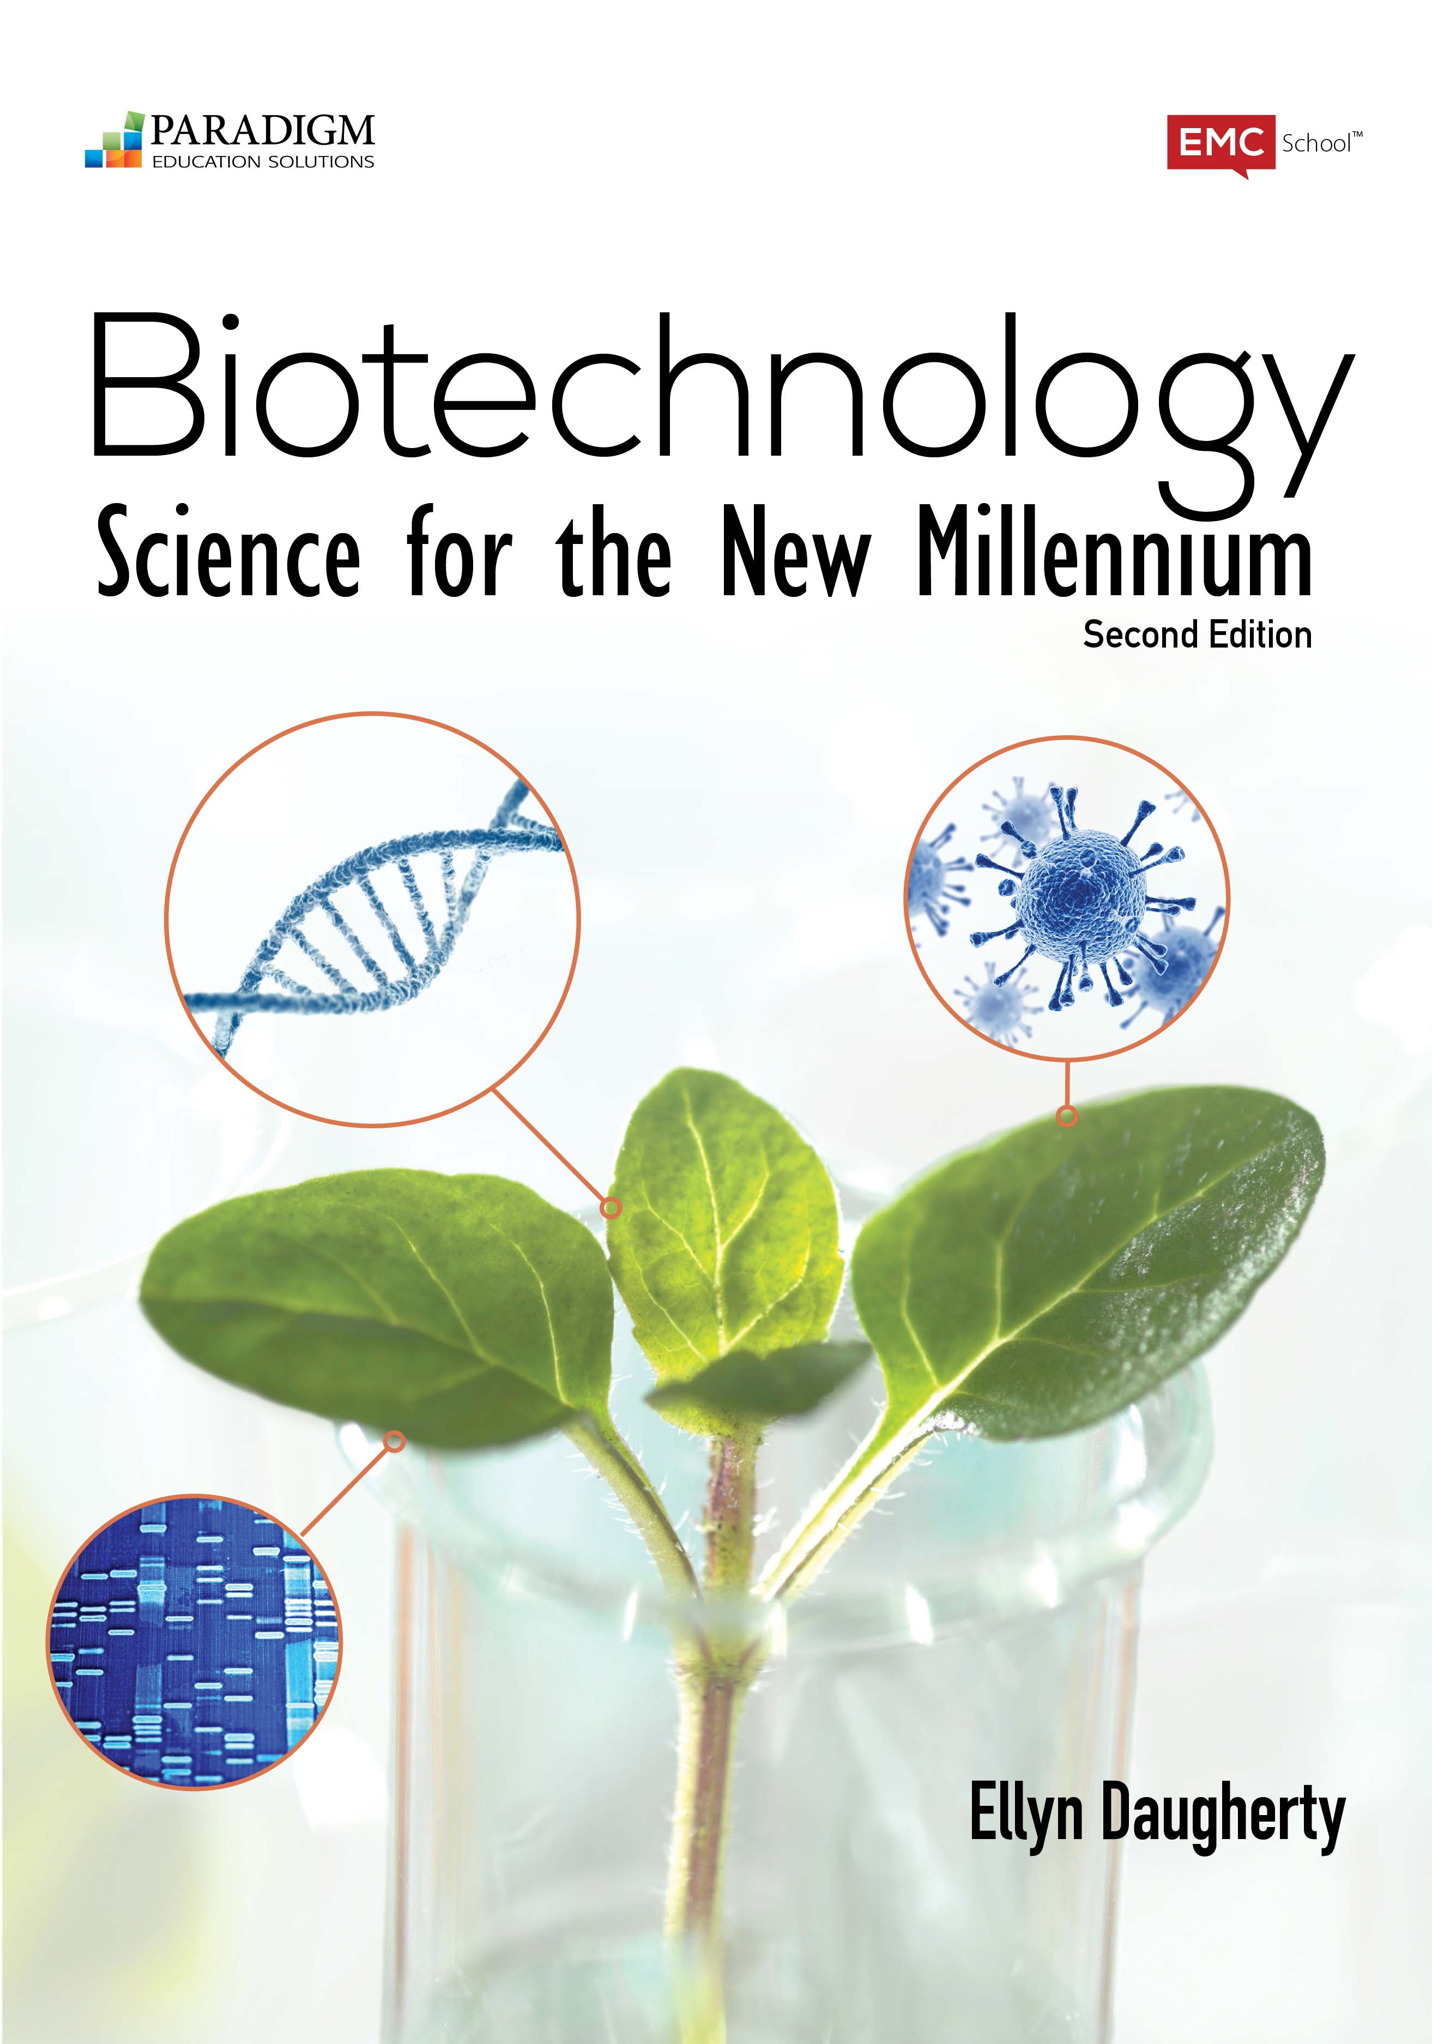
Proteins are the Cash of Biotech
Lab 6c Assaying for Amylase Activity
(B:S4NM The rAmylase Project Kits) Kit # BTNM-6C
Lab 6d in new edition
2012
Ellyn Daugherty
ellyn@BiotechEd.com
www.BiotechEd.com
Colin Heath
G-Biosciences
cheath@gbiosciences.com

Slide 2
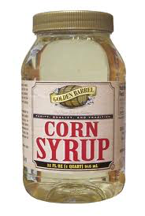


Amylase is a
commercially important biotech product
Amylase is an enzyme that catalyzes starch digestion to sugar. Used to:
Remove starch in products
Produce sugar from starch
Processing of cellulostic biofuel

Slide 3


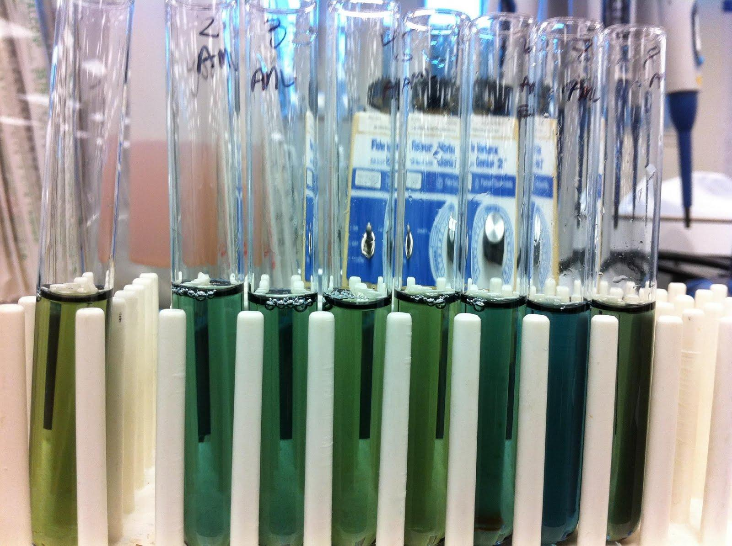
The goal of The rAmylase Project is to
Learn how to assay for amylase, a protein of commercial interest (rAmylase)
Genetically engineer cells to produce amylase (using pAmylase2014)
Grow transformed cells to volumes where amylase is purified and assayed

Slide 4

The rAmylase Project
Curricular model of rDNA/protein Business
Chapters 1-5 Basic SLOP
Lab 5f Characterizing Proteins by PAGE
Lab 6c Assaying for Amylase Activity
Lab 6d Direct ELISA of Bacterial Amylase
Lab 6e Western Blot to Identify Amylase
Lab 7g Amylase Concentration Assay
Lab 8b pAmy Plasmid Restriction Digestion
Lab 8c pAmylaseTransformation of E. coli
Lab 8g Miniprep for pAmylase Isolation
Lab 9c Amylase Ion-Ex Chromatography
Lab 13h Amylase Gene PCR
BS4NM Figure 1.21

Slide 5
Lab 6d in new edition

Slide 9
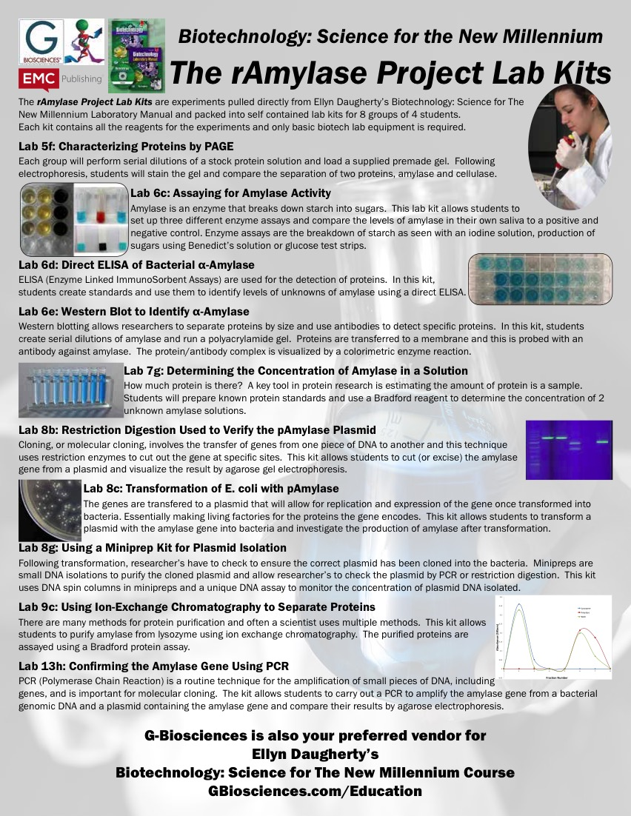

Slide 10
Biotech
Curricular Support
www.BiotechEd.com PPTS, Syllabi, Activities, Hints, Links, etc.
gbiosciences.com B:S4NM materials and kits
and fishersci.com
emcp.com/biotech B:S4NM curriculum

