Slide 1
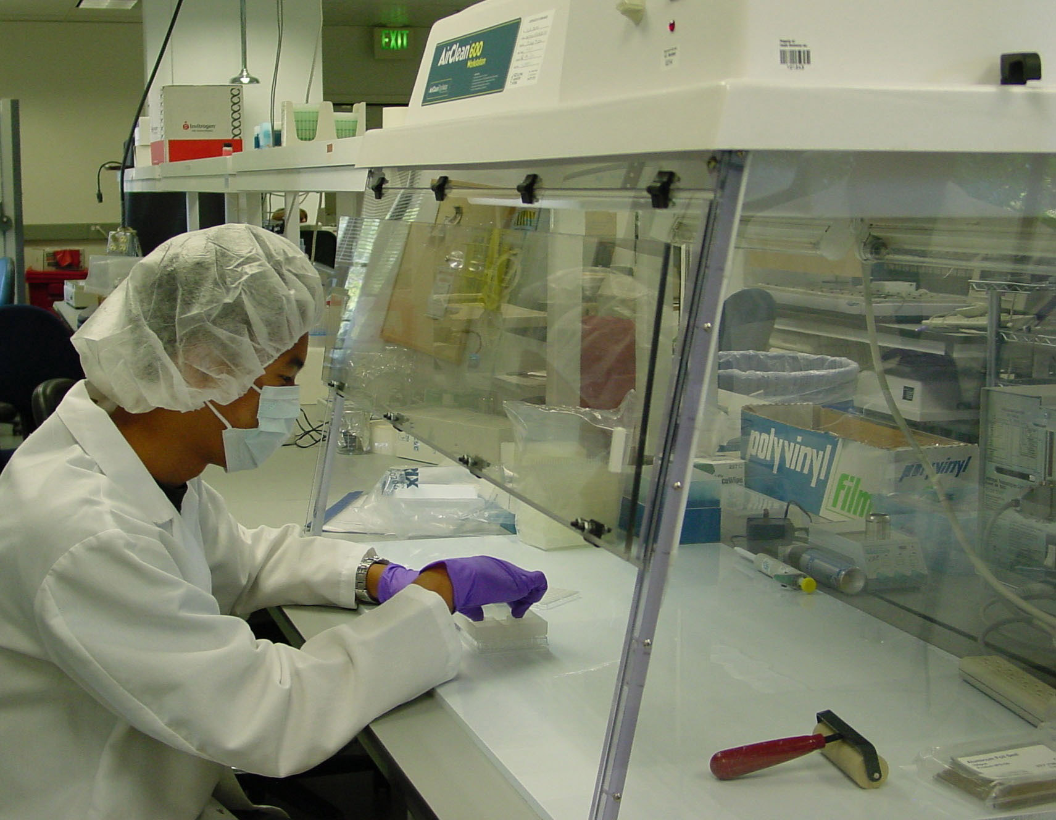
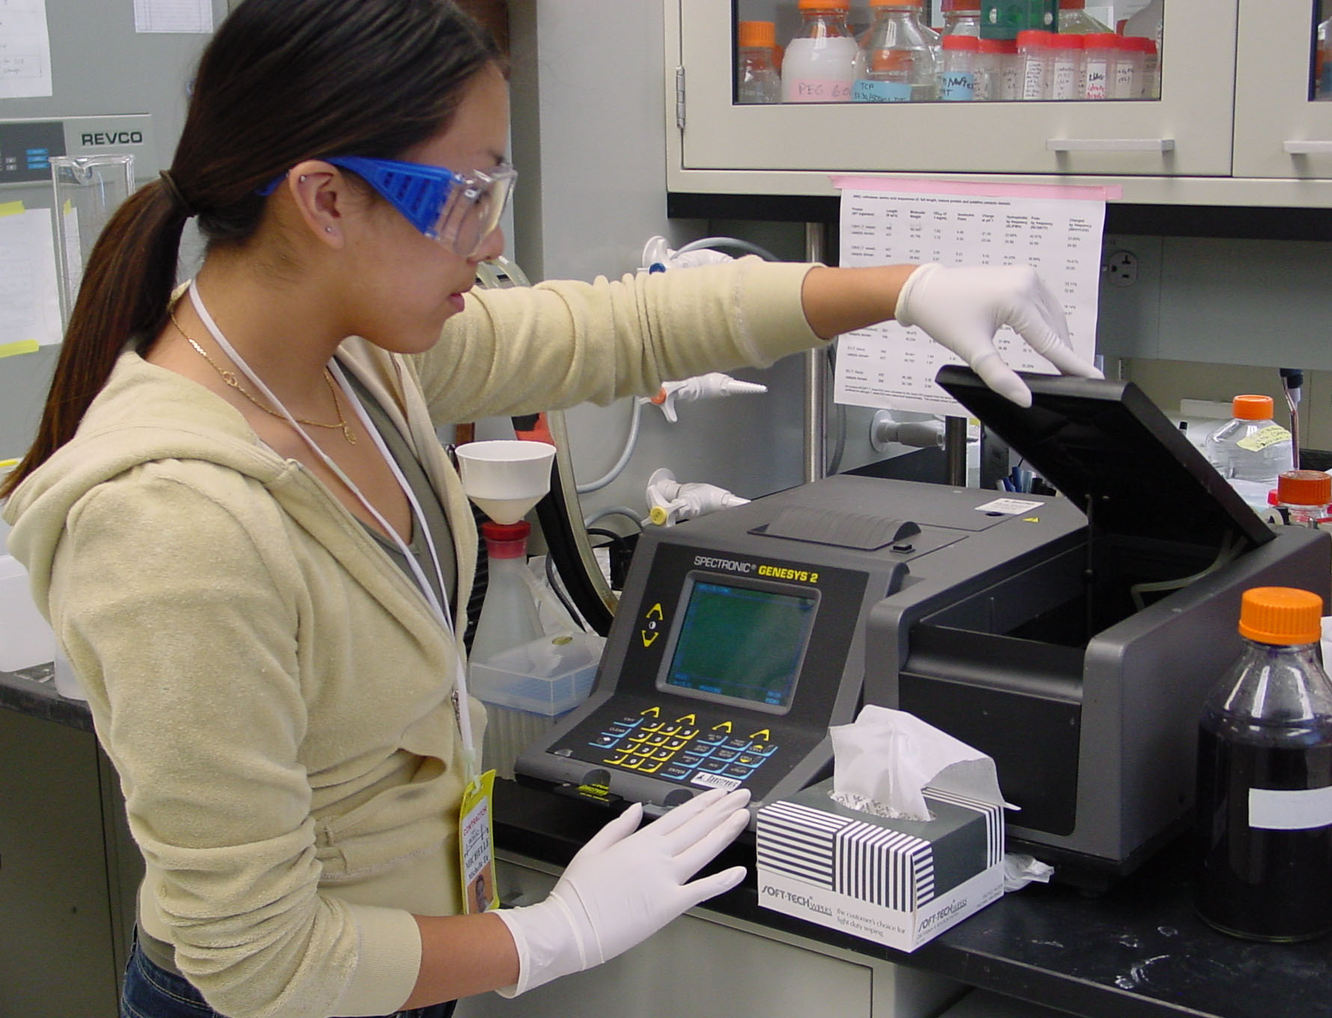
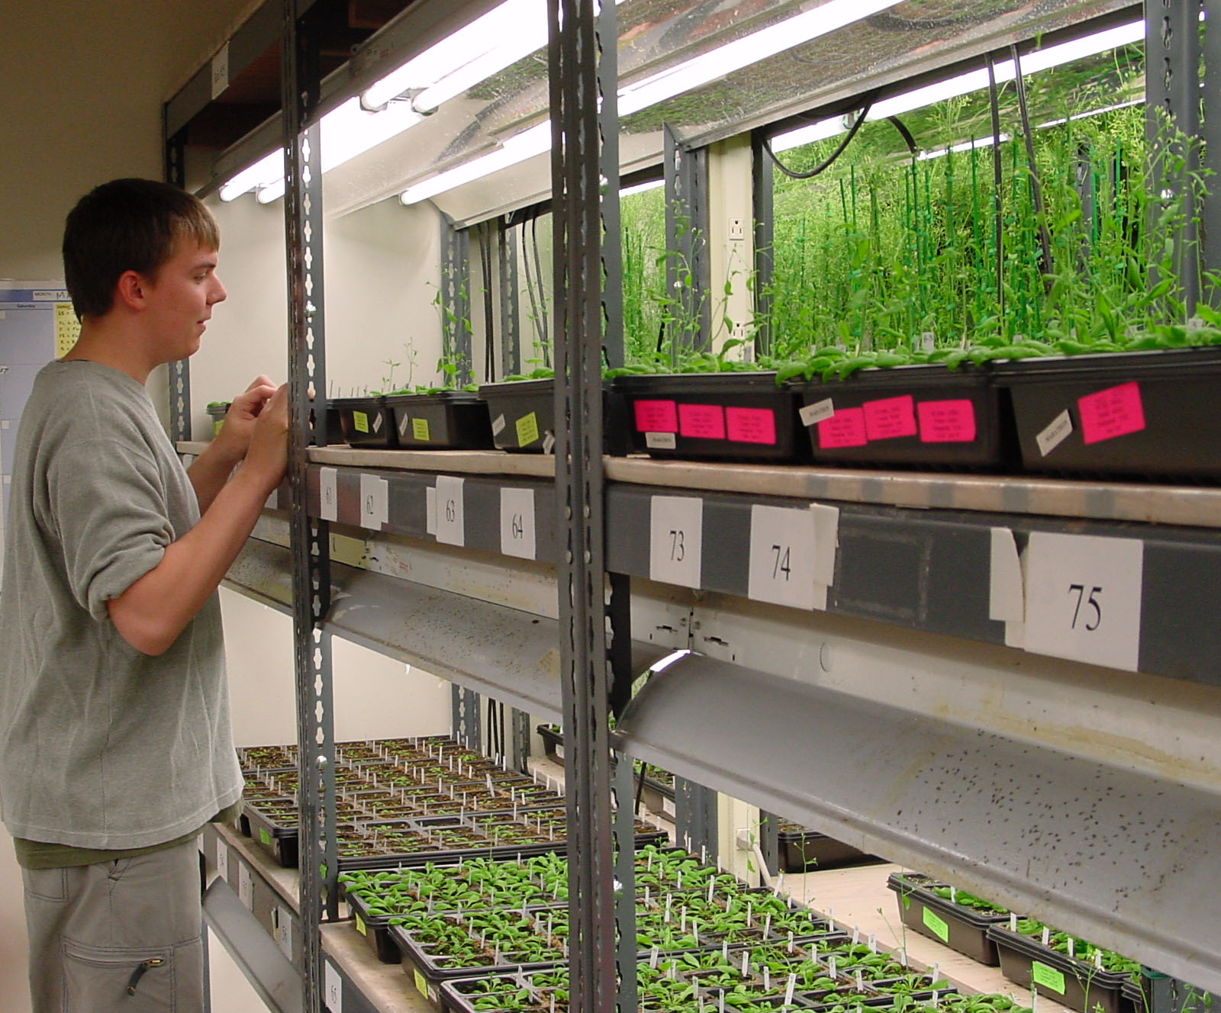
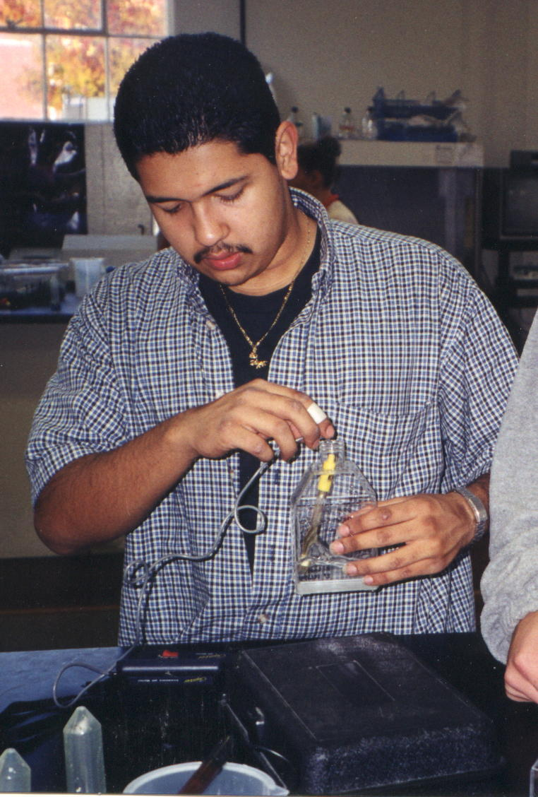
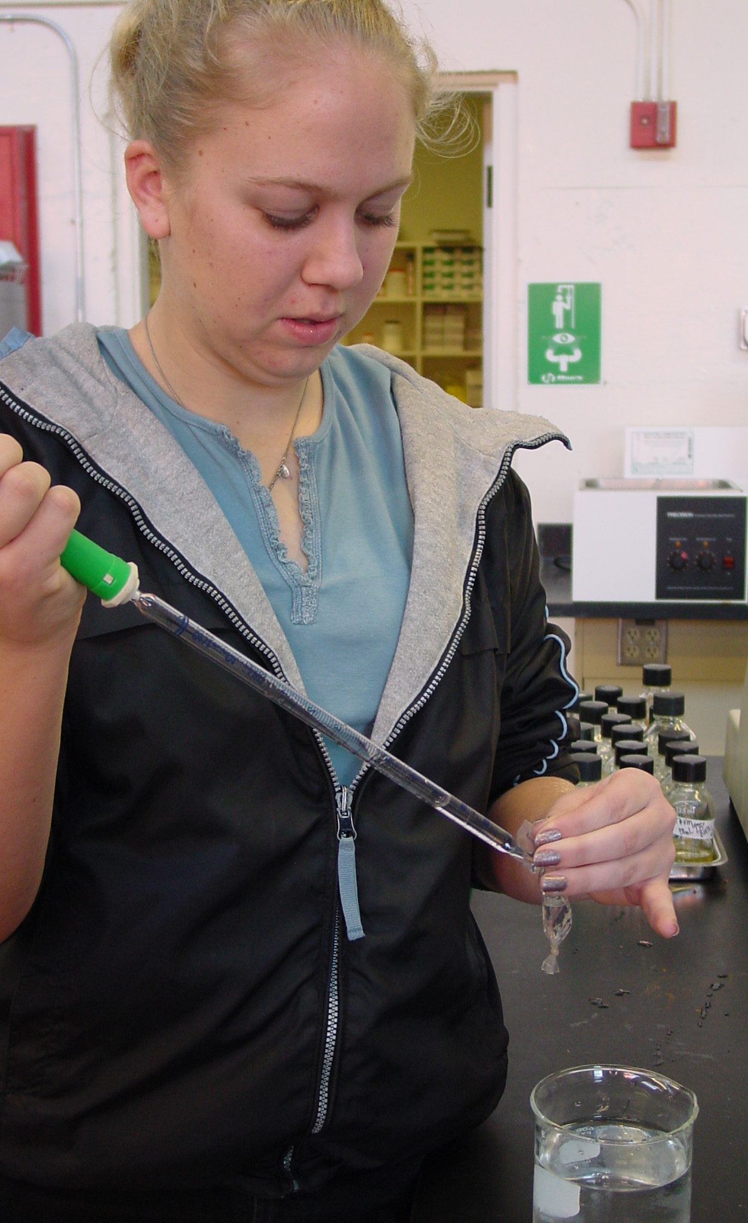
How to Start (or improve) a Biotech Program
Ellyn Daugherty
www.BiotechEd.com
www.emcp.com/biotech
Ellyn@BiotechEd.com
650-400-9424

Slide 2
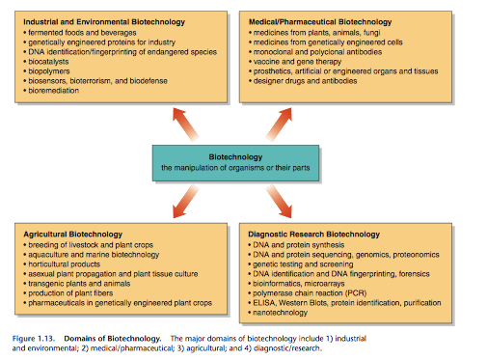
This is the Age of Biotechnology
According to the U.S. Bureau of Labor Statistics, by 2014, it is expected that there will be over 6.3 million jobs in science, engineering, and other technical trades.
It is our responsibility to prepare our students for the business and science of biotechnology.

Slide 3
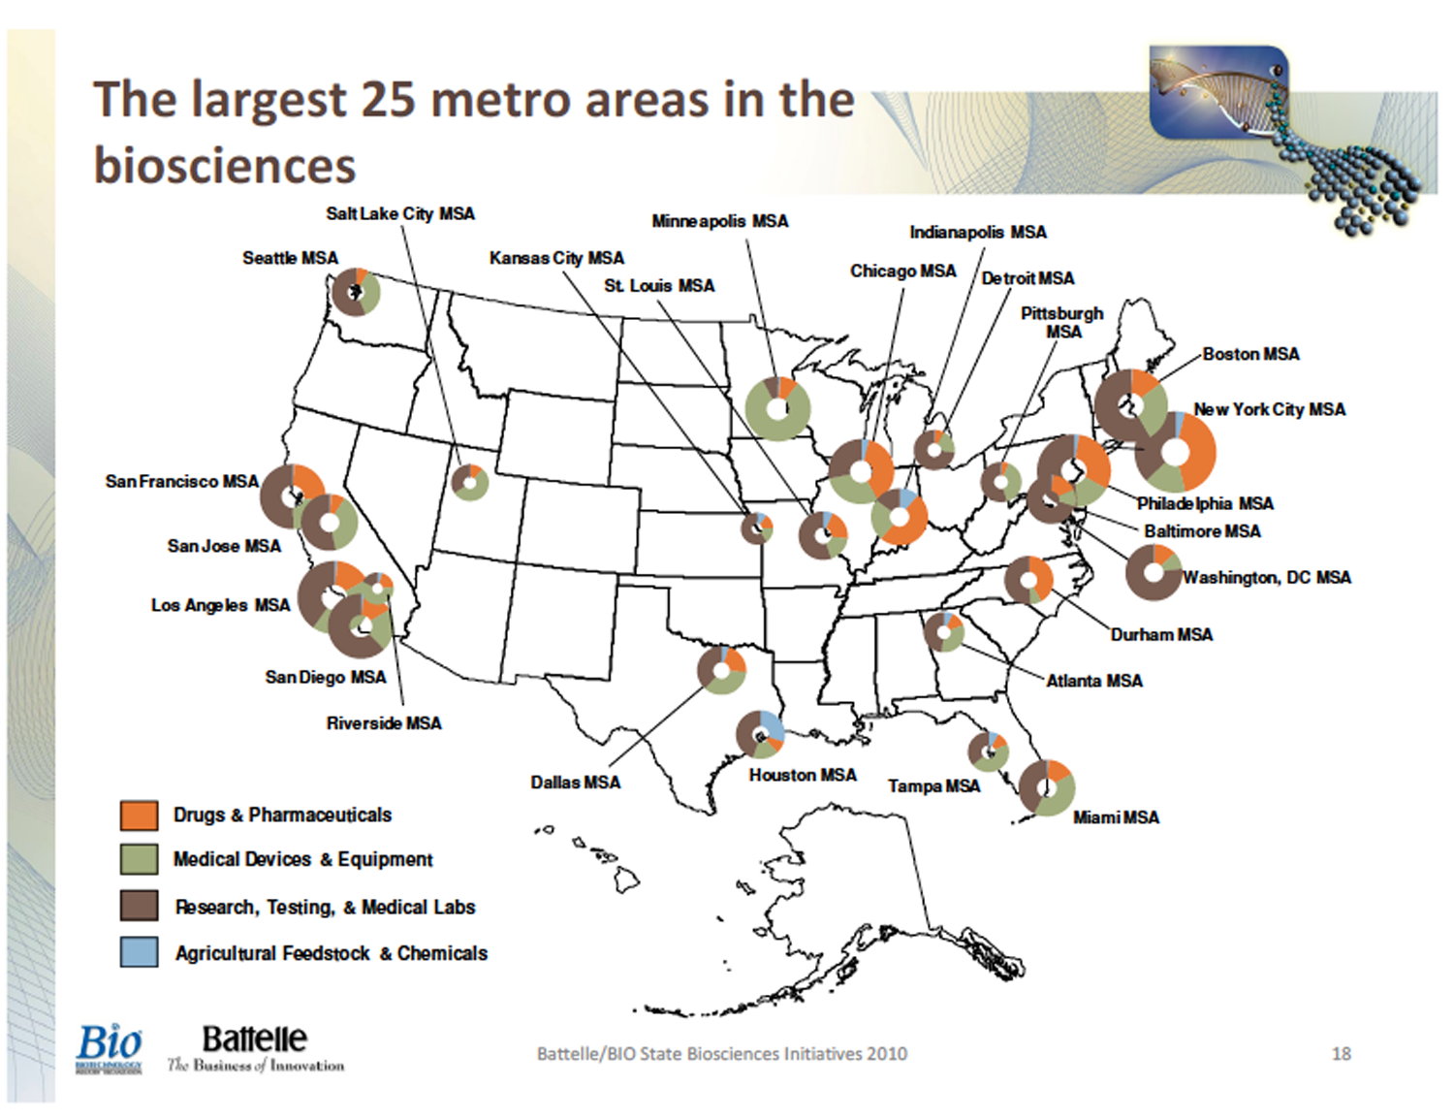
Each of these metropolitan areas has a significant number of research and testing labs. Some of the regions have a focus in the development of pharmaceuticals, medical devices or agricultural products.

Slide 4
Ellyn’s Top 10 Reasons for Biotech Courses
10. Biotech is inherently interesting to students. Who isn't interested in cloning, forensics, and saving the world from disease and famine?
9. Biotech prepares students for the workplace. The fastest growing industry in the nation is biotechnology. There are many jobs for many academic and skill levels.
8. Biotech courses are skills-based making them interesting and appropriate for students of all academic levels. Biotech classes may be truly untracked allowing students to meet and work with students of all academic and socioeconomic levels.
7. Biotech is an integrated science where students learn and apply biology, chemistry, physics, and mathematics. Students see meaning in their other math and science courses.
6. Biotech prepares students for higher-level science courses (i.e. AP Biology and AP Chemistry) and/or gives them a platform from which to move into CC technician programs and 4-year college programs.
5. Biotech courses teach self-directedness, responsibility, organization, and workplace etiquette.
4. Biotech students develop the skills to do real and original research. This may be applied in the workplace, in courses, and on science fair projects.
3. There are plenty of jobs in both the business and science sides of biotech in industrial, academic, and governmental facilities, all over the country and all over the world.
2. Biotechnology is an industry with excellent benefits and good job satisfaction.
And at # 1. Biotech classes are fun!= High Student Attendance/Promptness & high teacher satisfaction.

Slide 5
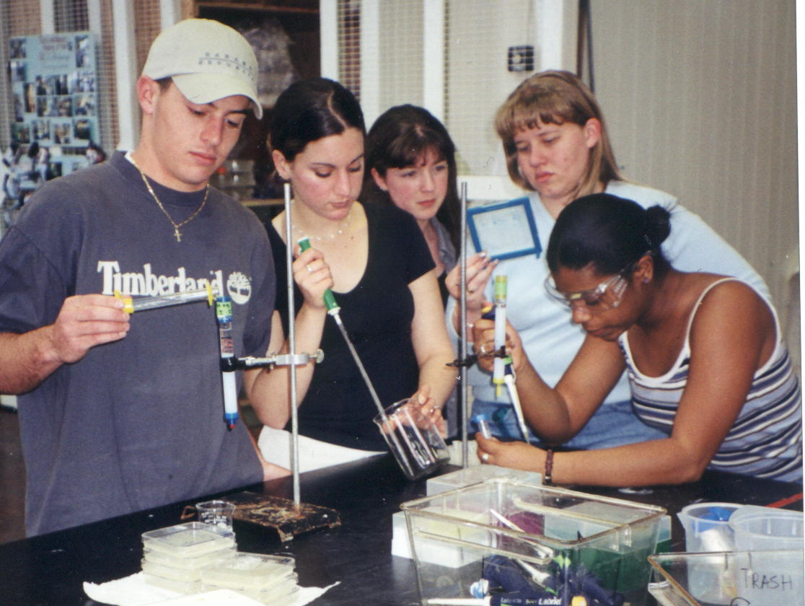
You Can Create a Program that Meets the Needs of your Students and Community

Slide 6
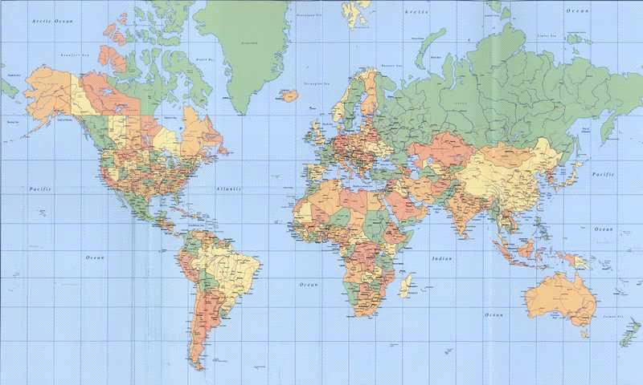
My Professional Goals
Biotechnology
Biotechnology programs in every high school, CTE center, and community college, tailored to the student population and industry and community needs
Aligned and articulated programs in HS and CC so that teenagers and adults have the same platform from which to enter specialized programs
To make it as easy as possible for educators to do the other 2

Slide 7
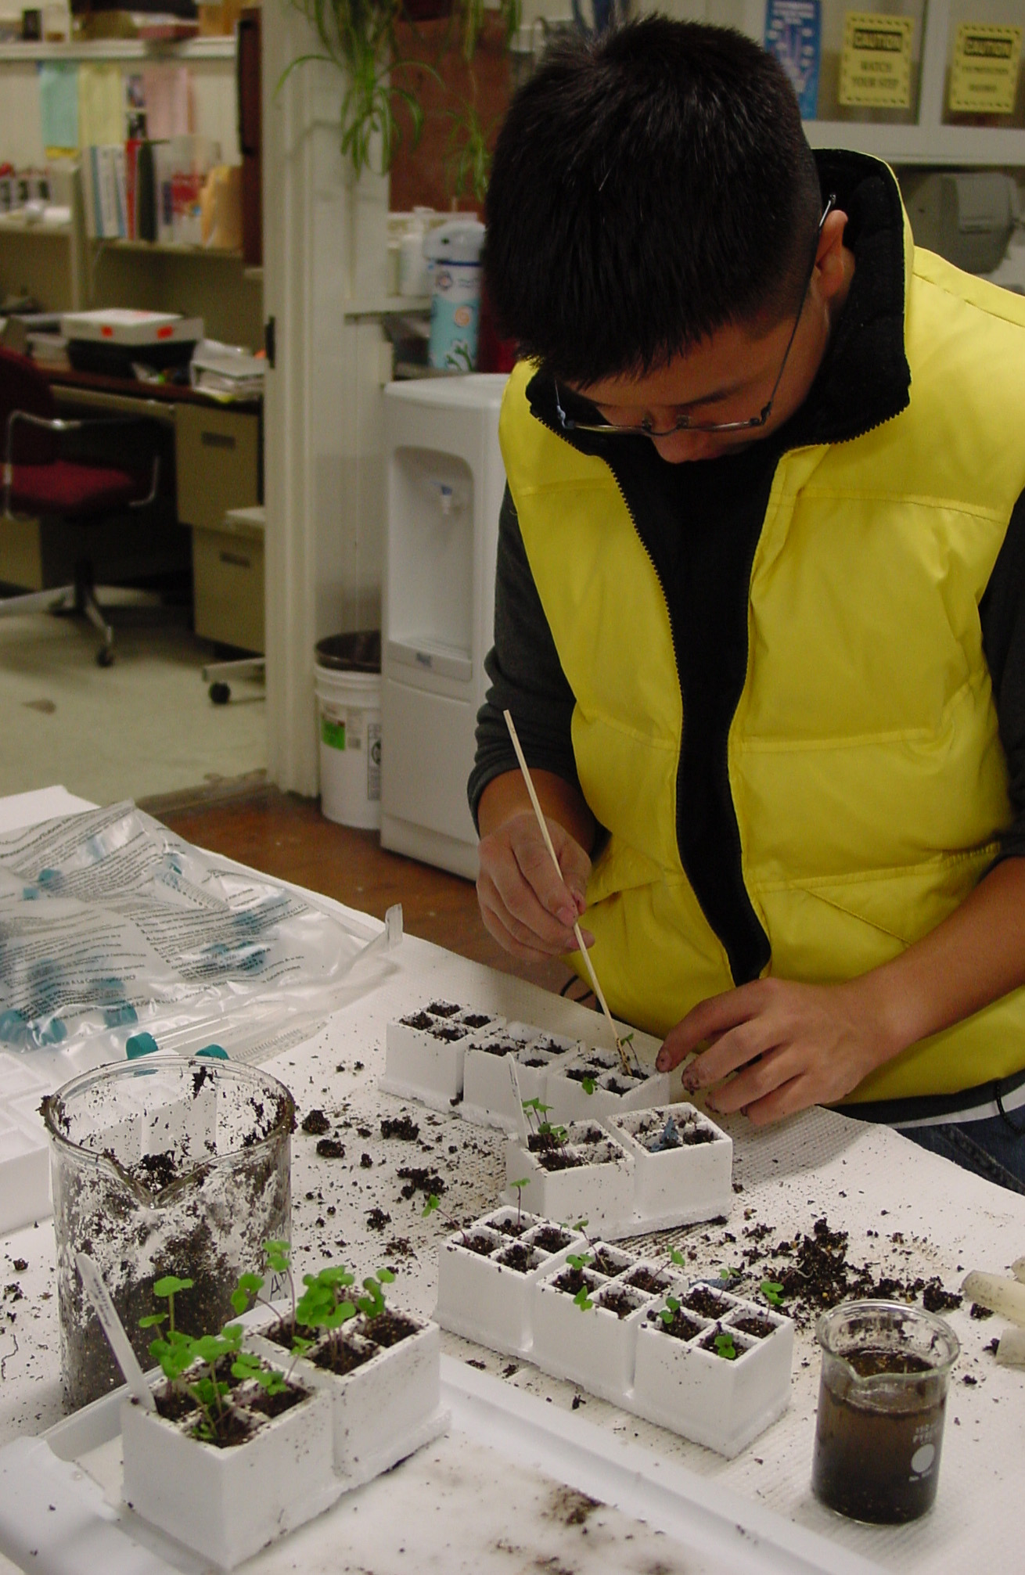
Starting A Biotech Program
To Meet the Needs of Your Students and Your Community
Things to Consider:
Target Student Population
Industry/College Targets
Career/Job Targets
Kind of Course(s)
Goals/Objectives of Course(s)
Curriculum
Setting up a Training Facility
Getting Support
Other Issues
Check out www.BiotechEd.com and the Instructor’s Guide

Slide 8
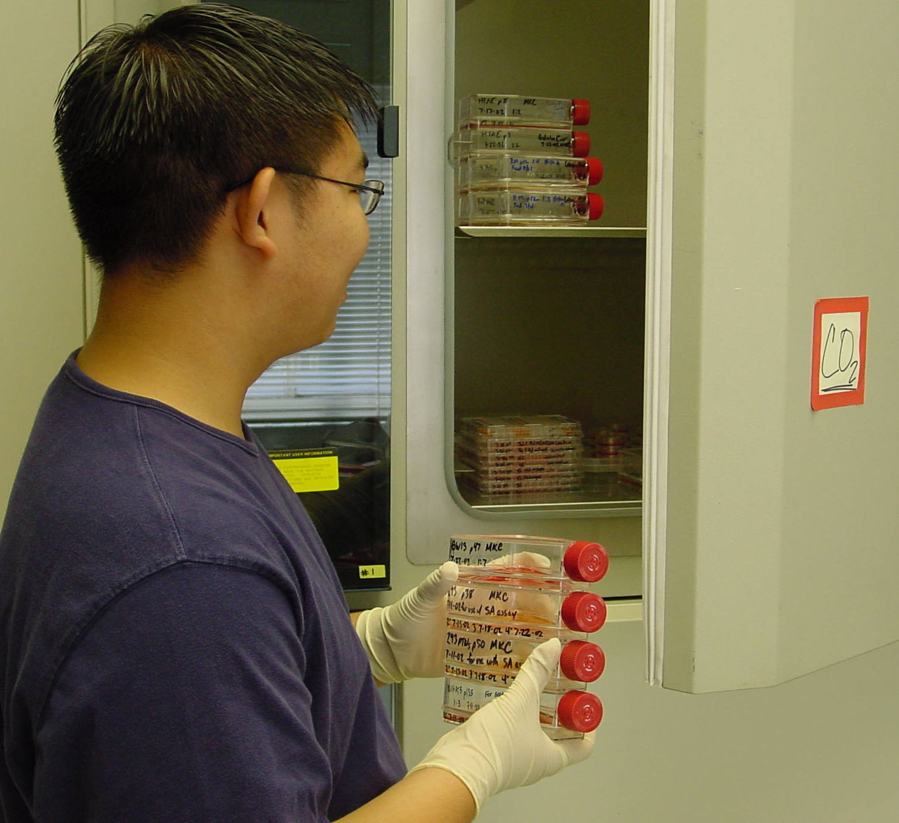
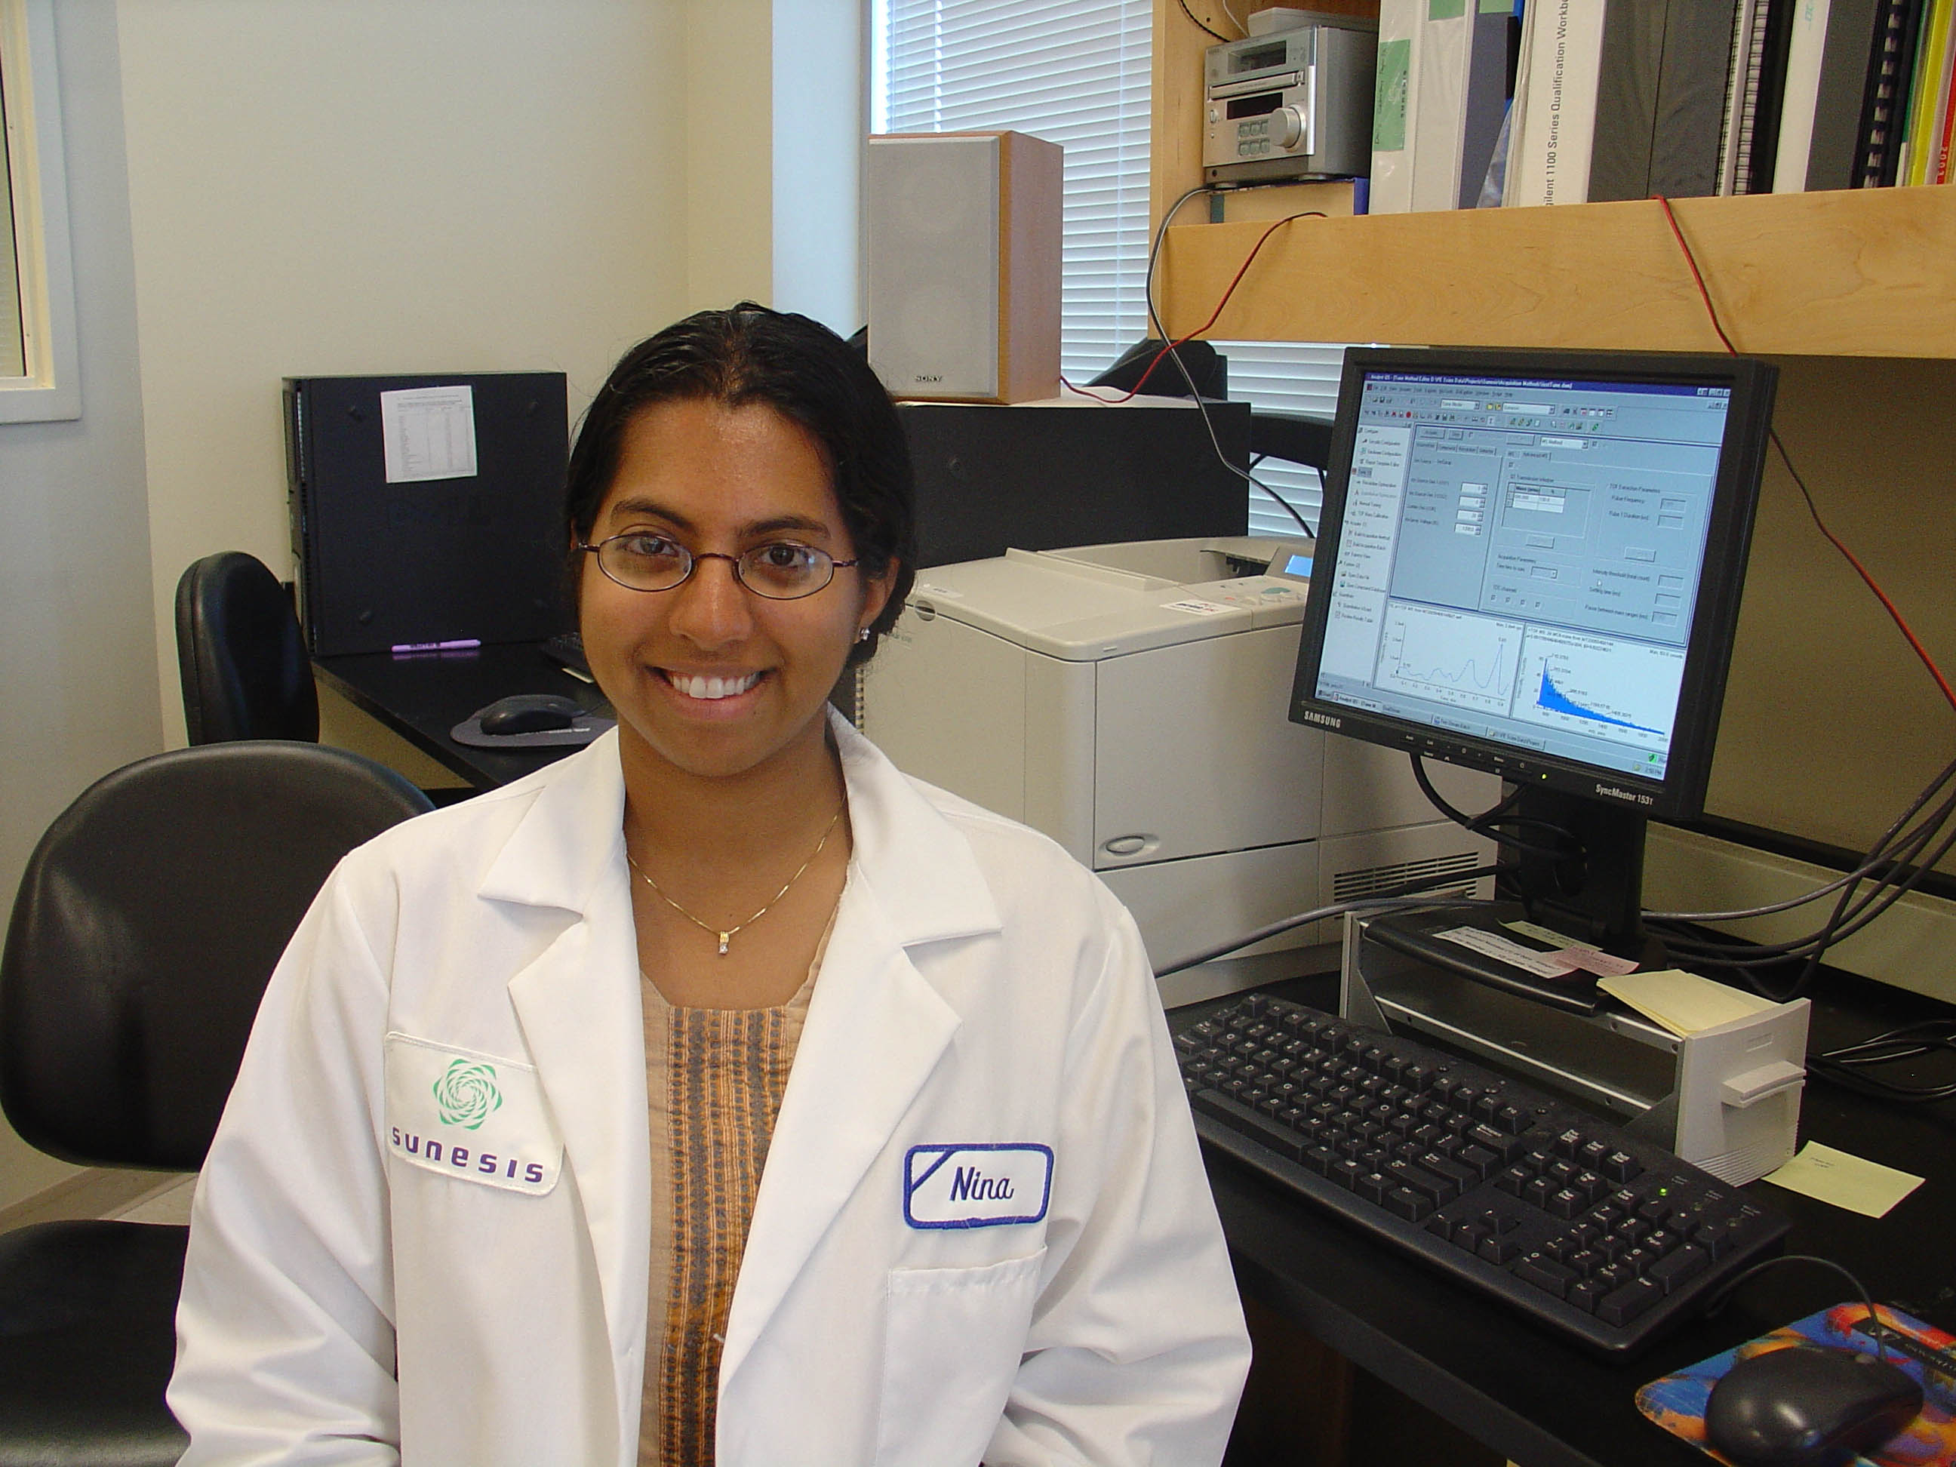
Target Student Population ?
Virtually Every Student Can Have a
Positive Biotechnology Experience
  Low-level or high-risk students?
  Middle 50% students?
  Honors students?
  All students at all levels?
  Basic English literacy required
  Some basic math required
  Some computer literacy needed
  Most important factors:
  Good work ethic
  Attention to detail
  Willingness to learn
  Good interpersonal skills
If the focus is on skill development, students at all levels can enjoy and benefit from biotech.

Slide 9

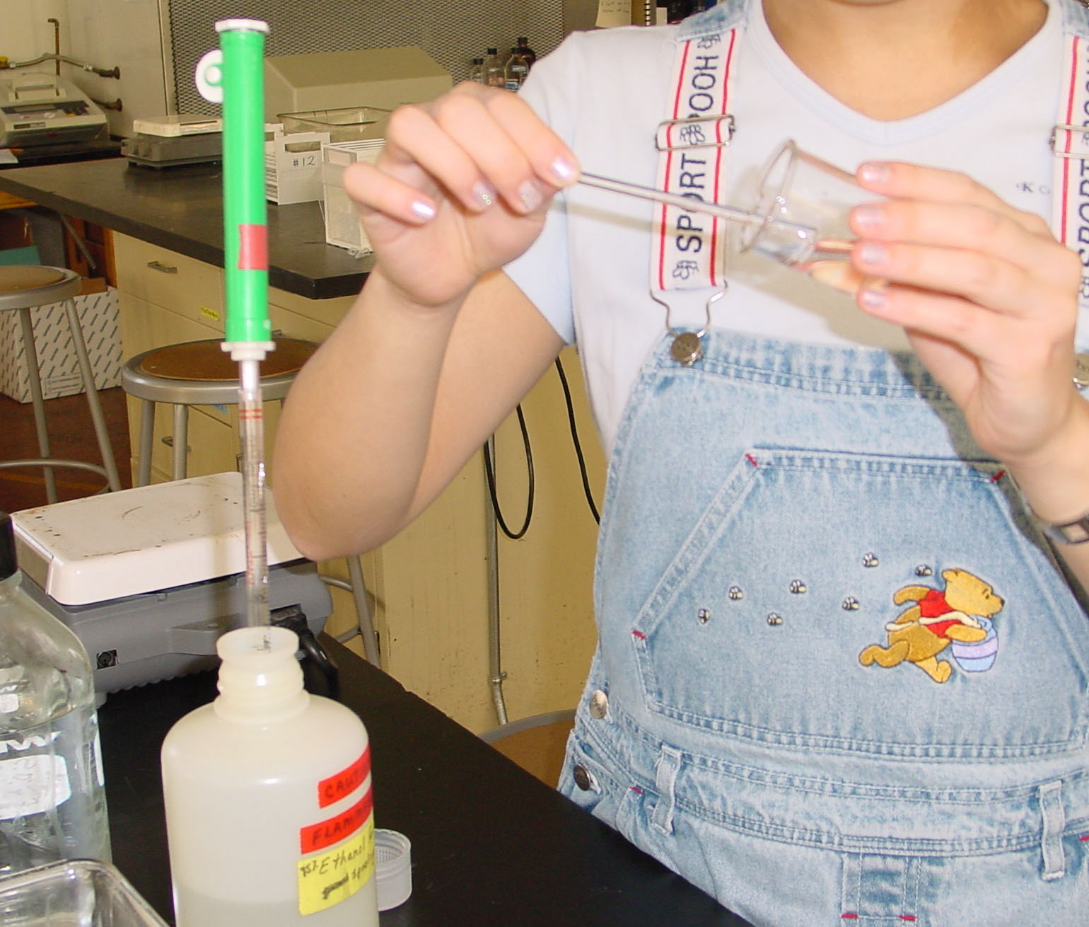
A Biotech Experience for Every Student in their 9th Grade Biology
For example, Gene Connection G=C
Started in 1992 by 3 teachers from 3 different districts
County run/implemented
30+ biotech activities/experiments
All equipment/materials provided
Comes in 30+ crates for 3-6 weeks
They provide teacher training and support
Low cost to schools, $500 for as much as needed
Our recruitment vehicle for Biotech 1-2
www.geneconnection.org

Slide 10
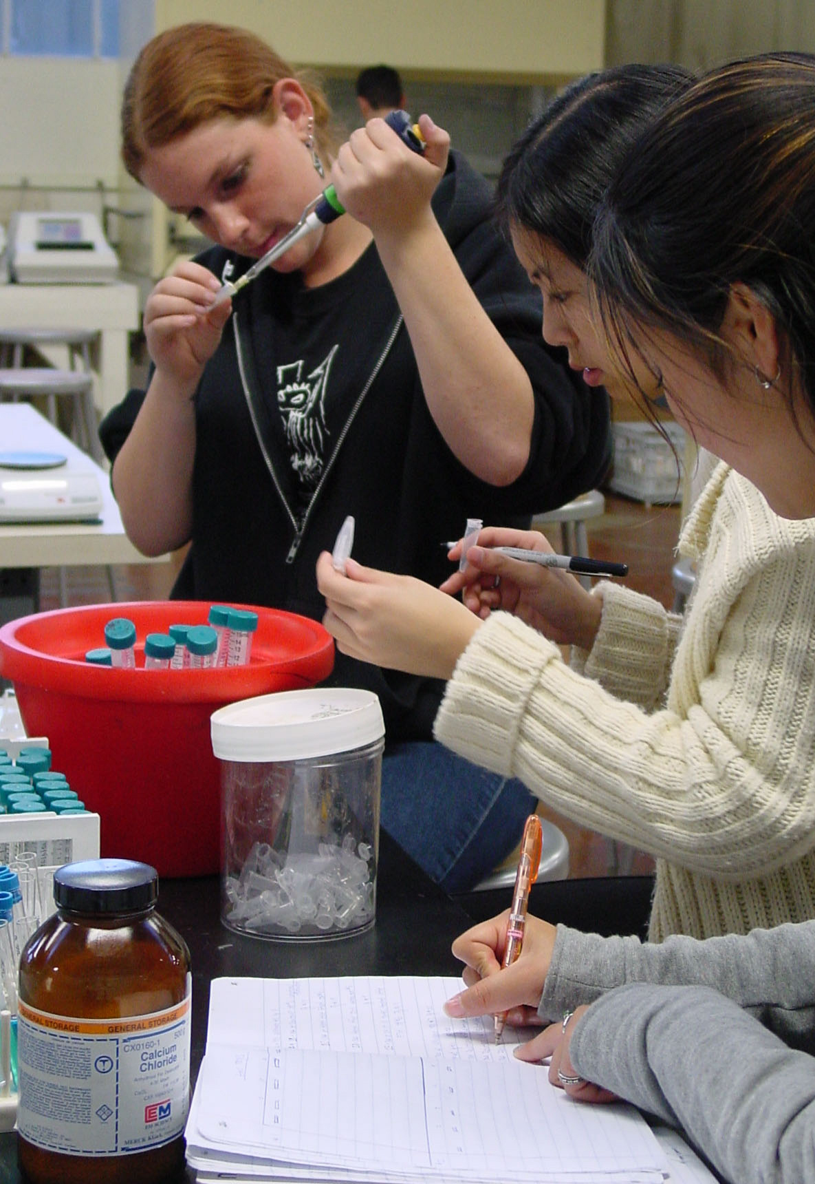
6 G=C Labs -->
The Prerequisite to SMBCP
6 G=C Labs:
Strawberry DNA Isolation and Spooling
Introduction to Micropipeting
Chemistry and Physics of a Gel Box
Running Dye Molecules on a Gel
DNA Fingerprinting Simulation/Gel
pGlo Transformation
Plus, there is an introduction to bioethics and biotechnology career exploration
But if you don’t have G=C, what can you do?

Slide 11
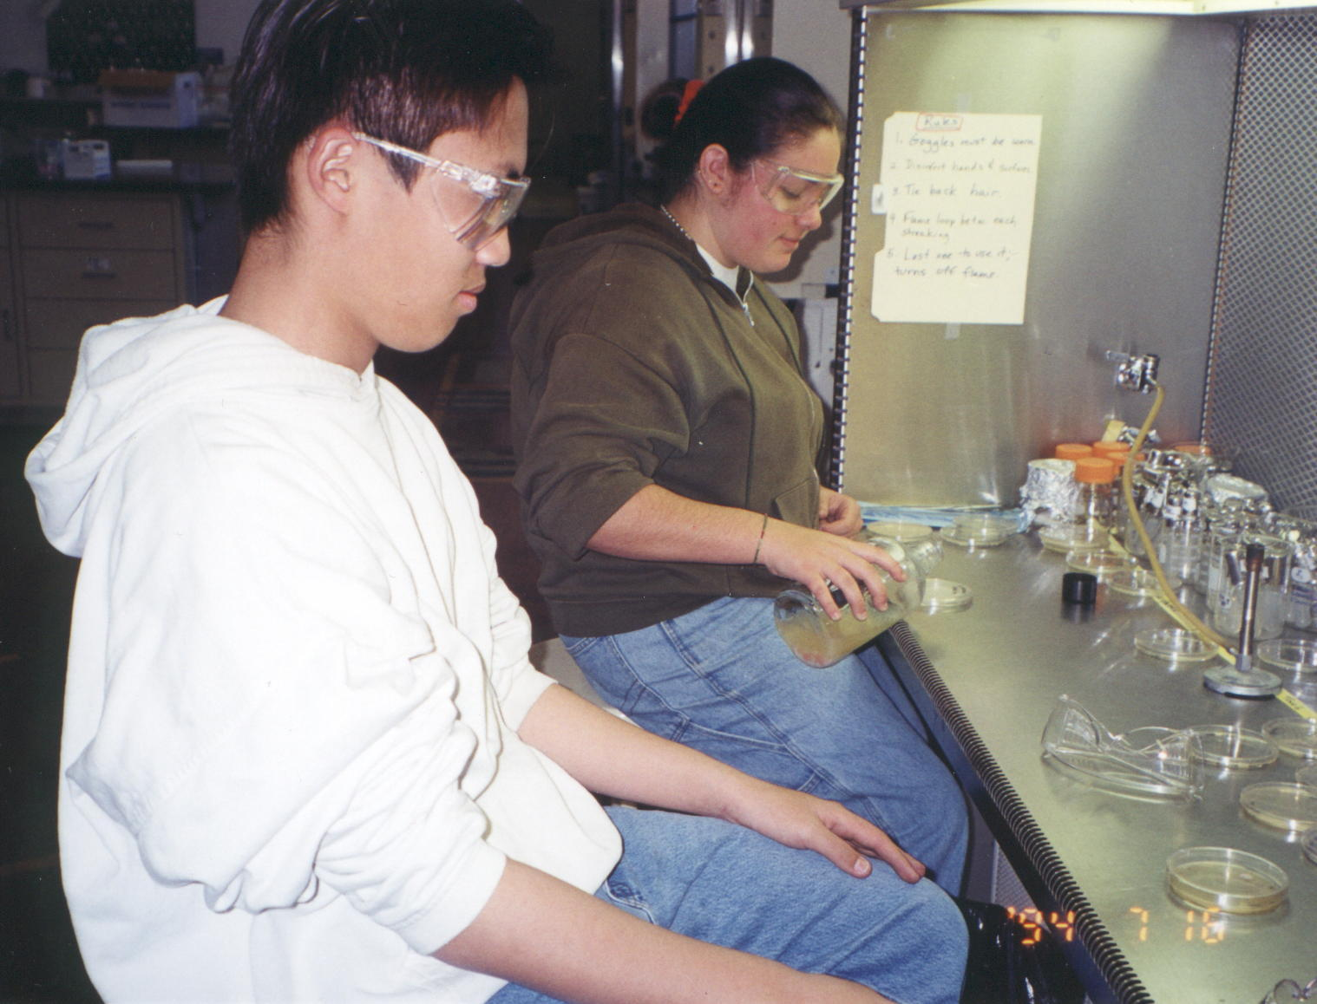
Most of these labs and other good ones are available from:
G-Biosciences
Edvotek
BioRad
Carolina Biological
Molecular Biology
Fotodyne
And several groups (Bio-Link centers, ie. Austin CC), universities (U of Houston?), and other institutions have equipment donation programs, equipment loan programs, and/or teacher professional development programs.

Slide 12
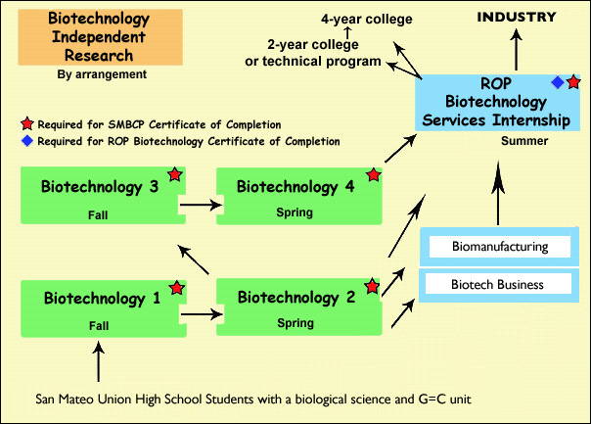
San Mateo Biotechnology Career Pathway
Required for
Certificate of Completion
Biological Science Prerequisite (G=C)
Biotechnology 1
  SLOP proficiencies
Biotechnology 2
  Modeling the production of a recombinant protein
Biotechnology 3
  Agricultural and Pharmaceutical
Biotechnology 4
  Protein and DNA Diagnostics
Biotechnology Services Internship
  Unpaid (minimum) 180 hr industry lab position
Optional:
Biotech Independent Research = Mentor-guided, independent lab research in SMBTC
Employment > about 10-20 student/year placed into part-time positions at $11-14/hr

Slide 13
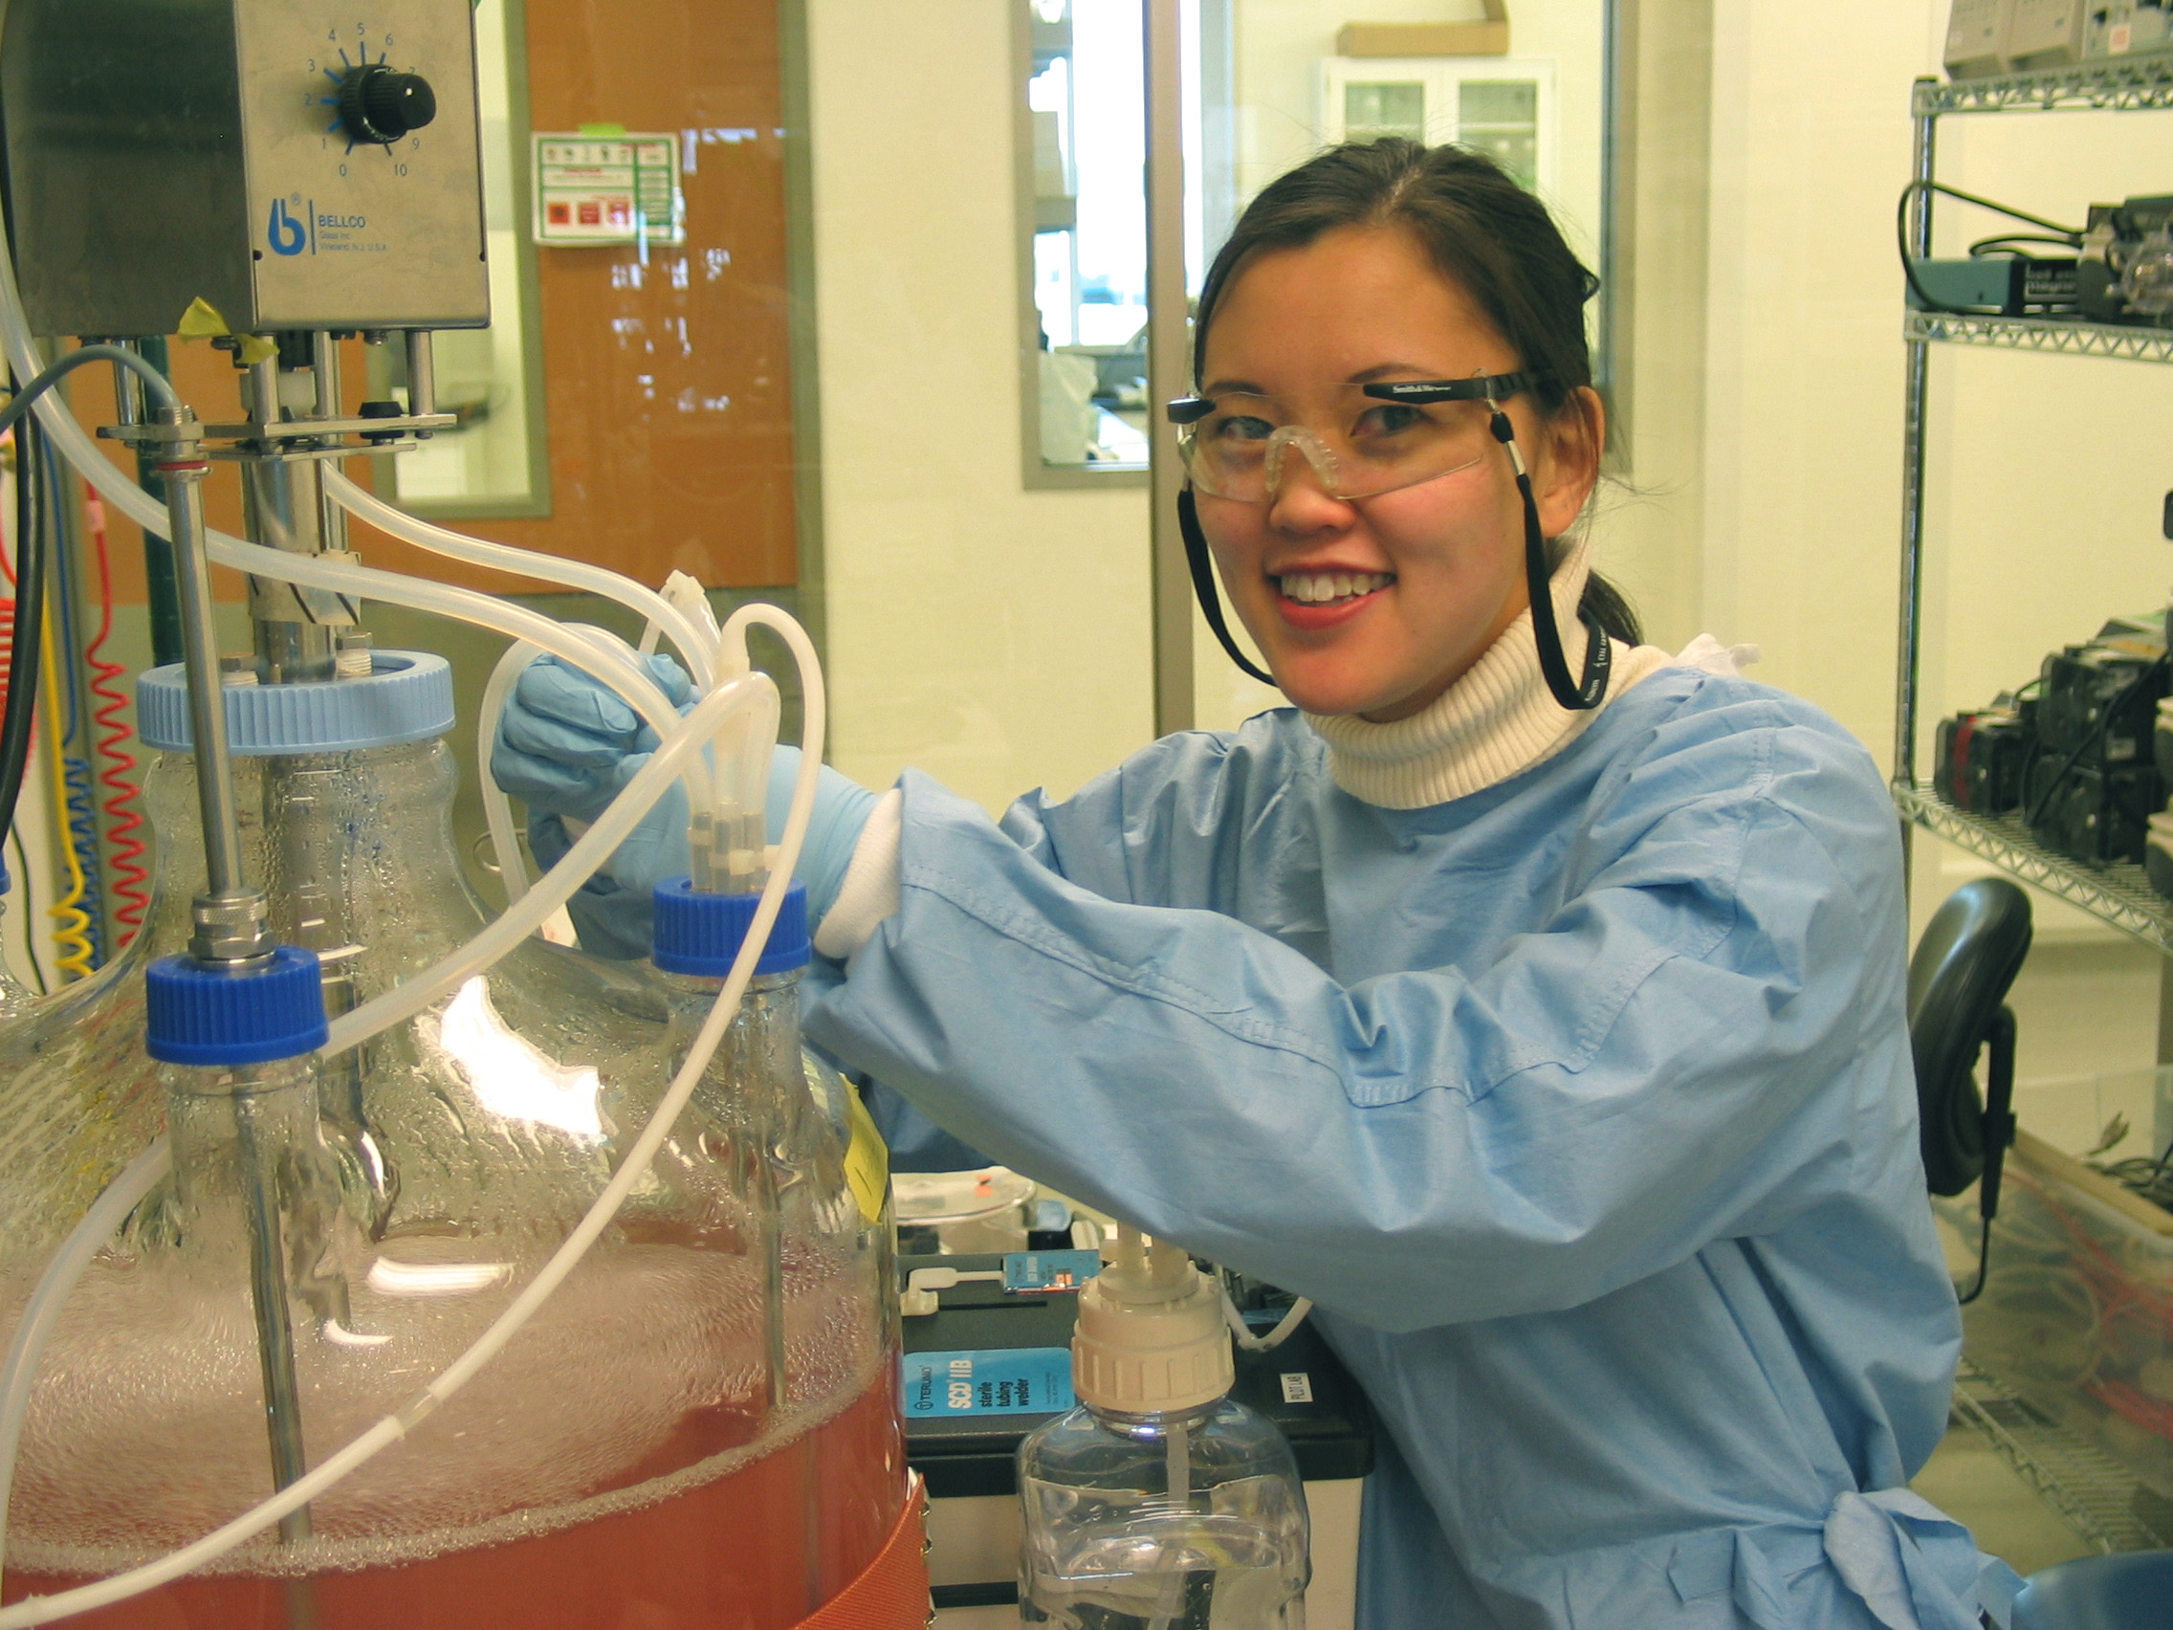
Industry Targets
College Targets
CC Technician Certificate
AA/AS Biotechnology
AA/AS Biology, Chem, etc.
BA/BS Biochem, Biotech, etc.
Academic/Gov Research
Career Titles
Pharmaceuticals/Medicine
Industrial Products
Bioinstrumentation
Agriculture
Academic/Gov/Regulatory
Scientist
Research Associate
Biotechnician (RA or Tech)
Biomanufacturing Tech
Quality Control (RA or Tech)
Lab Technician

Slide 14
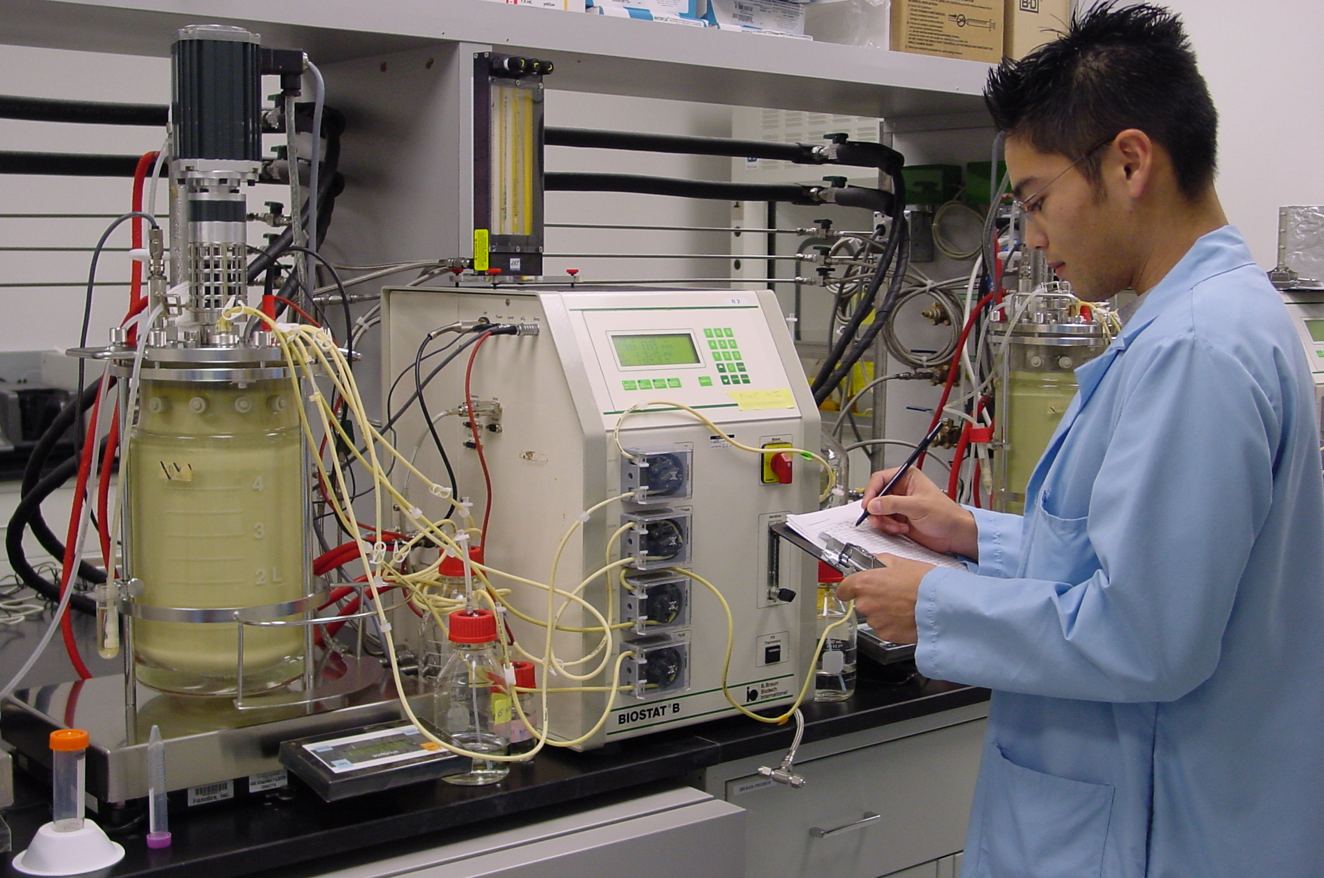
Once you know your targets you can start planning the
Kind (Scope/Sequence/Number)
of Course(s)?
        1-semester, 1-year, 2 or more years?
        Articulated with other programs?
        Concept-based vs Process-based?
        Elective, Tech-Prep, Academy, Honors, part of diploma or degree program?
It depends on the goals and objectives for your program !

Slide 15
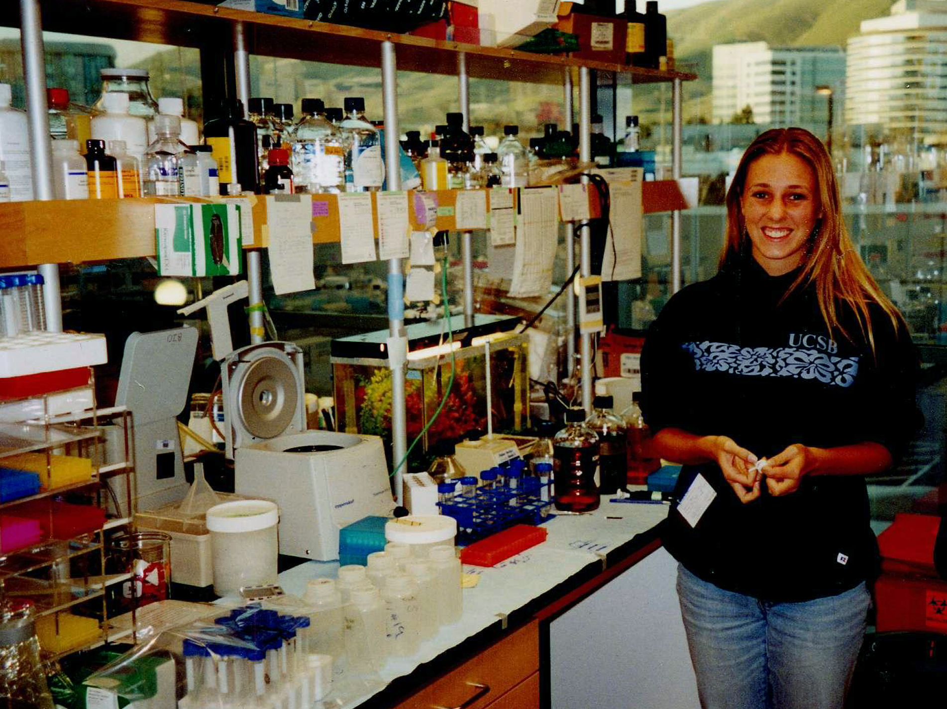
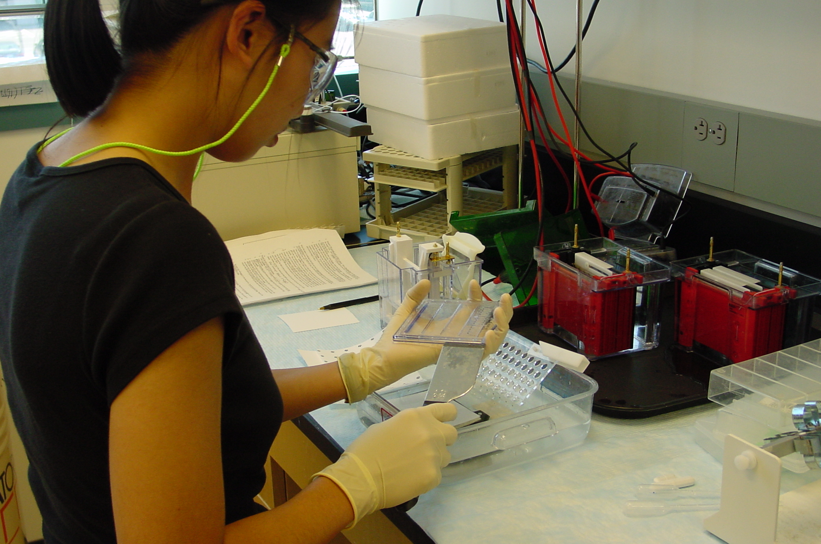
SMBCP Goals
To better prepare students for higher education?
To better prepare students for industry?
To increase scientific literacy in students?
All of the above √
Prepare a “Course of Study”
Find a curriculum that supports it.
Find suggested Course of Studies and Scope and Sequences on www.BiotechEd.com

Slide 16
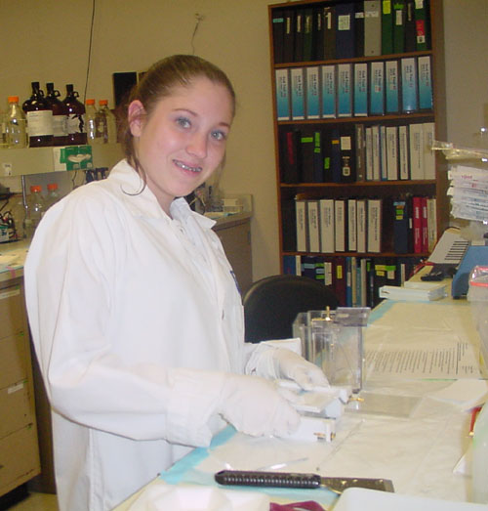
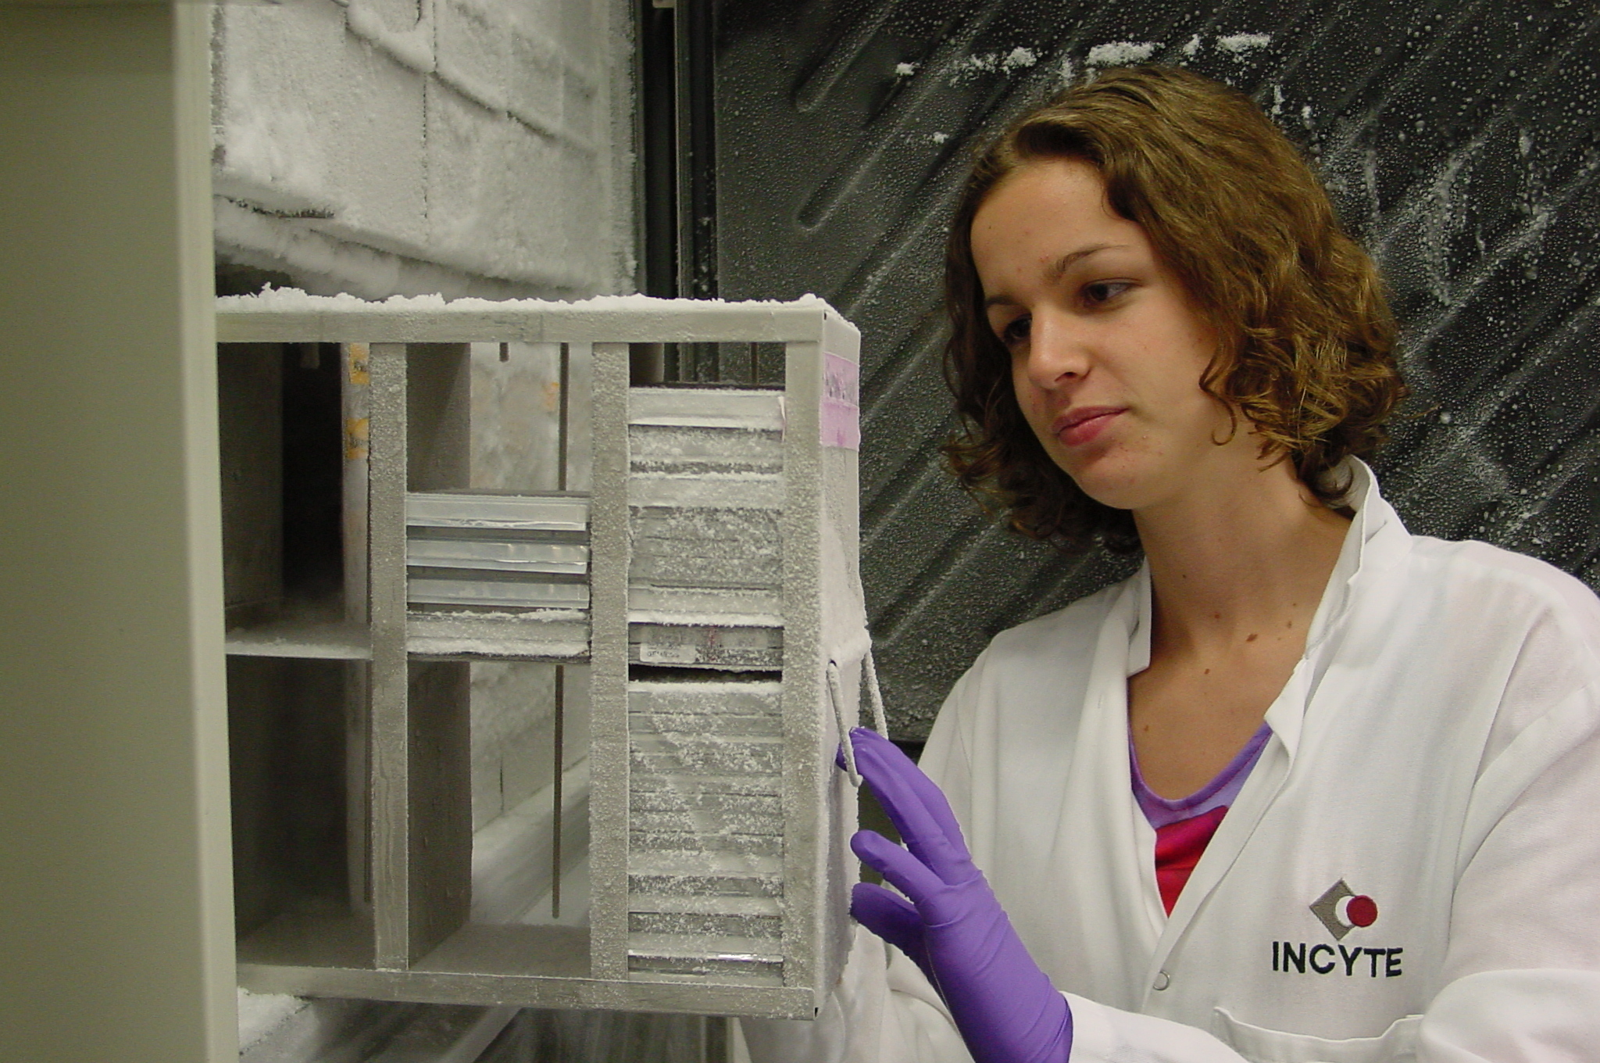
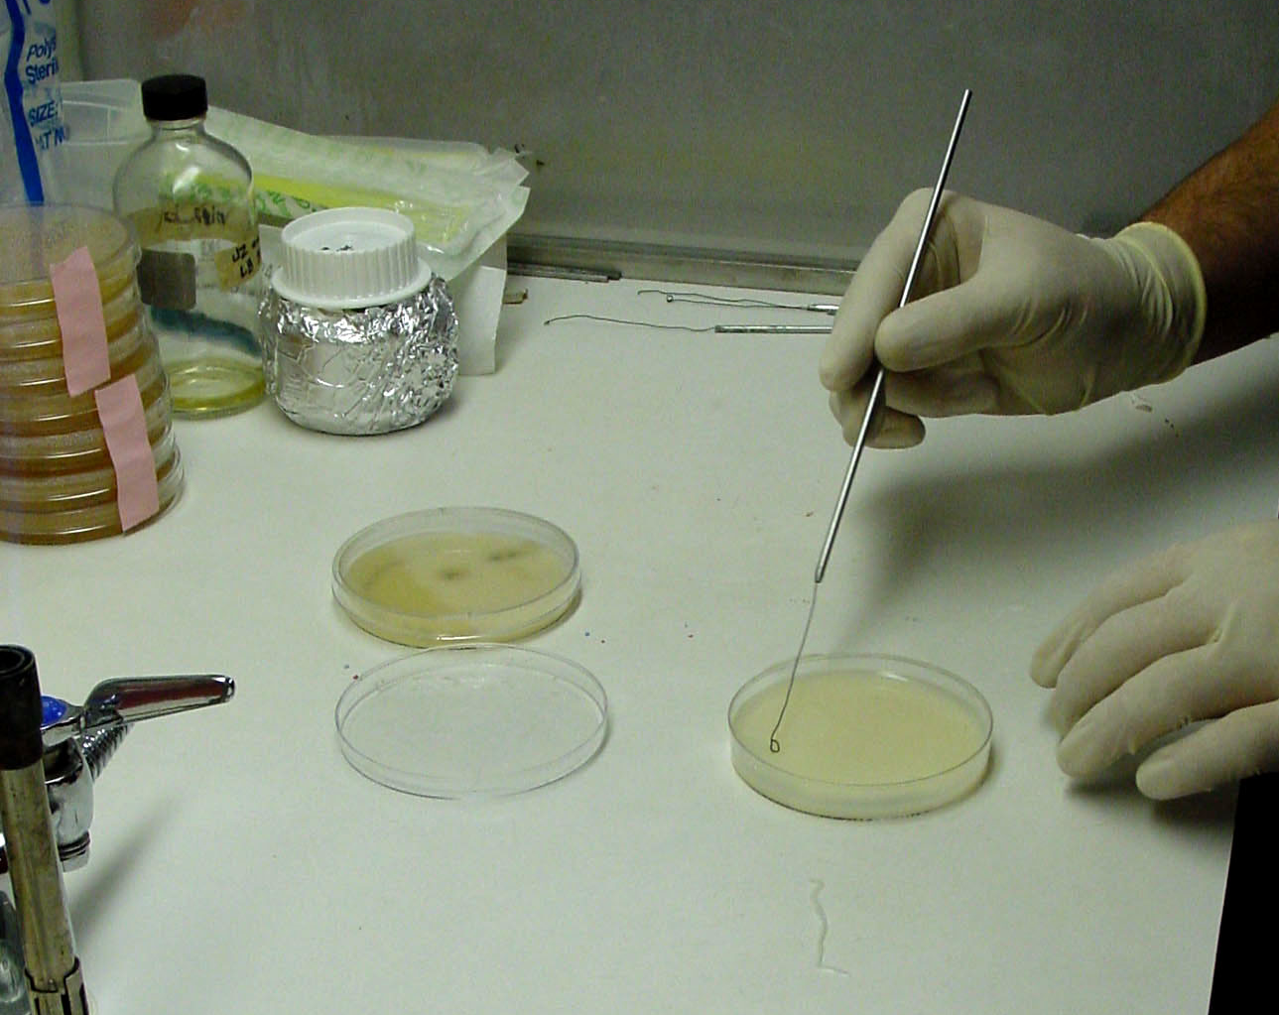
Process Development,
Concept-Supported Curriculum
For example, SMBCP =
Biotech 1 (Ch 1-5) = SLOP proficiencies
Biotech 2 (Ch 6-9) = Recombinant Protein Production
Biotech 3 (Ch 10-12) = Agriculture and Pharma Biotech
Biotech 4 (Ch 13-14) = Protein and DNA Diagnostics
Biotech Internship = Unpaid, 180 hr, industry lab
Biotech Independent Research = optional
All courses included career exploration and workplace experiences.

Slide 17
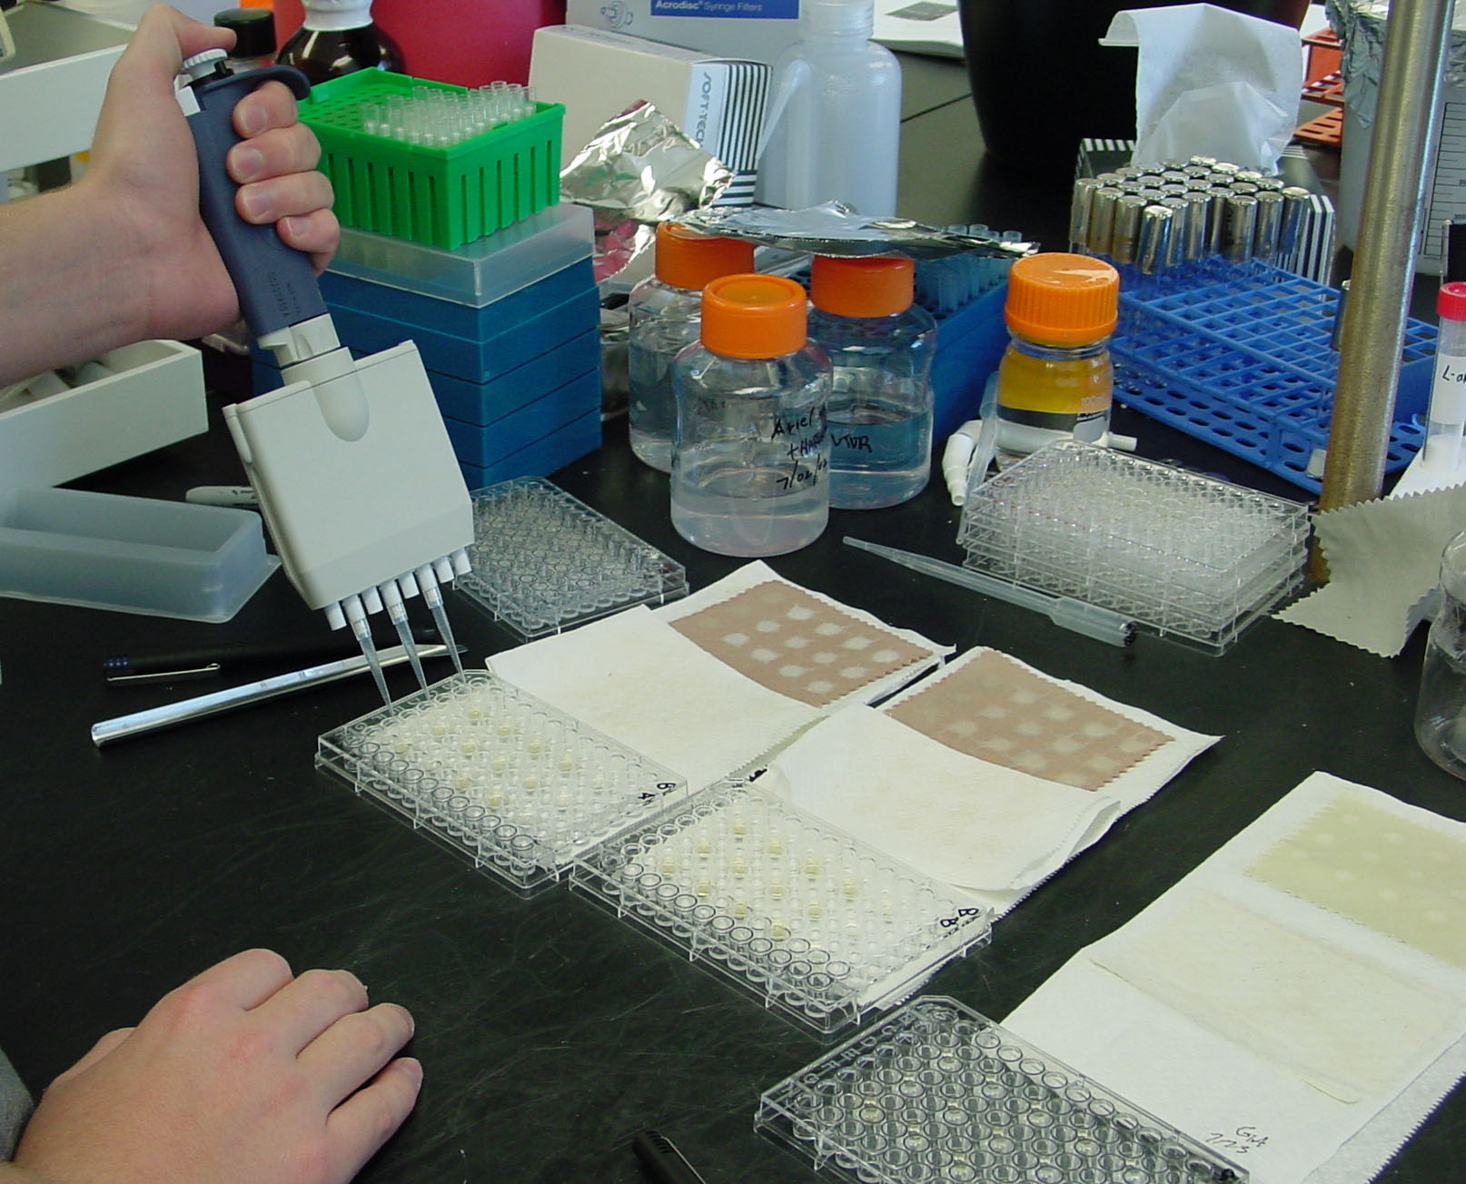
Increasing Skill Development and Workplace Experiences
SLOP Training/Skills Tests
Career Exploration in Text
Authentic Assessment
Company/Stock Projects
Guest Speakers
Field Trips
Career Project/Site Visits
Job Shadows
Laboratory Internships
Independent Research Projects
Employment
Check out “BiotechBeyondClassroom.ppt” from www.BiotechEd.com

Slide 18
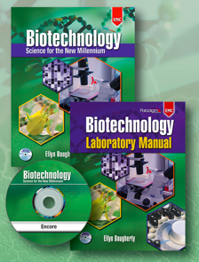
I needed Curricular Materials to Support the Biotech Pathway’s Skill Development and Career Exploration !?!
There weren’t any appropriate for our goals and objectives, so I wrote them…
Comprehensive text with concepts that support scientific process, skill development, and career exploration
Lab manual that focuses on skill development and demonstration of proficiencies
Student CD with lab skill review and remediation.
2 Instructor’s Guides (IG and CP)
Publisher’s Internet Resource Center
www.emcp.com/biotech
Take a tour through the entire curriculum at www.BiotechEd.com

Slide 19
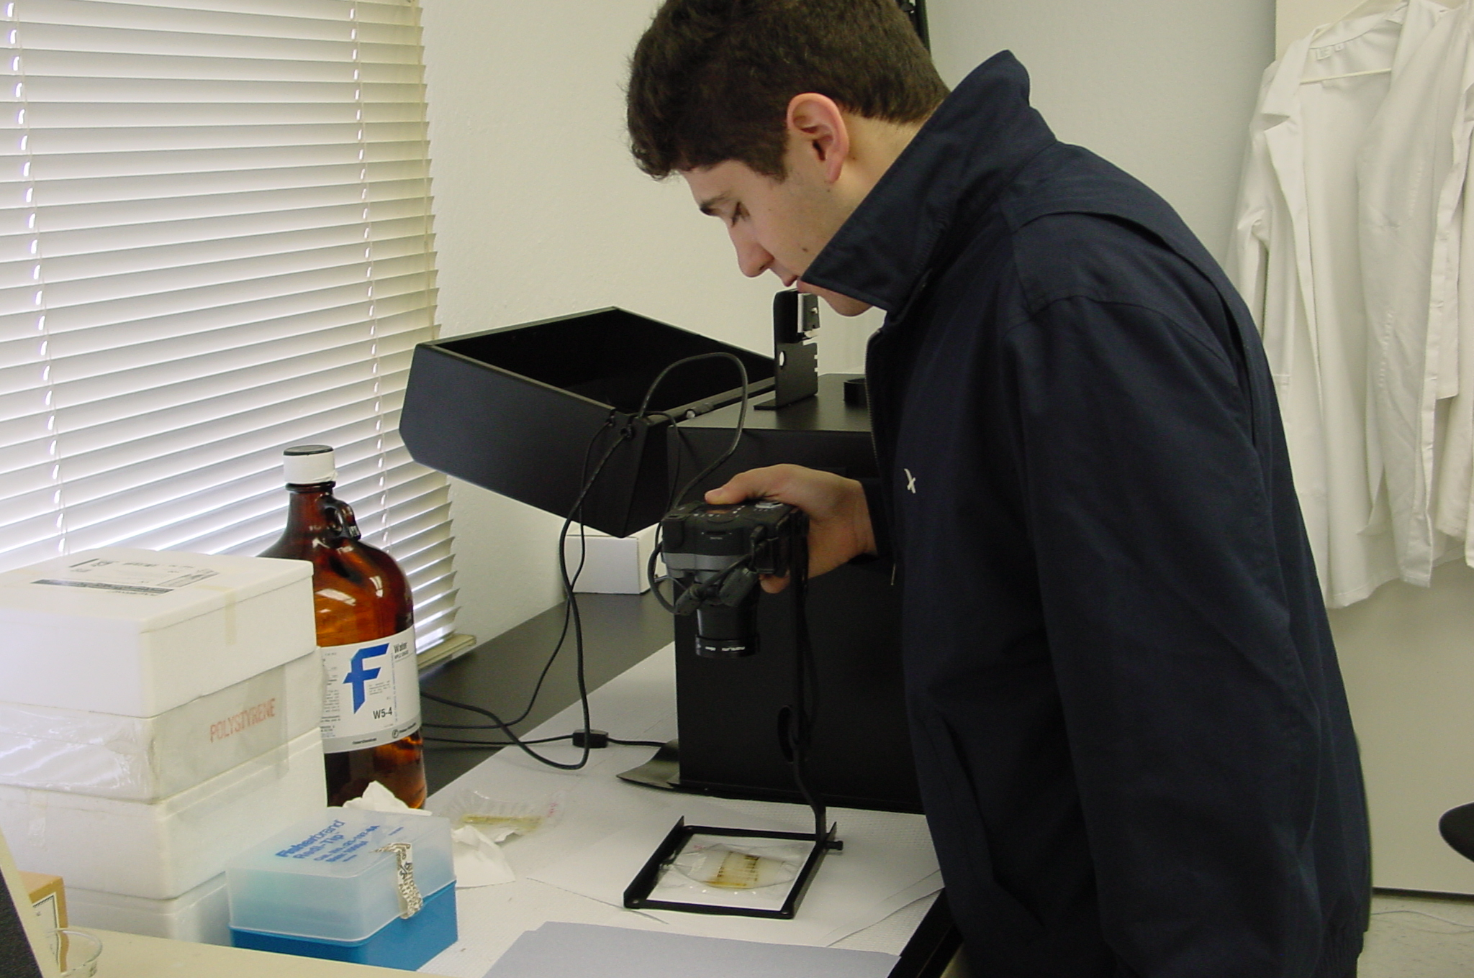
Additional Curricular Support
Biotechnology: Science for the New Millennium
Ellyn Daugherty, EMC-Paradigm
Introduction to Biotechnology, Thieman & Pallandino, Benjamin Cummings
Recombinant DNA and Biotechnology: A Guide for Teachers & Students, Kreuzer & Massey, ASM
DNA Science: A First Course in Recombinant DNA Technology, Micklos & Freyer, Cold Springs Harbor
Basic Laboratory Methods for Biotechnology, Seidman, Prentice Hall
And more:
Biotech Education Groups (Workshops)
  County (Gene Connection, SCCBEP, EBBEP, SFBase, Probe, etc.)
  Regional (CAST***, Bio-Link Centers, Dolan DNA Learning Center***, BayBio, etc)
  CC/University (Austin CC***, Bio-Link CC Day/BIO, Access Excellence, BIO, Bio-Link Forum, etc.)
  National (NSTA, NABT, Bio-Link***, www.dnalc.org , BIO, SMBCP***, etc.)
Vendor websites and/or workshops
  - G-Biosciences’, Carolina Biological, Fotodyne, Edvotek, Sigma, BioRad, etc.)

Slide 20
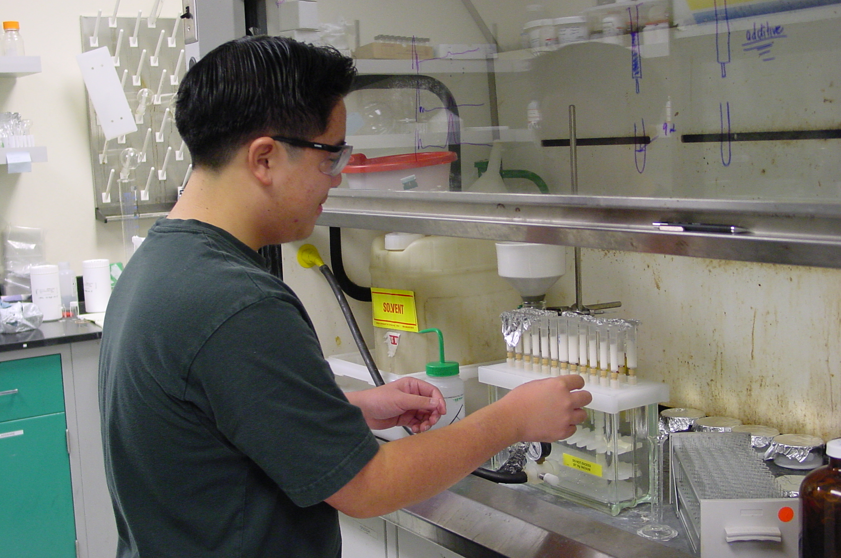
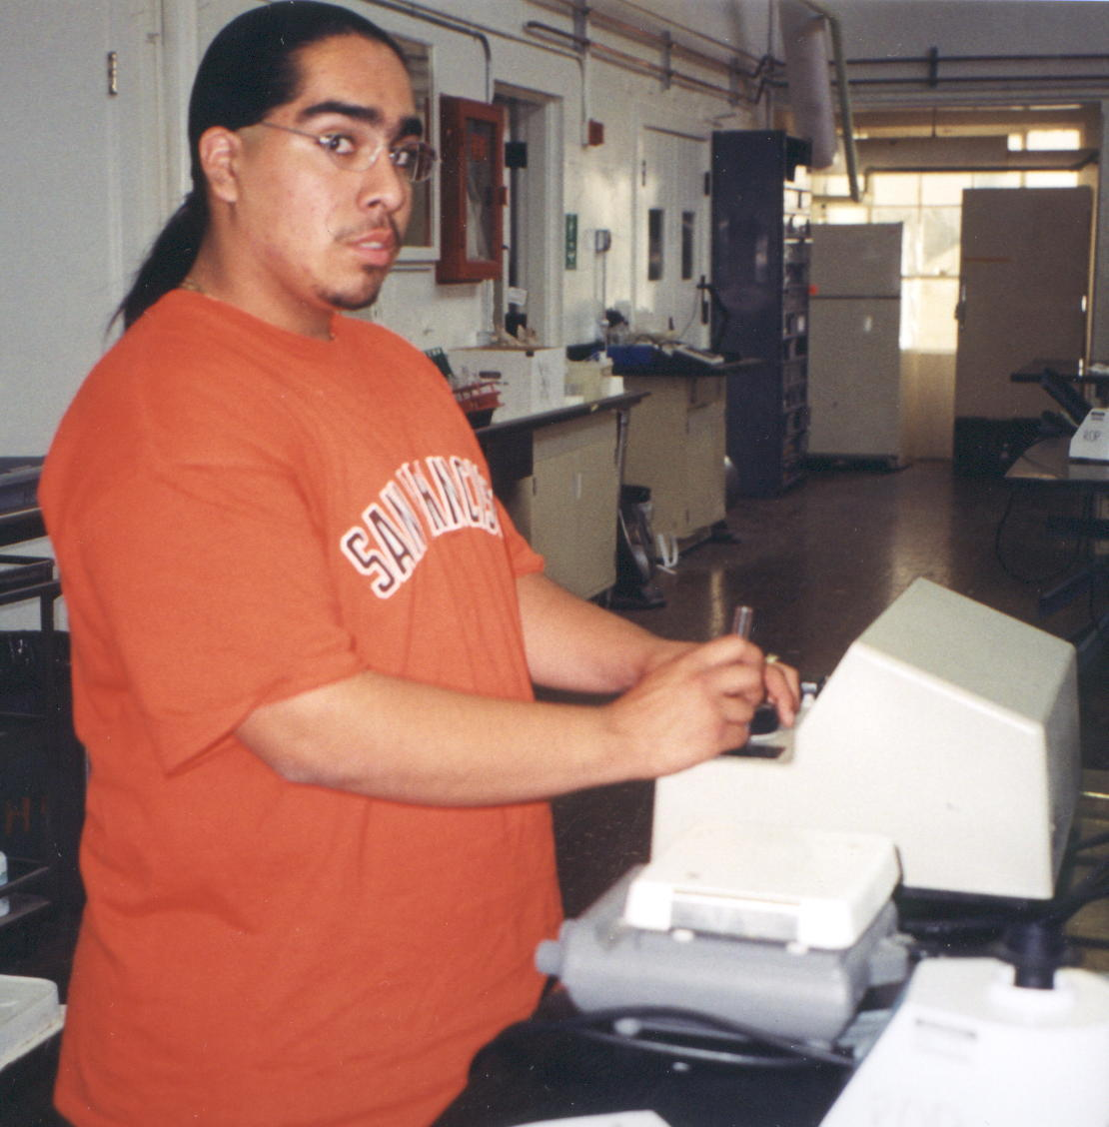
What Kind of Support Is Needed?
Financial
  Books, Lab Manuals, CDs, etc.
  Equipment/Supplies
  Computers
  Release Time, Field Trip $
Curriculum
  Books, Lab Manuals, CDs, etc.
  Lab Facility
  Workplace Experiences
Moral
  Reasonable expectations from Admin
  From Counseling, Clerical, and Admin
  Designated Classroom
  Reasonable amount of Preps
  Reasonable amount of Students
  Reasonable Budget

Slide 21
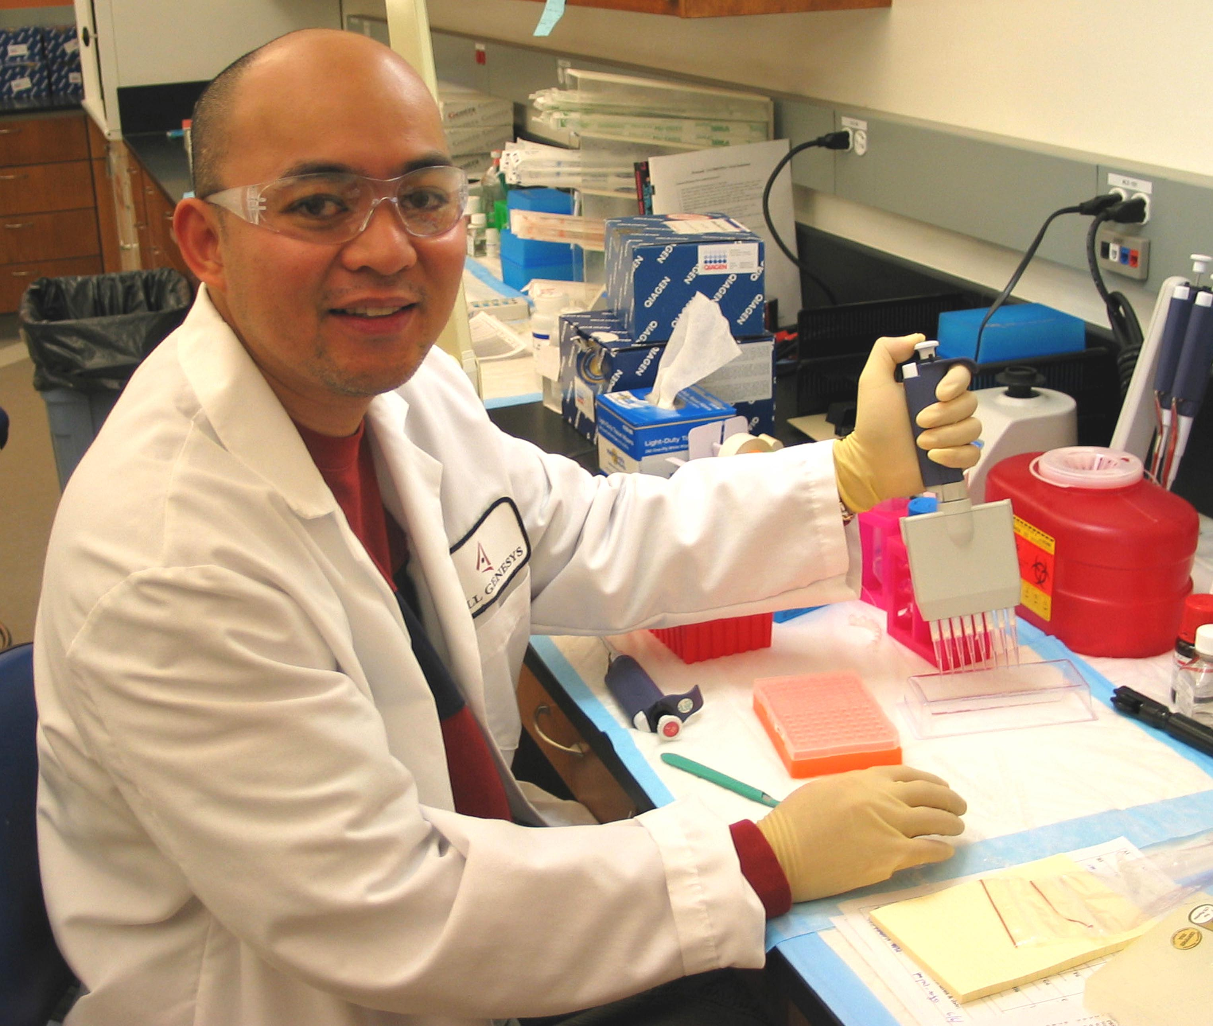
Set-up an Advisory Committee
An Advisory Committee can help identify the needs, in regards to biotech education, of the student population and the local community.
An Advisory Committee might include supportive people from the following areas:
1-2 more science teachers
1-2 teachers of other disciplines
1-2 instructors from CC programs
2-3 students
Counselor(s)
Site Administrator (Principal or AP)
District Administrator
1-2 Parents (PTA/PTO/Booster)
2-4 Industry Members (RAs, Scientists, HR, Administration)
2-3 Business Community (Rotary, Chamber of Commerce, etc.)
Other related Community Members (Police, Forensic Scientists)

Slide 22
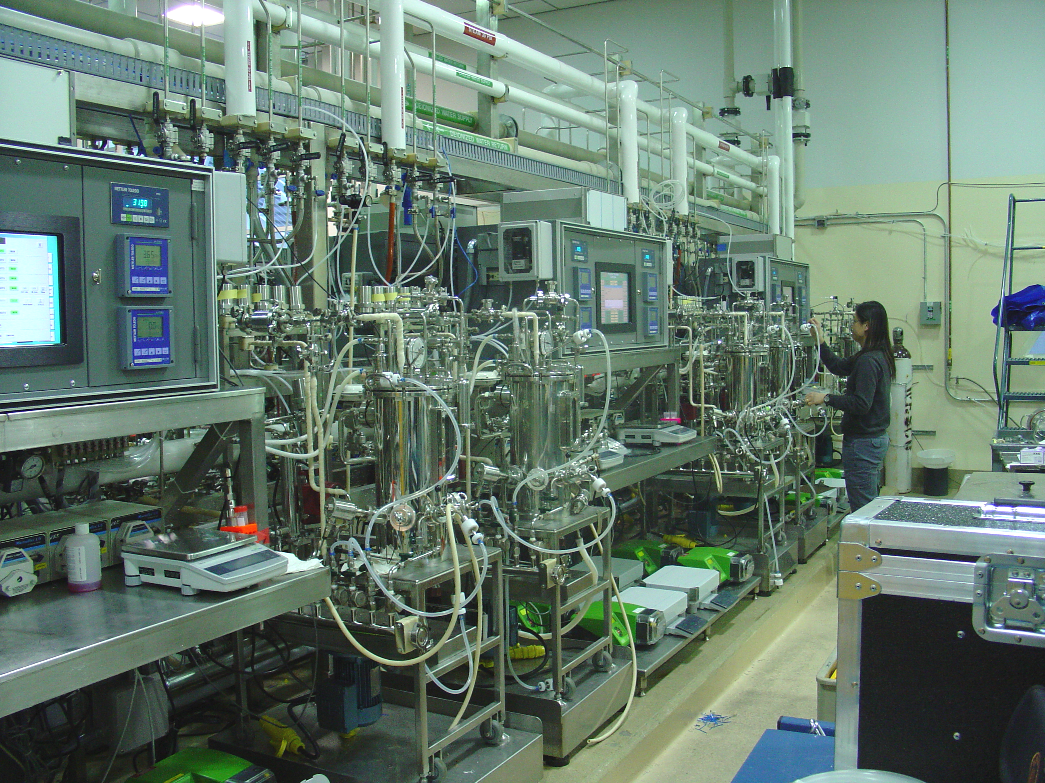
Potential Partners/Internship Sites
Corporate/Industry Labs (large and small)
  Pharmaceuticals R&D, Manufacturing, QC
  Industrial R&D, Manufacturing, QC
  Instrumentation R&D, Manufacturing, QC
  Greenhouses
Government Funded Agencies/Labs
  US Fish & Wildlife
  County/City Forensics
  NIH, Salk, Scripps
  DOE
  State Division of Forestry
Academic Labs
  University/College Labs
  Medical Schools
  Dental Schools
Medical Facilities
  Hospitals
  Clinical Labs
  Pharmacies

Slide 23
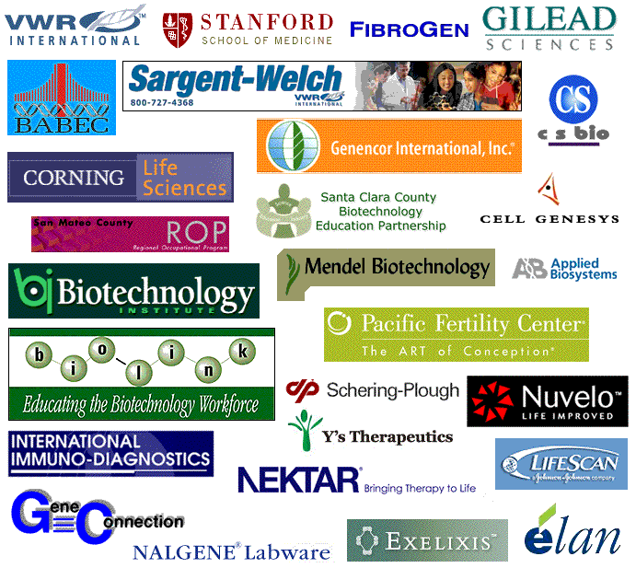
Academic and Industry Partners

Slide 24
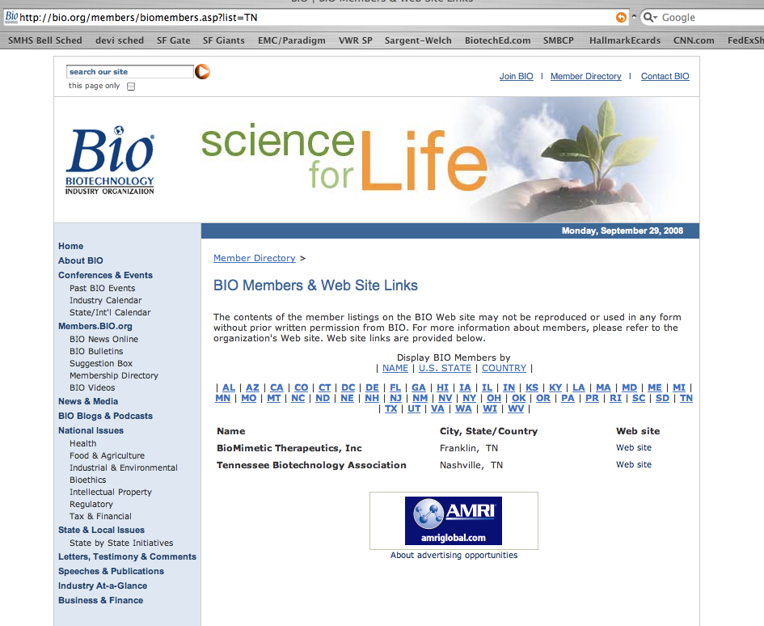
To Find Biotechnology Institutions in Your Area: go to www.bio.org

Slide 25
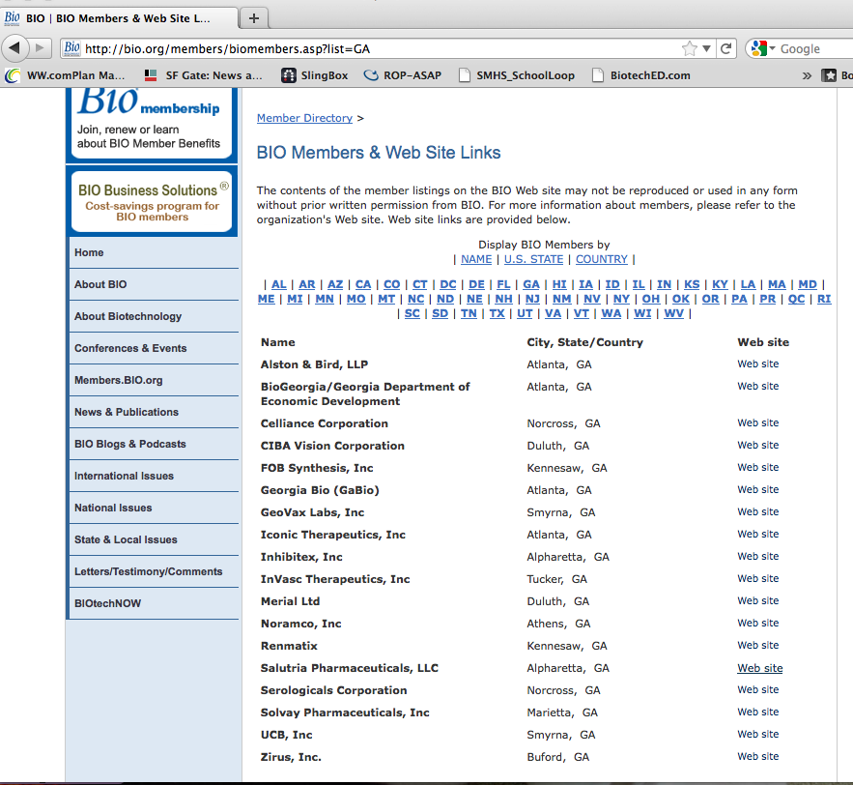
For Example: Georgia…
http://www.bio.org, click on Members Directory, click on “By US State”
About 20 companies/facilities

Slide 26
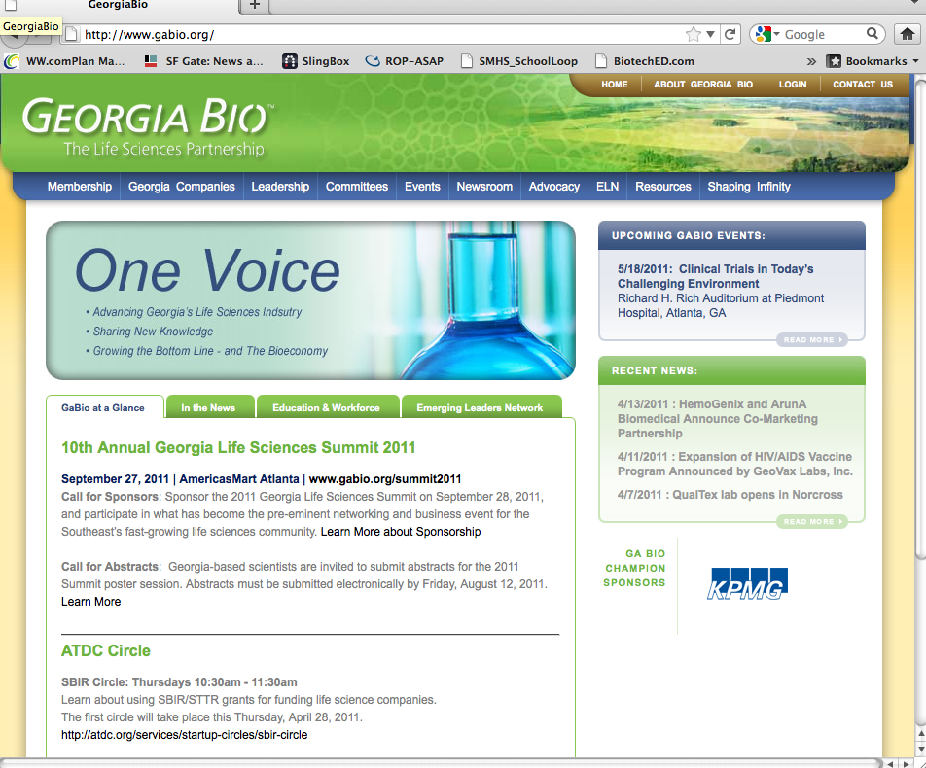
Georgia BIO
www.gabio.org

Slide 27
$ Bucks for Biotech $
National
  SEPA Program Science Education Partnership Award funds grants for innovative educational programs.
  Carl Perkins Vocational and Technical Education Act
State/Regional
  Impact Program University of West GA
  Northwest GA Math/Science Education Partnership– for Teacher Prof Development
Corporate/Private
  Motorola Foundation $3.5 million in Innovation Generation Grants - for innovation STM courses/programs
  Tyco Electronics (an ADC company in S. GA) math and science education
Foundations
  Sid W. Richardson Foundation The Sid W. Richardson Foundation provides grants to nonprofit organizations in Texas primarily in education, healthcare, human services, and the arts.
  The Dana Center The Dana Center supports K–12 teachers and leaders working to implement high academic standards for all students.
Small Businesses
  Environmental Labs, Medical Offices, Dental Offices, Biotech Law

Slide 28
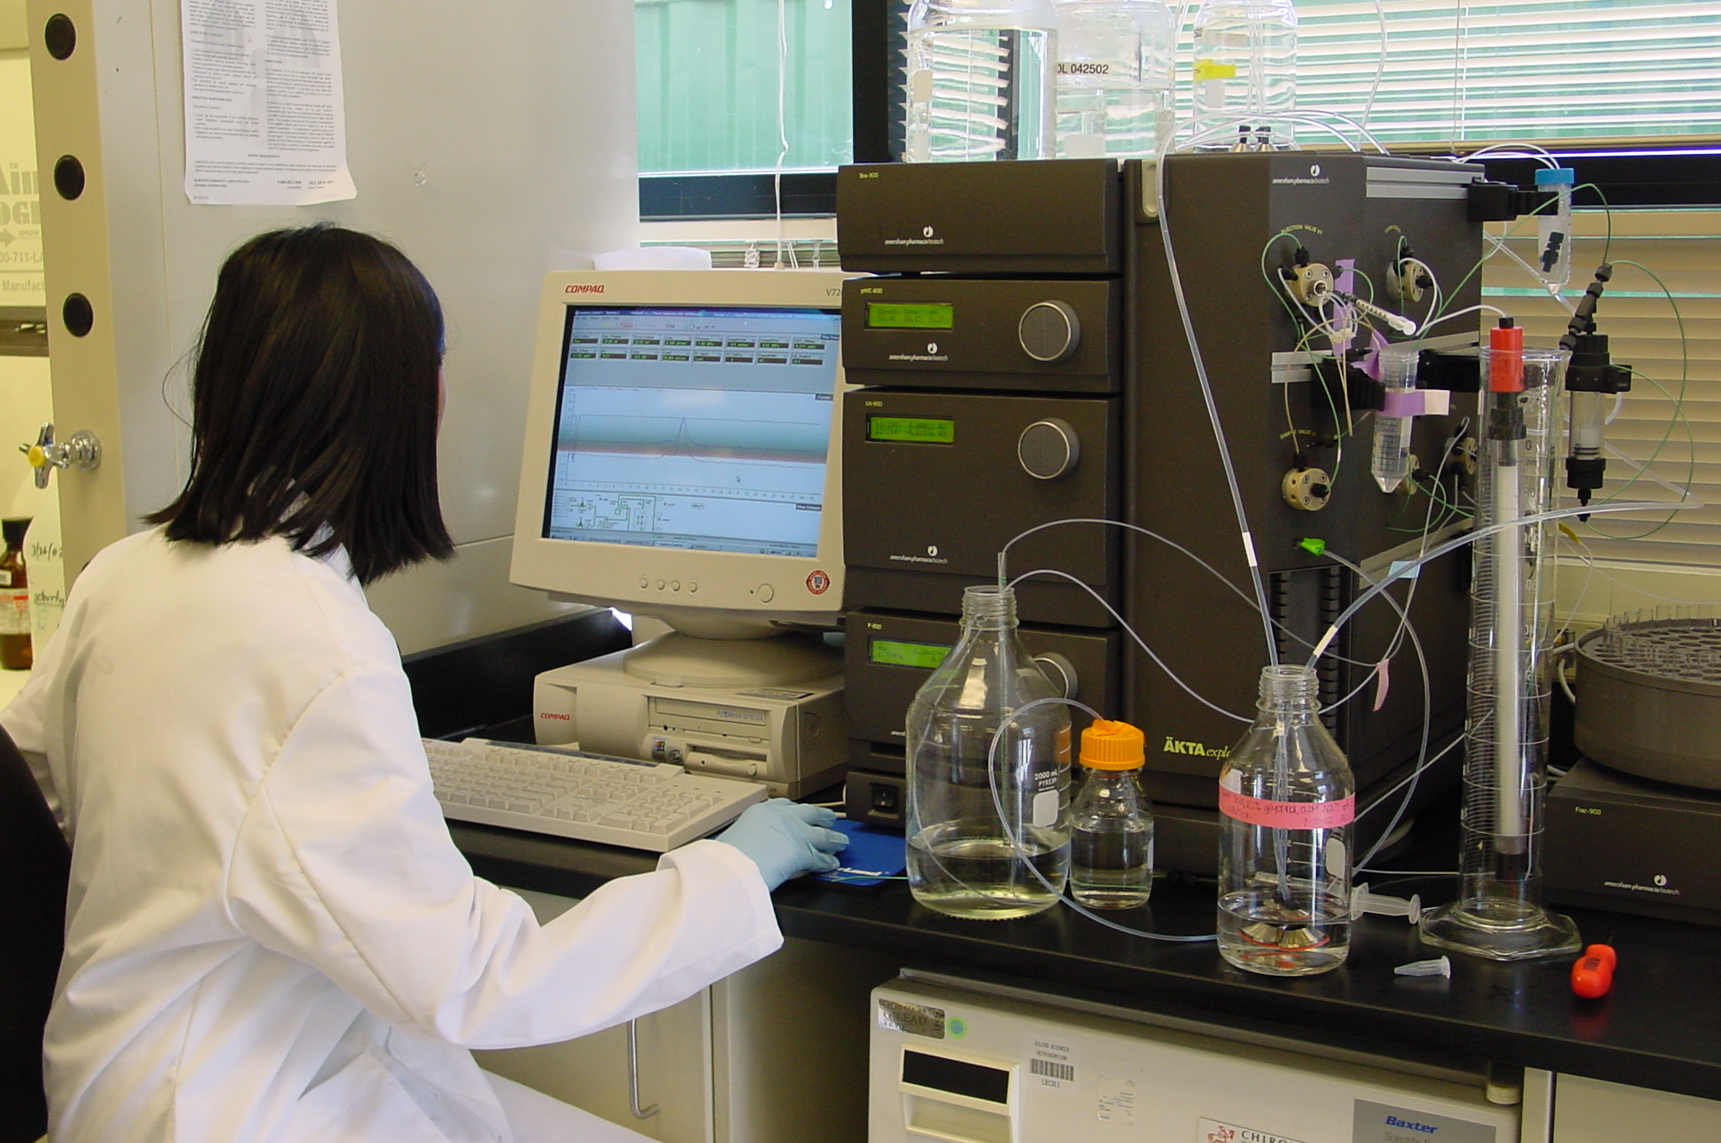
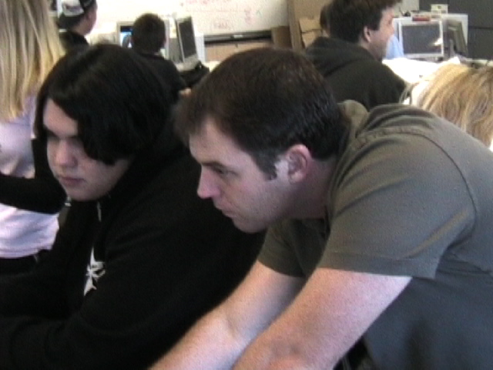
Other Issues?
Where will Biotech be taught?
”designated space”
sharing of rooms discouraged
with enough room for storage
with computer access
How will you recruit students?
start with Biology, Life Science, Applied Bio, etc.
Who will teach Biotech at your site?
an enthusiastic teacher
willing to learn but
“no experience needed”
What will be the Timeline for Implementation?
be reasonable, it takes time to do all of this and gain experience

Slide 29
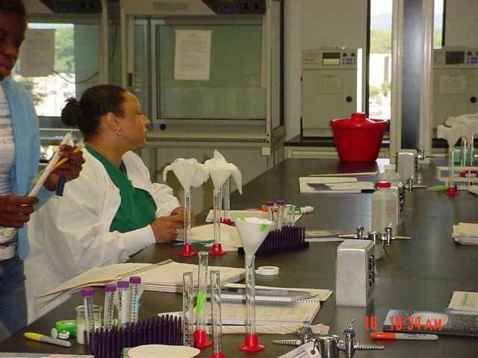
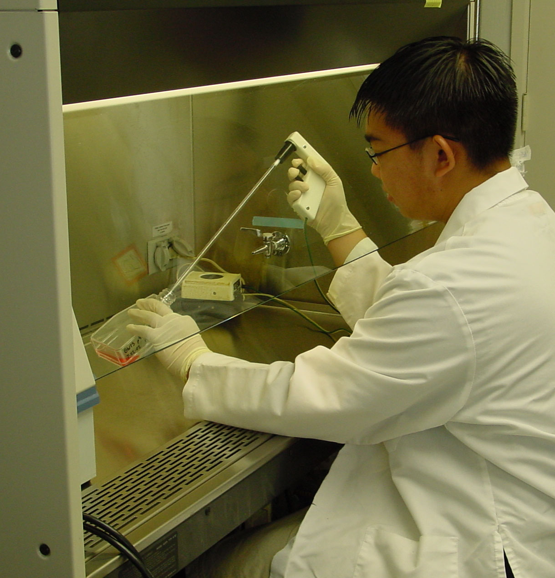
Biotechnology Training Facility
Almost any room can be converted to a lab room training facility
Need lots of table top/counter tops, electricity, and computers
Need water/sinks on one wall
Need gas line (methane) on one wall
Resin top lab table where fire or caustic chemicals are used, Trespa® on lab stations and counters
Enough room for storage of glass, plastics, chemicals, equipment
Use several lab refrigerators and
-20°C freezers (under counter models)
See www.fisfersci.com, gbiosciences.com, for materials lists & www.BiotechEd.com for Lab Planning PPT

Slide 30
Recruiting Students into the Program
Target Student Population ?
  Age - Adults? Teenagers?
  Academic Level- University bound? Technician bound? Honors students? Middle 50% students?
  Socioeconomic - Low level? High risk students? Advantaged?
Will There Be Prerequisites?
None?
Biology/Life Science?
Chemistry? Math? English? Computers?
How will they know they want Biotech?
PR, Information Dissemination?
Recruitment Strategies?

Slide 31
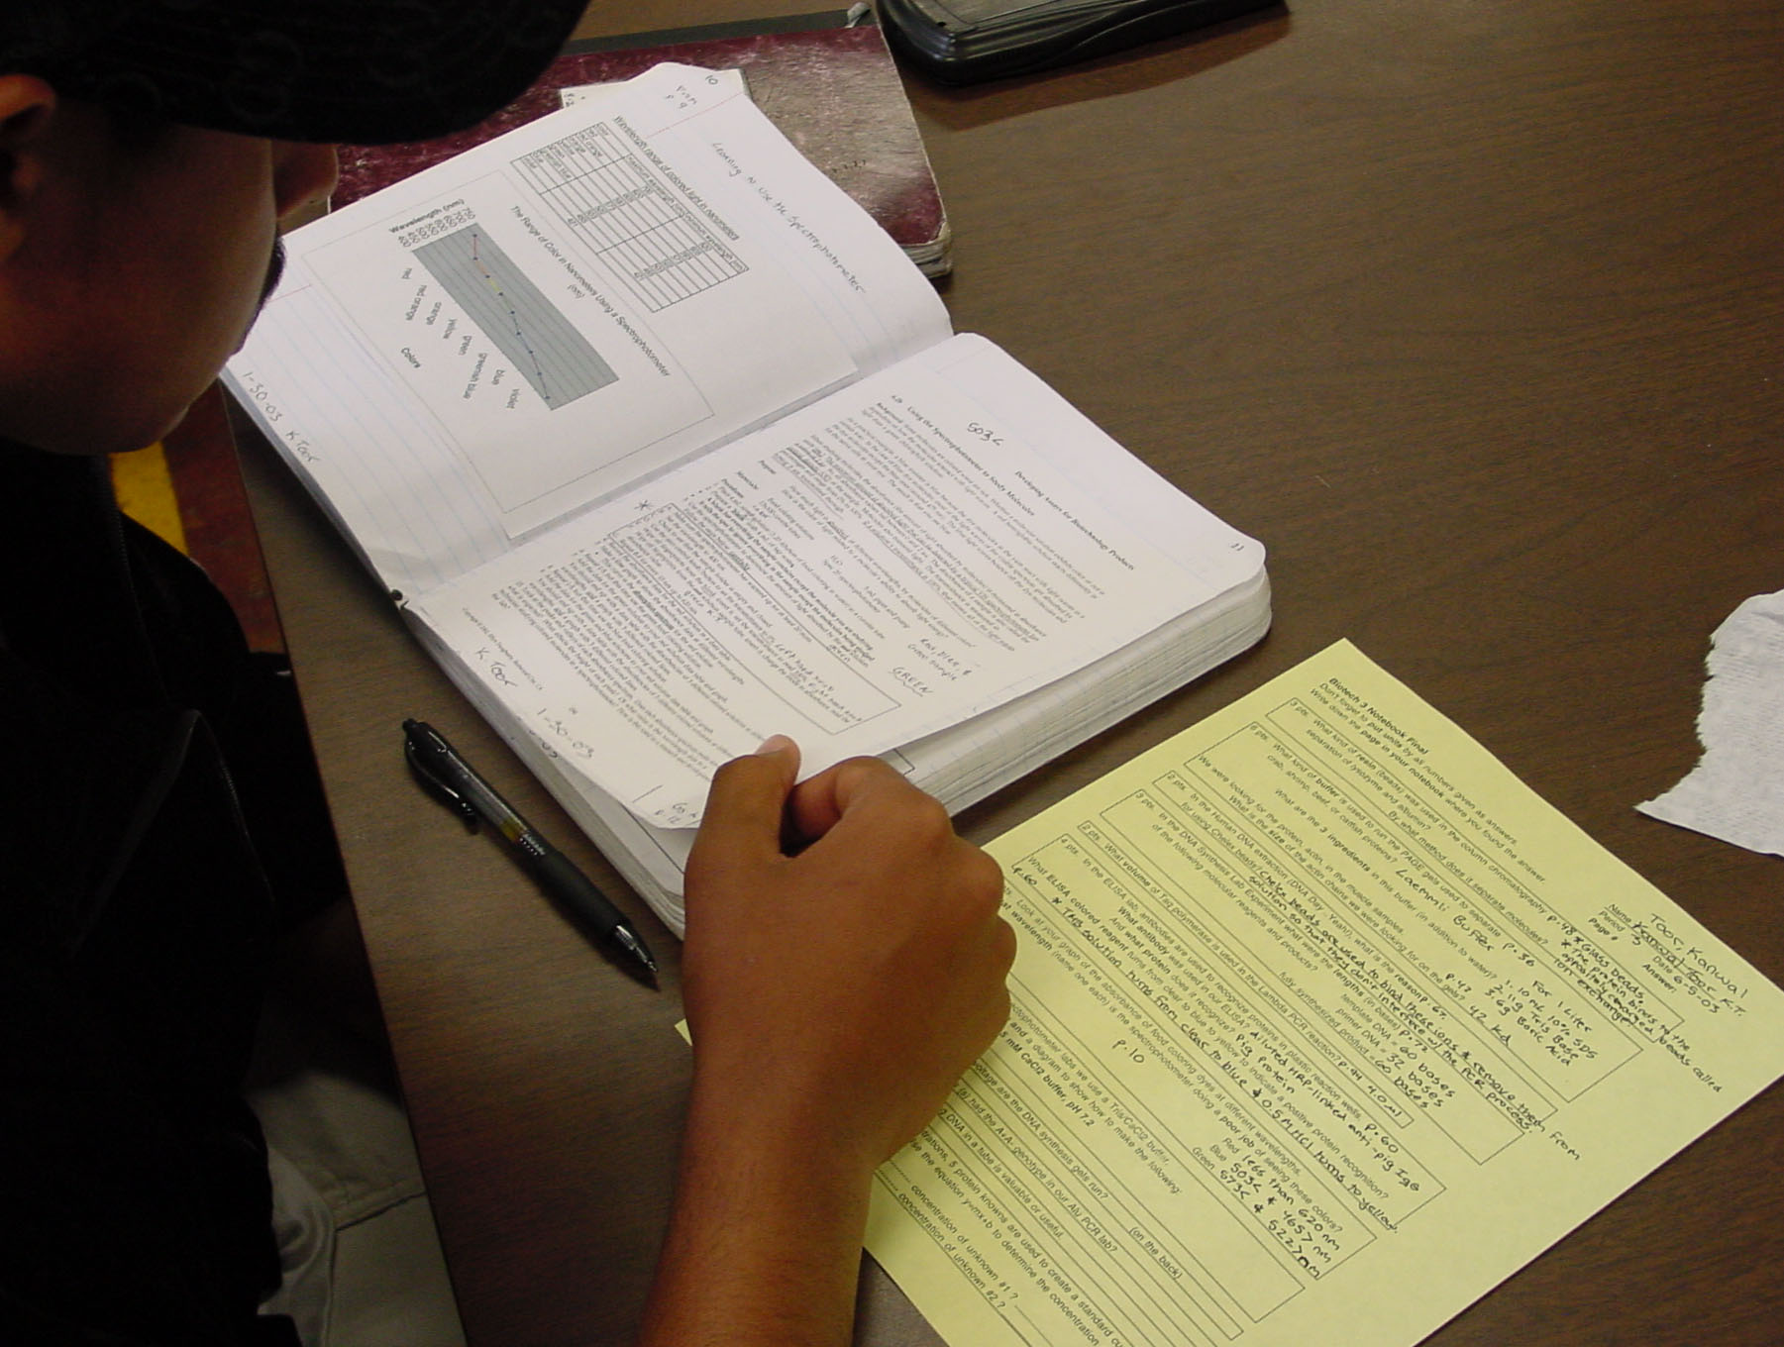
Authentic Assessment
Evaluated in a manner similar to industry
Proficiency-Based
  Minimum 80% score on all quizzes, projects, notebook
  Remediation and tutoring to increase proficiencies
Grading
  10% Attendance
  10% Promptness
  30% Record-Keeping
  20% Participation
  30% Skills/Skill Quizzes/Oral Exams
Formal Evaluation every 6 weeks
Check out “AuthenticAssessment.ppt” at www.BiotechEd.com

Slide 32
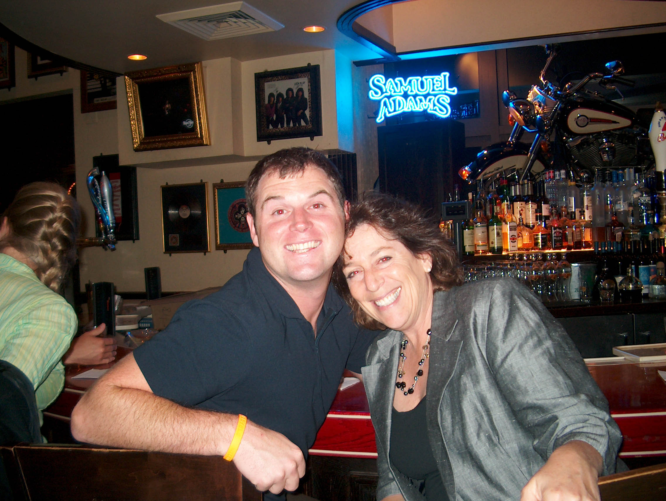
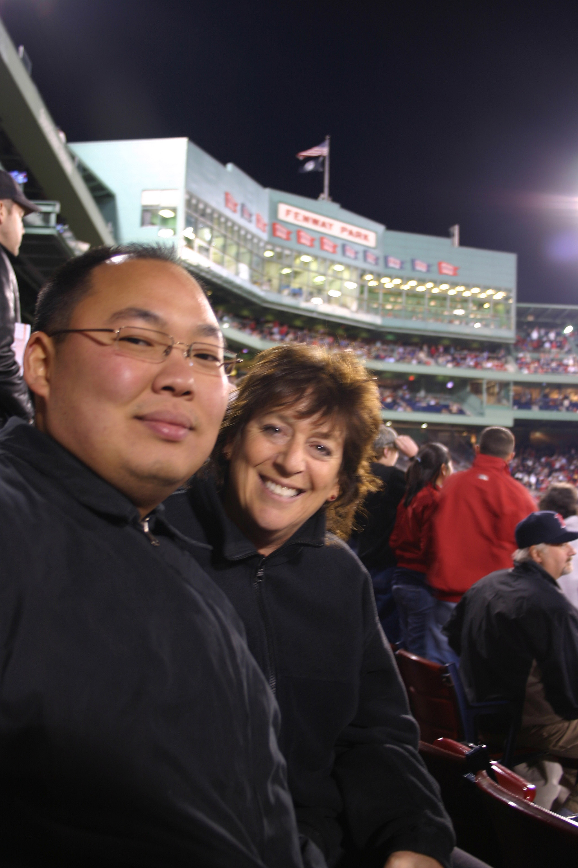
The Biotechnology Teacher
It is all about enthusiasm:
  Any science teacher has the background to teach biotech.
  Teacher learns as students do (using text, lab manual, IGs, and websites).
  Lots of curricular and professional support (Bio-Link, NABT, NSTA, Biotech Institute, Fralin, other local regional groups/programs).
  Biotech teacher network is growing FAST and is a nurturing one.

Slide 33
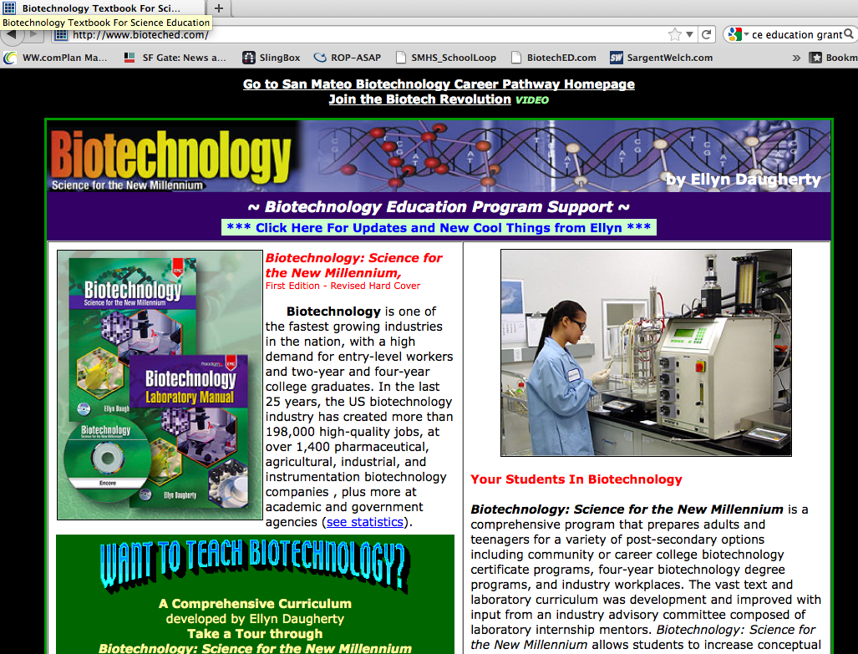
www.BiotechEd.com

Slide 34
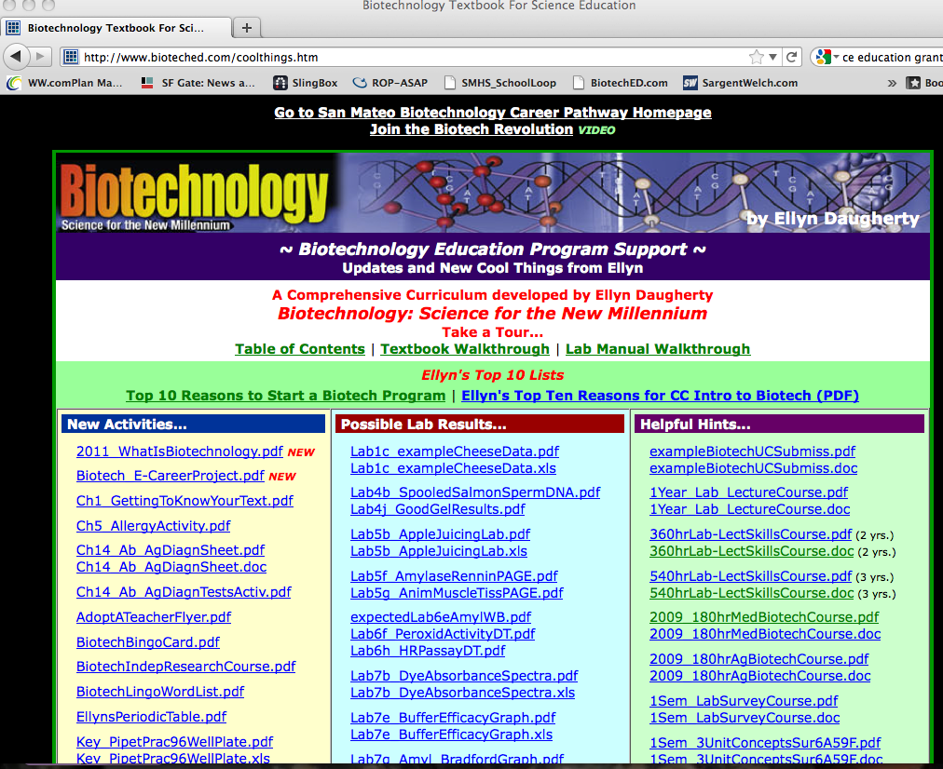
www.BiotechEd.com

Slide 35
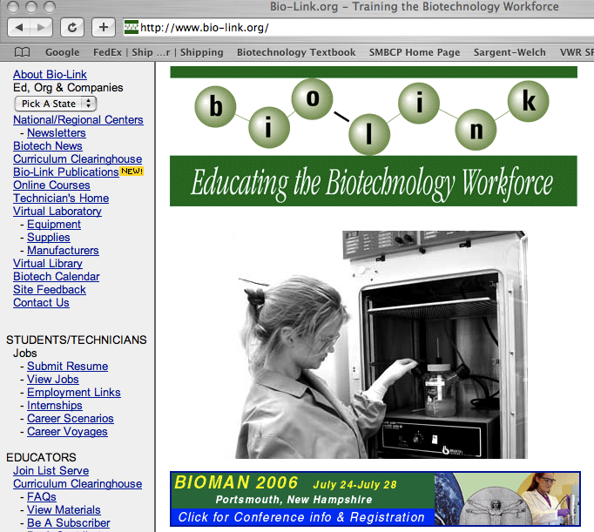
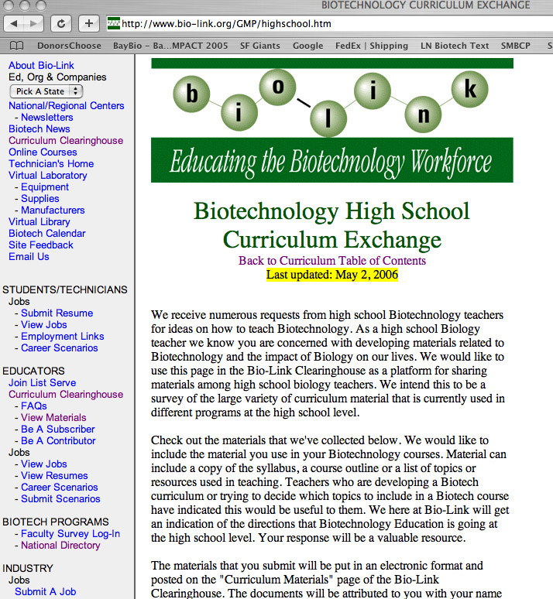
Get more help at conferences and workshops!
DNA is the Show but Protein is the Dough
By me in my lab at the SMBTC
2 days in July
BIO-LINK Summer Fellows Meeting
www.bio-link.org
Usually 1st week of June
35+ Biotech Educators, CC & HS
NSTA and NABT Conferences
March and Oct respectively
www.nsta.org and www.nabt.org
Demos & hands-on biotech workshops

Slide 36
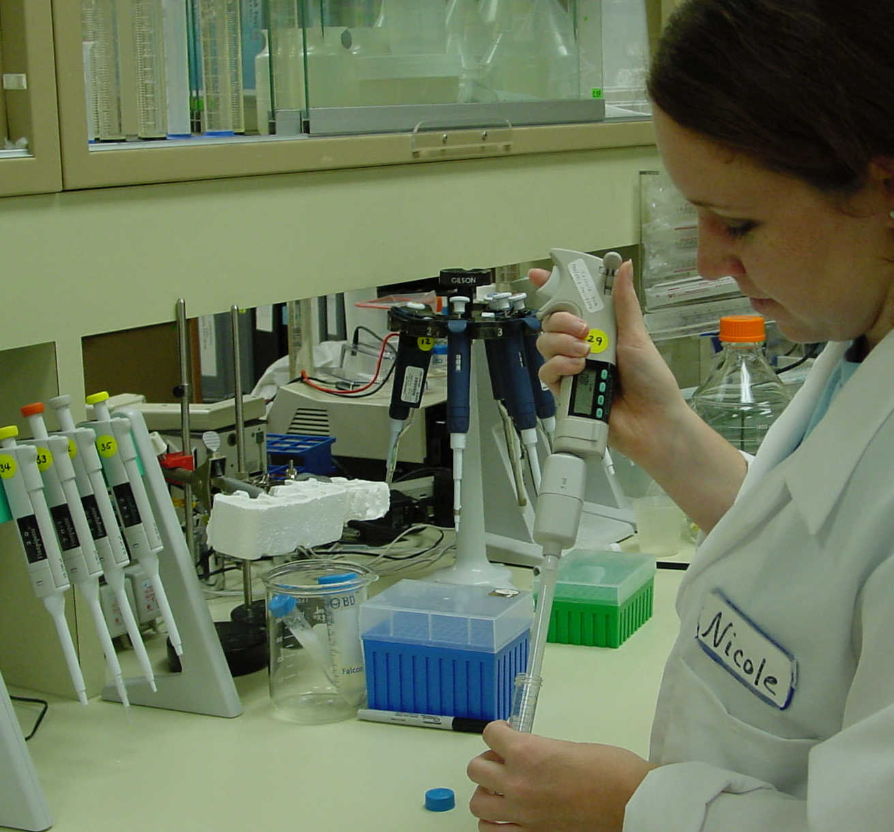
Biotechnology is an opportunity to teach science in a way that results in science literacy, research skills & career awareness for virtually every student.
Students learn the skills and gain the confidence and self-directedness that are necessary for independent research (science fair projects) and higher-level science courses.
Students see meaning and application in their math, biology, and chemistry.
Students learn the science and business of biotech so that they are better prepared to make decisions about their futures and society.

