Slide 1

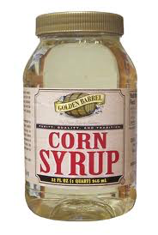

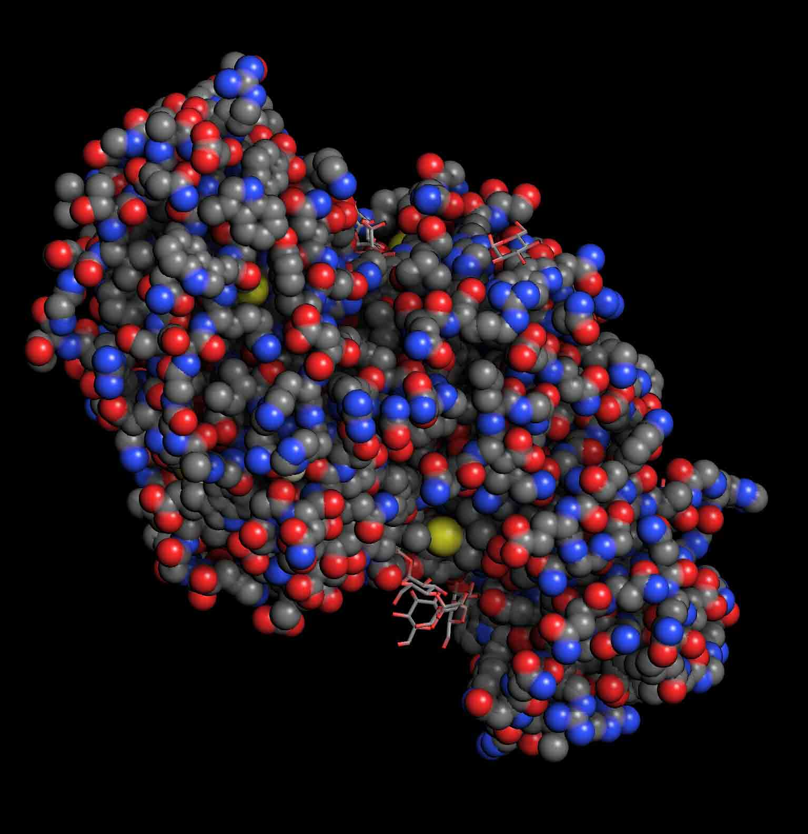
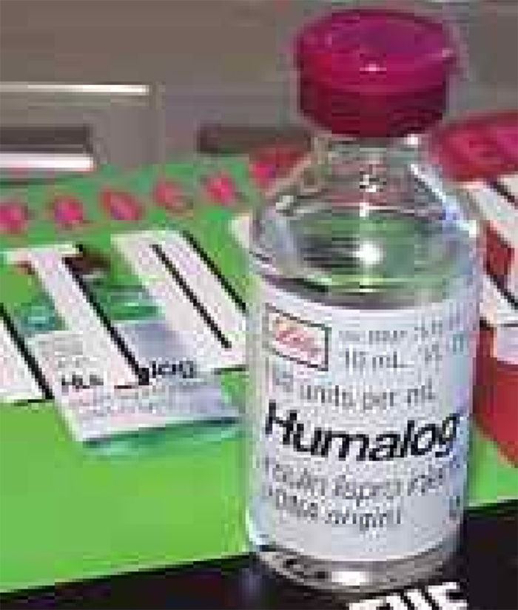
Biotech is STEM Education
Biotechnology is the the application of science, engineering, and technology to manipulate cells and their components to produce products or services that may improve the quality of human life
Industrial Products
Biofuels
Medical Products
Bioinformatics
Food Products
Ellyn Daugherty ellyn@BiotechEd.com www.BiotechEd.com

Slide 2

Every step in biotech research and development integrates the concepts, processes and technologies of biology, chemistry, physics, mathematics, and engineering.

Slide 3
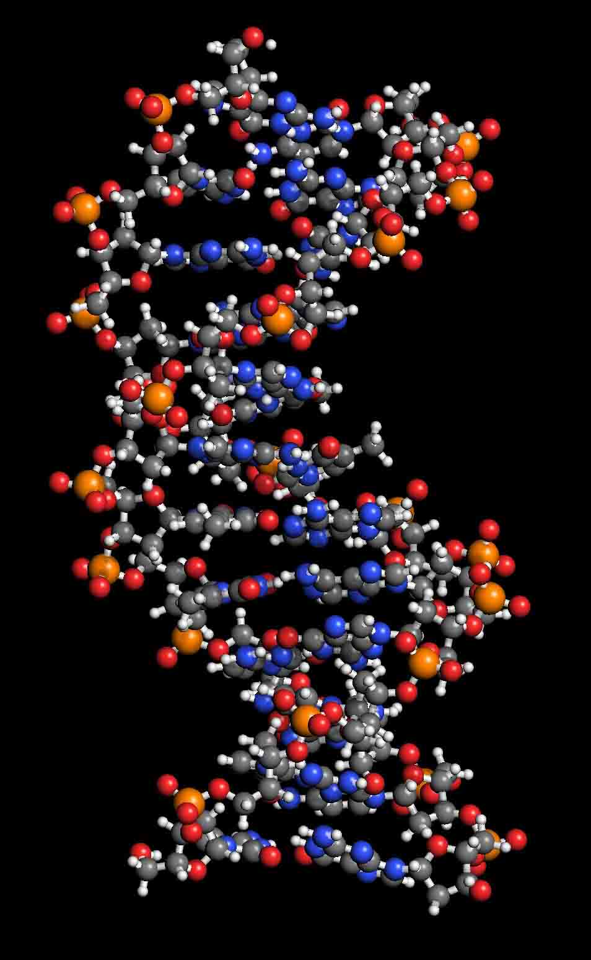

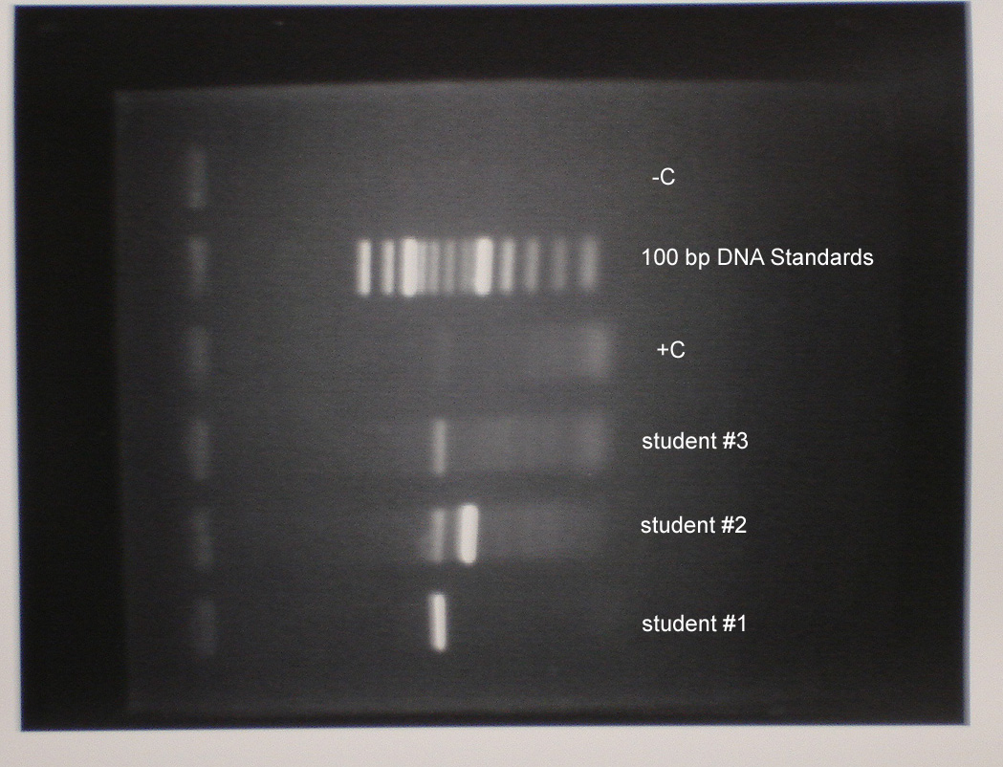

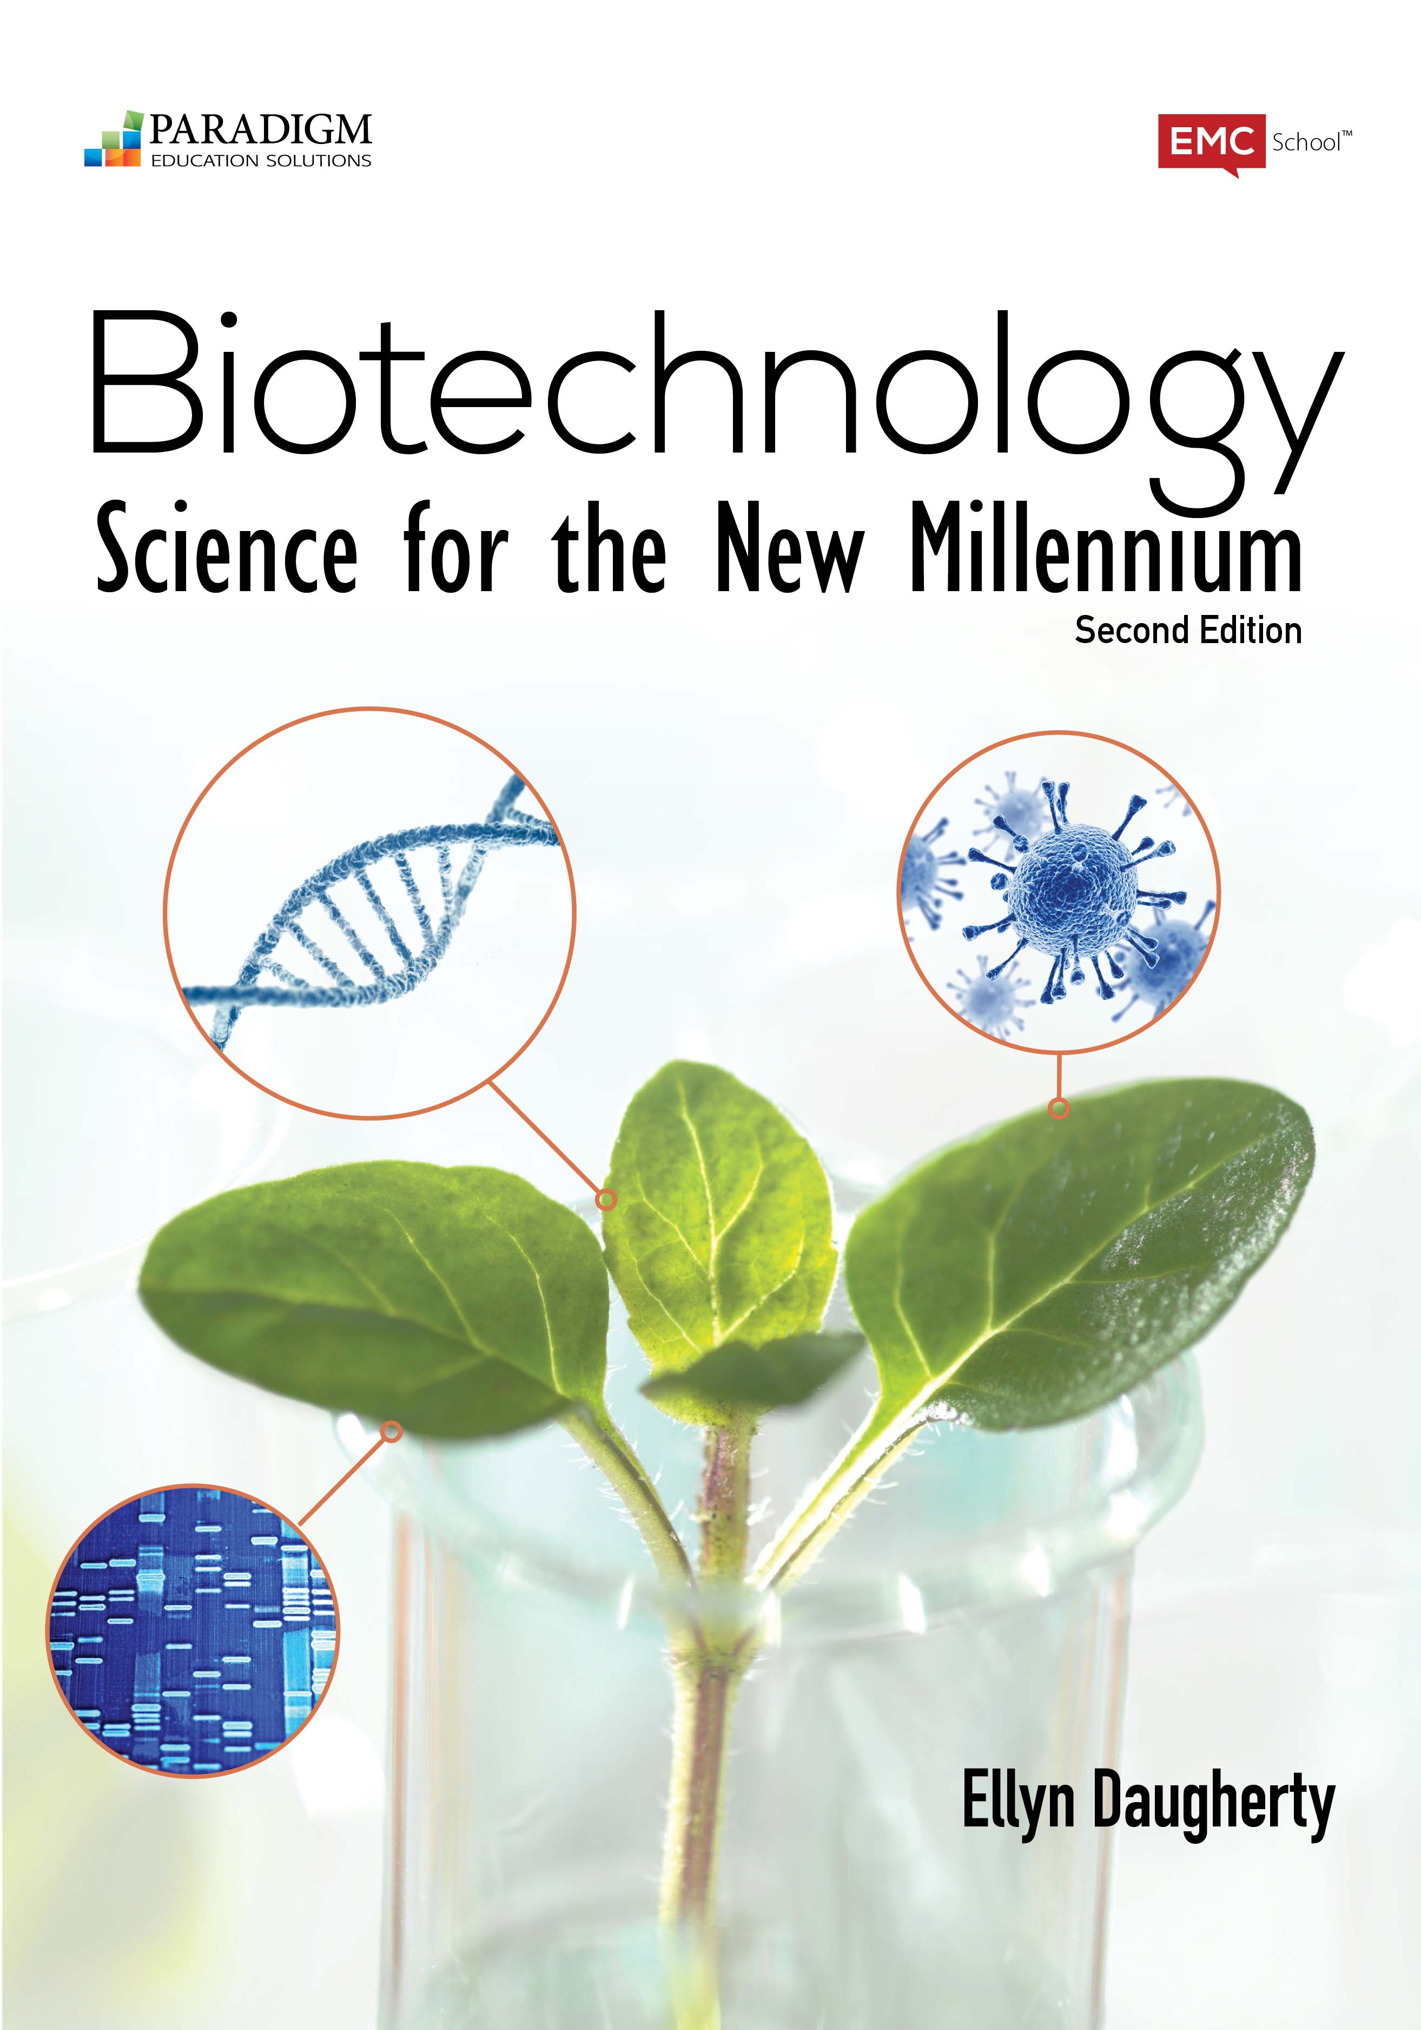
What a Biotech STEM Course Might Look Like
Scientific Methodology, Lab Research, and Computer Tools
> Expt design, databases, molecular modeling, reports
Standard Lab Operating Procedures and Instruments
> Solution Prep, Cell Culture
> DNA/protein Isolation & Assays
Recombinant DNA Protein Production
Research/Manufacturing Applications:
> Pharmaceuticals
> Agricultural Products
> Industrial Products
> Environmental Issues
> Biodefense, Food Safety
> Opportunities to design protocols and products

Slide 4
BS4NM, 2017
9 new/improved Molecular Modeling and Bioinformatics Activities
(Introducing) Computer-generated Molecular Models
Viewing the 3-D Structure of a DNA Molecular Model
The AA Sequence Determines Structure of Insulin
Insulin: Complicated Choices for a Simple Protein
Studying Protein (Amylase) Three-Dimensionally
A Glow in the Dark Cat? What’s Next?
Who Passes the BRCA1 Test?
PCR Primer Design
What’s the Difference? Alpha or Beta, It’s All Amylase.

Slide 5
Biotech is STEM:
Bioinformatics
Databases
Molecular modeling
Pick: “1BLI”

Slide 6
Ball and Stick model - color-coded amino acids in amylase (1BLI)

Slide 7
Space-filling model in rainbow rendering - amylase (1BLI)

Slide 8
VAST can compare two protein structures
wild-type alpha amylase superimposed with heat-resistant engineered alpha-amylase

Slide 9
Native alpha amylase superimposed with heat-resistant engineered alpha-amylase
See yellow loop - due to additions in the 1E3Z polypeptide
Intended Mutation Produced using PCR

Slide 10
In this view, you can see that the starch substrate still binds at the active site.
See yellow loop - due to additions in the 1E3Z polypeptide

Slide 11
PCR = directed DNA synthesis
DNA sample ID
NC_001416.1

Slide 16
What a Biotech STEM Curriculum Looks Like
Scientific Methodology, Lab Research, and Computer Tools Chapters 1, 2…14
> Expt design, databases, molecular modeling, reports Chapters 1, 2…
Standard Lab Operating Procedures and Instruments Chapters 1, 2…
> Solution Prep, Cell Culture Chapters 3 & 4
> DNA/protein Isolation & Assays Chapters 4 & 5
Recombinant DNA Protein Production Chapters 6-9
Research/Manufacturing Applications: Chapters 10-14
> Pharmaceutical/Medical Biotech Chapter 12
> Agricultural Products Chapter 10 &11
> Industrial Products Chapters 1, 2, 13
> Environmental Issues Chapter 14
> Biodefense, Food Safety Chapter 14
> Opportunities to design protocols and products Chapters 1, 2…14

Slide 17
Biotechnology Curricular Support
BiotechEd.com PPTS, Syllabi, Activities, Hints, Links, etc.
gbiosciences.com B:S4NM materials and kits
and fishersci.com
emcp.com/biotech B:S4NM curriculum

