Slide 1
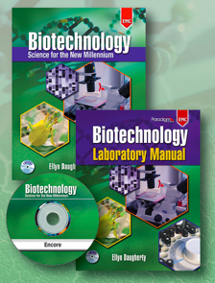



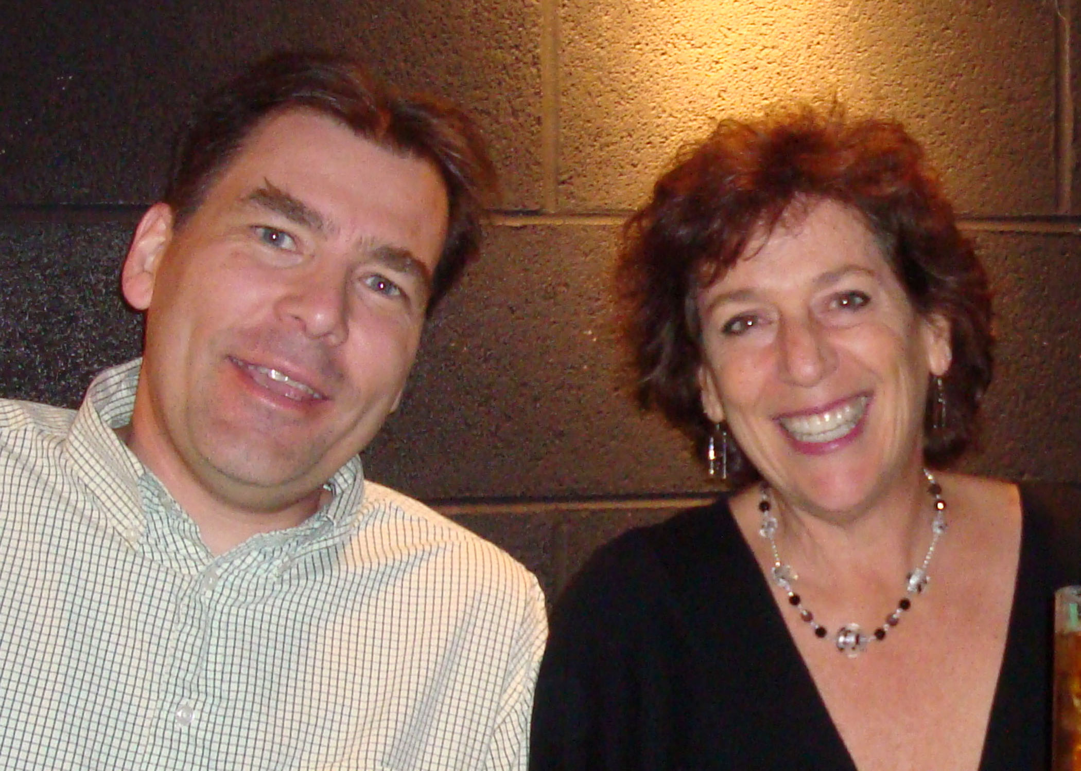
Faster, Better Biotech: The rAmylase Project
Lab 8g Mini-Prep of pAmylase 2014 Kit
Ellyn Daugherty
ellyn@BiotechEd.com
www.BiotechEd.com
Simon Holdaway
The Loomis Chaffee School
simon.holdaway@gmail.com

Slide 2
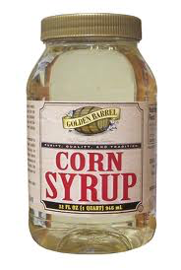


Amylase is a
commercially important biotech product
Amylase is an enzyme that catalyzes starch digestion to sugar. Used to:
Remove starch in products
Produce sugar from starch
Processing of cellulostic biofuel

Slide 3


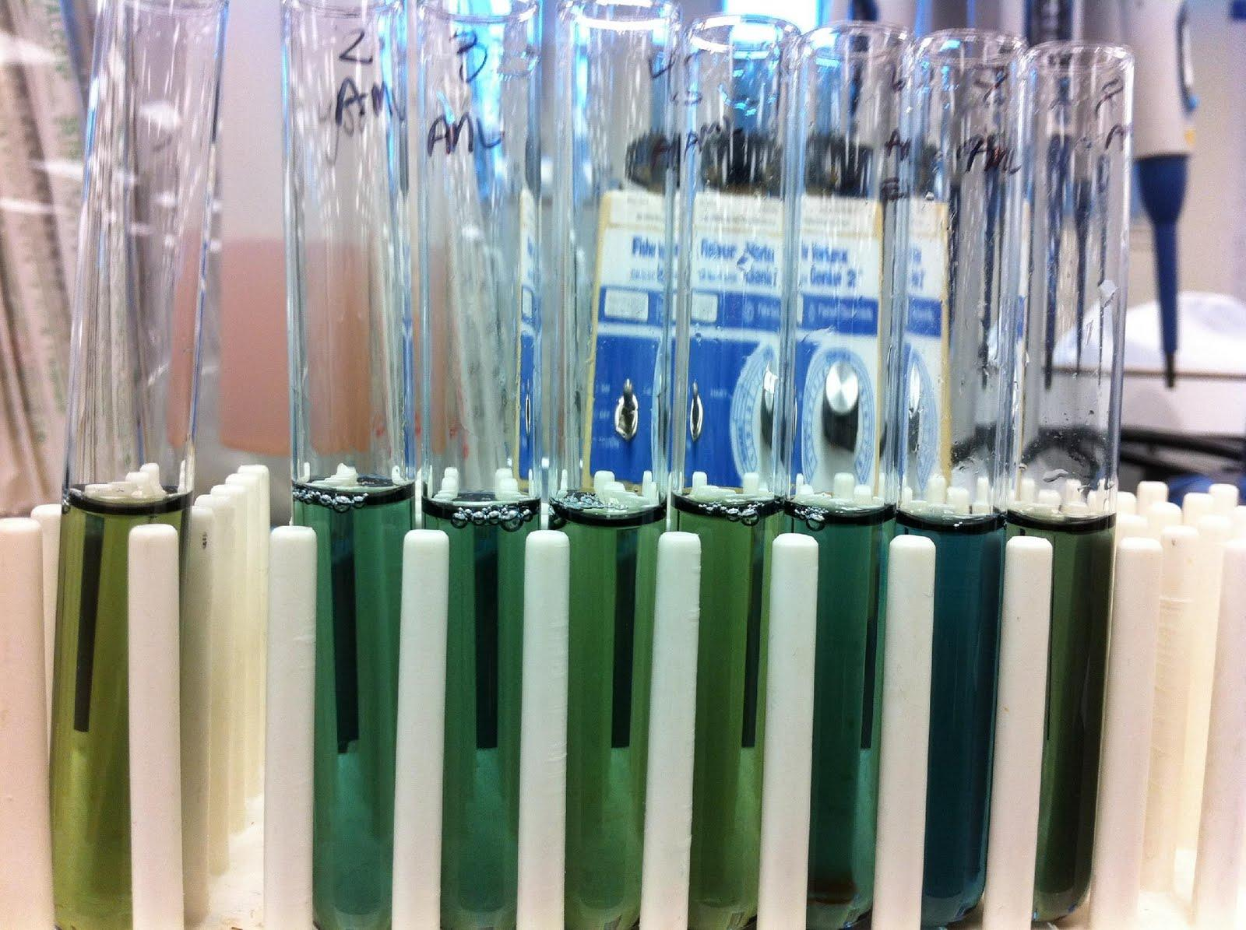
The goal of The rAmylase Project is to
Learn how to assay for amylase, a protein of commercial interest (amylase)
Genetically engineer cells to produce amylase (using pAmylase2014)
Grow transformed cells to volumes where amylase is purified and assayed

Slide 4

The rAmylase Project
Curricular model of rDNA/protein Business
Chapters 1-5 Basic SLOP
Lab 5f Characterizing Proteins by PAGE
Lab 6c Assaying for Amylase Activity
Lab 6d Direct ELISA of Bacterial Amylase
Lab 6e Western Blot to Identify Amylase
Lab 7g Amylase Concentration Assay
Lab 8b pAmy Plasmid Restriction Digest
Lab 8c pAmylaseTransformation of E. coli
Lab 8g Miniprep for pAmylase Isolation
Lab 9c Amylase Ion-Ex Chromatography
Lab 13h Amylase Gene PCR

Slide 5
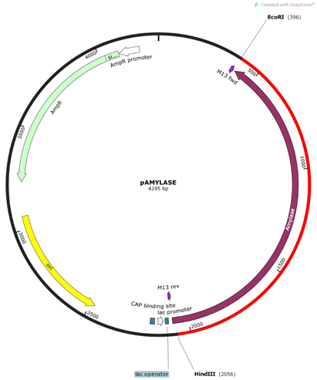
The rAmylase Project: Lab 8g Faster, Better Plasmid Isolation
Using a Miniprep Kit for Plasmid Isolation
(G-Biosciences # BTNM-8G)
A preparation (called “prep,” for short) may be used to extract the transforming plasmid from the transformed cells.
Mini-prep = when the amount of cells and cell culture is small, the amount of plasmid recovered from the cells is relatively small.
A miniprep yields about 20 to 30 μg of DNA (usually 20 μg in a 20-50 μL sample).
Mini-preps used to be done “from scratch” (Lab 8f) but now commercial kits (Lab 8g) make it easy to recover plasmid from your transformed cells
New pAmylase2014
4295 base pairs
1 EcoRI and 1 HindIII site

Slide 6
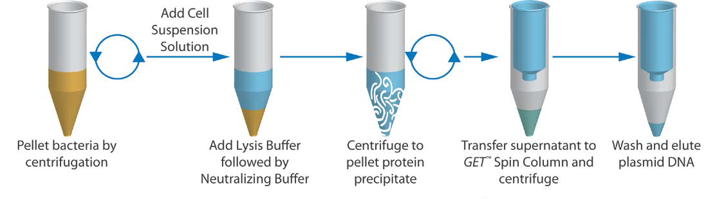
The rAmylase Project: G-Bio Lab 8g Mini Prep Kit # BTNM-8G
Fast, high yield mini-prep kit, easy to use in classroom,
8 groups doing 2 preps each, most reagents aliquoted
Pellet Cells → Lyse → Bind → Wash → Elute

Slide 7
Features of G-Bio Spin Column Mini-prep kit
Recovered plasmid DNA in predominately supercoiled form
DNA ready for immediate use in restriction enzyme digestion, cloning, PCR, or transformation
Up to 20-40 μg of plasmid DNA per prep (0.1 µg/µL)
Get plenty for quantifying
1 µL shows on G-Bio dotMetric test
10 µL shows well on a gel (Lab 4j or Lab 8b)
5 µL good for PCR (Lab 13g)
No phenol/chloroform extraction or alcohol/isopropanol precipitation required

Slide 8
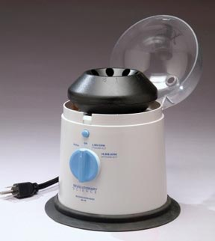
Additional Equipment & Materials Required
Mostly common lab supplies:
• High-speed Microcentrifuge
15,000xg or higher
• Heat block or water bath
• Micropipets P1000, P100 & sterile tips
• Disinfectant towels/Bleach
• Forceps
• Small weigh boat (for indicator testing)
• Disposal container with 10% bleach
• Shaking Incubator for overnight cultures
… Gel apparatus and reagents if you want to run gels
RS-101 Revolutionary Science Centrifuge

Slide 9
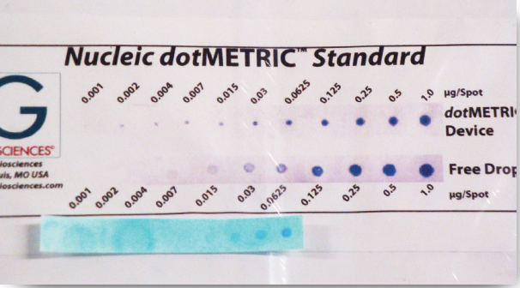
Faster Better Biotech: Plasmid Yield
How do you check to see if you got plasmid?
Old way…waste the small sample in restriction digest or UV spec.
Now…Use a G-Biosciences Nucleic dotMetric™ Assay kit (Geno Technology Inc.) to quantify the amount of DNA in the plasmid sample.
Take a 1μL sample and blot it on the test strip.
Then using their DNA nucleic acid indicator and washes, stain the DNA sample proportional to the mass present.

Slide 10
The rAmylase Project: G-Bio Lab 8g Mini Prep Kit # BTNM-8G

Slide 11
The rAmylase Project: G-Bio Lab 8g Mini Prep Kit # BTNM-8G

Slide 12
The rAmylase Project: G-Bio Lab 8g Mini Prep Kit # BTNM-8G

Slide 13
The rAmylase Project: G-Bio Lab 8g Mini Prep Kit # BTNM-8G

Slide 14
The rAmylase Project: G-Bio Lab 8g Mini Prep Kit # BTNM-8G

Slide 15
G-Biosciences Nucleic dotMetric Assay
1 µl Assay For Estimation of DNA Concentration (< 1 µg/µL)
Each sample will be tested. Water will be tested as a –C.
Apply 1 µL drop of each sample plus a drop of dH₂0 onto the dotMetric Test Strip (remove the protective cover 1st)
Developed with 500 µL of DNA Dye (cover all dots) for 1 min. Remove dye and wash/dunk in dH20
Compare the color density of the nucleic acid spots to the dotMetric standard strip.
No spectrophotometers or cuvettes required.

Slide 16
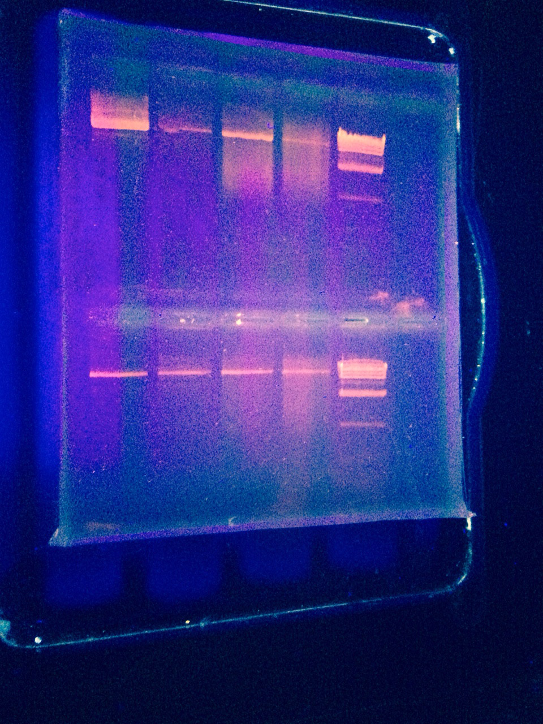
The rAmylase Project: G-Bio Lab 8g Mini Prep Kit # BTNM-8G
Did the plasmid mini-prep work?
DotMetric Assay
Run the DNA on a gel to ‘see’ the plasmid DNA
The super coiled plasmid runs at about 8,000 bp
Or you can do a restriction digest (HindIII/EcoRI digest)
supercoiled pAmy2014 >>>>>

Slide 17
pAmy2014 Restriction Digest (Lab 8b)
We will conduct a quick Restriction Digestion (RD) and run cut and uncut samples on 1xLB fast gels.
Only conduct the RD on one partner’s sample. Keep the other as uncut sample.
Label a 1.5mL tube (RD and your initials) and add the following in the following order:
> 4µL dH2O
> 10µL of the mini-prep pAmylase sample
> 2µL 10x Restriction Buffer 4
> 2µL each HindIII and EcoRI
Pool samples and Incubate at 37°C for 10 min.
Add 4µL of EZ-Vision Loading Dye to 20 µL of RD sample
Label another 1.5mL tube (pAmy and your initials)
Add 10µL of the other partner’s mini-prep sample to the tube.
Add 2 µL of EZ-Vision Loading Dye to 10 µL of uncut mini-prep sample

Slide 18
pAmy2014 Visualization
Use 1X LB buffer/0.8% agarose gel with 2 sets of 6-well combs.
Have only 1 cm of running buffer over gel.
1. Load all of each sample to a designated well.
Have 1 partner load uncut sample into a well, then the other partner load RD sample into the adjacent well.
2. Have at least one lane of DNA standard markers =
10µL of Lambda/HindIII markers in EZ-Vision Loading Dye
3. Record what is loaded in each well.
4. Run gel for 10 min at 300 V (or as close as you can get)
5. Transfer gel to UV light box and visualize. Photograph.
Uncut pAmylase supercoiled plasmid is seen at about 8,000 bp
What bands should be seen in restricted plasmid and what sizes?

Slide 19
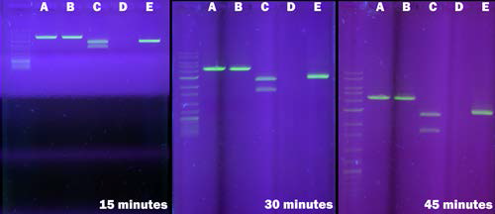
Results on 1X TAE Agarose DNA Gels

Slide 20
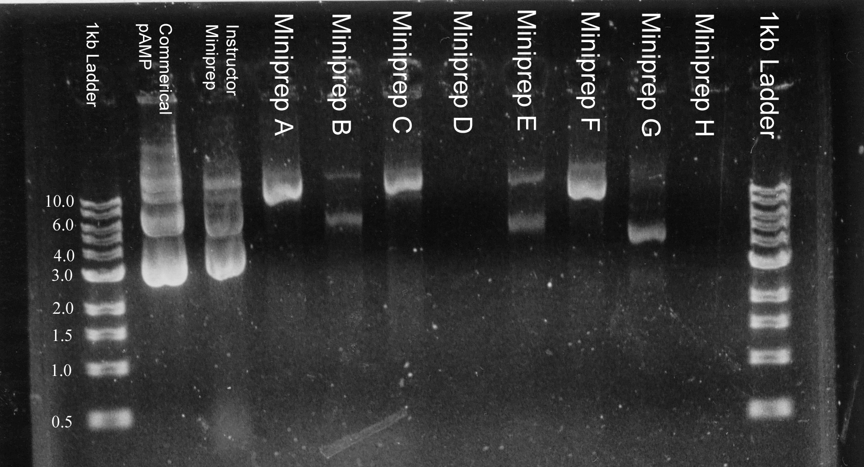
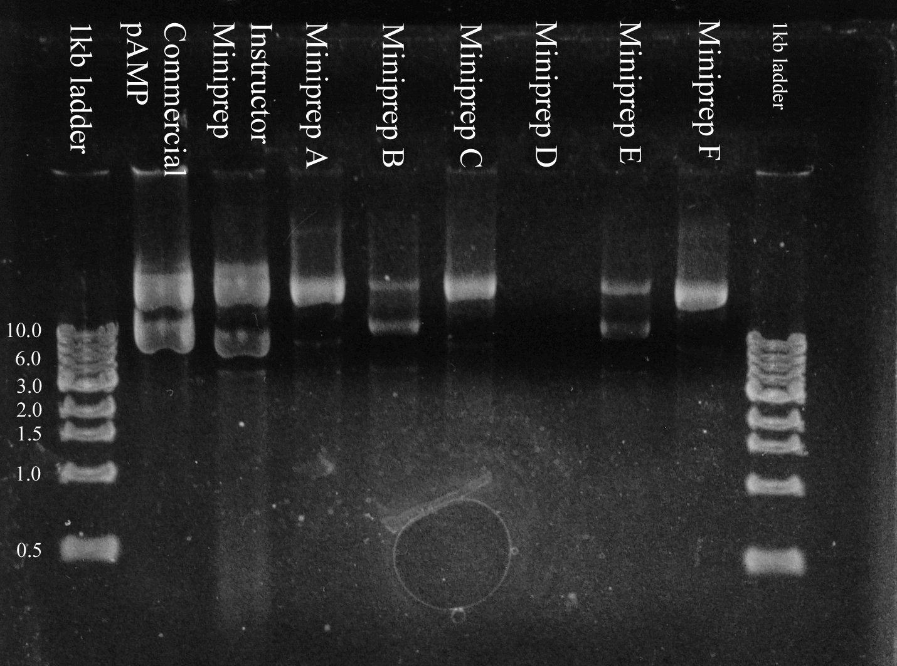
Fast, faster, fastest DNA Gels
Plasmid mini-prep
TAE gel
1% agarose
1972 technology
Plasmid mini-prep
LB gel
1% agarose
2007 technology
60 V for 60 minutes
300 V for 8 minutes

Slide 21
Faster, Better Biotech:
DNA (Agarose) Gels
Gels made with
TAE Buffer
A tris acetate EDTA or tris borate EDTA gel tolerates only 110 volts, takes three times as long to run, and results in fuzzy DNA patterns.
Tris also produces loads of unwanted heat - heat that limits the voltage that can be used.
Slow gel runs of 45-60 min
Steams up gel box
Gels made with
Lithium Borate (LB) Buffer
http://www.fasterbettermedia.com and available through G-Biosciences
Lithium borate conducts electricity better than TRIS so you can turn up the voltage and current on agarose gels :
Fast gel run times (8-15 min)
Same protocol as TAE gels just substitute 1X LB buffer for 1X TAE
Purchase as 10X or 20X concentrate

Slide 22
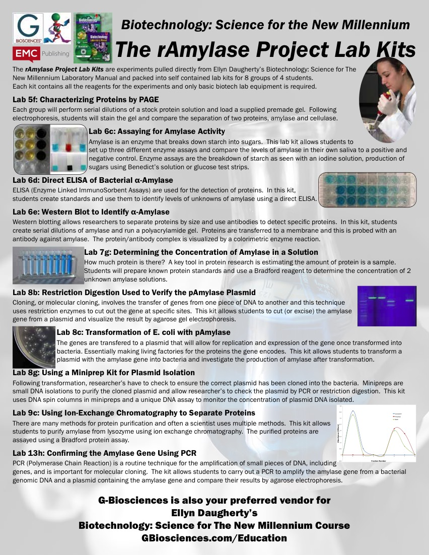

Slide 23
Biotech
Curricular Support
www.BiotechEd.com PPTS, Syllabi, Activities, Hints, Links, etc.
gbiosciences.com B:S4NM materials and kits
emcp.com/biotech B:S4NM curriculum

