Slide 1

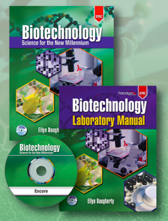

Biotechnology;
Science for the New Millennium
Relevant, flexible, innovative STEM curriculum integrating science, math & business
Text with Encore CD
Laboratory Manual
Lab Kits/Materials
Encore CD
Instructor’s Guide
Course Planner
Student Notebook
ExamView Assessment
Skills Quiz Assessment
Websites/IRC
And lots of teacher/program support
2012
June 2016
Ellyn Daugherty
www.BiotechEd.com
Ellyn@BiotechEd.com
650-400-9424

Slide 2

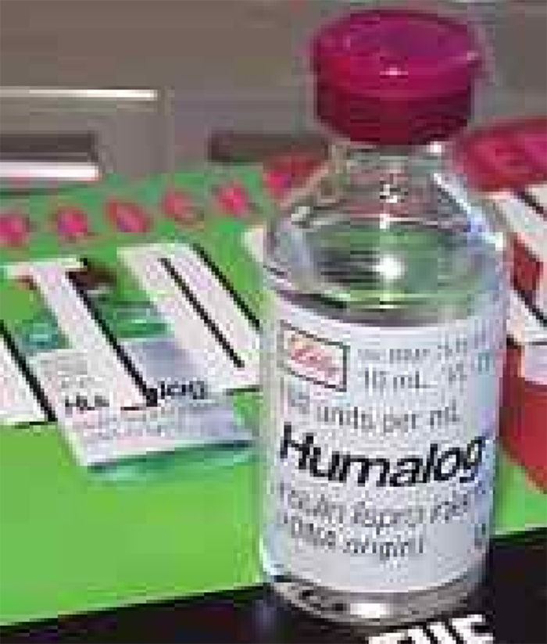
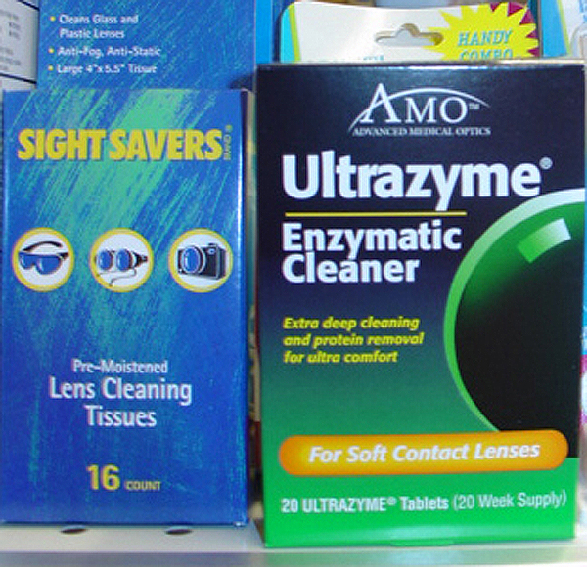
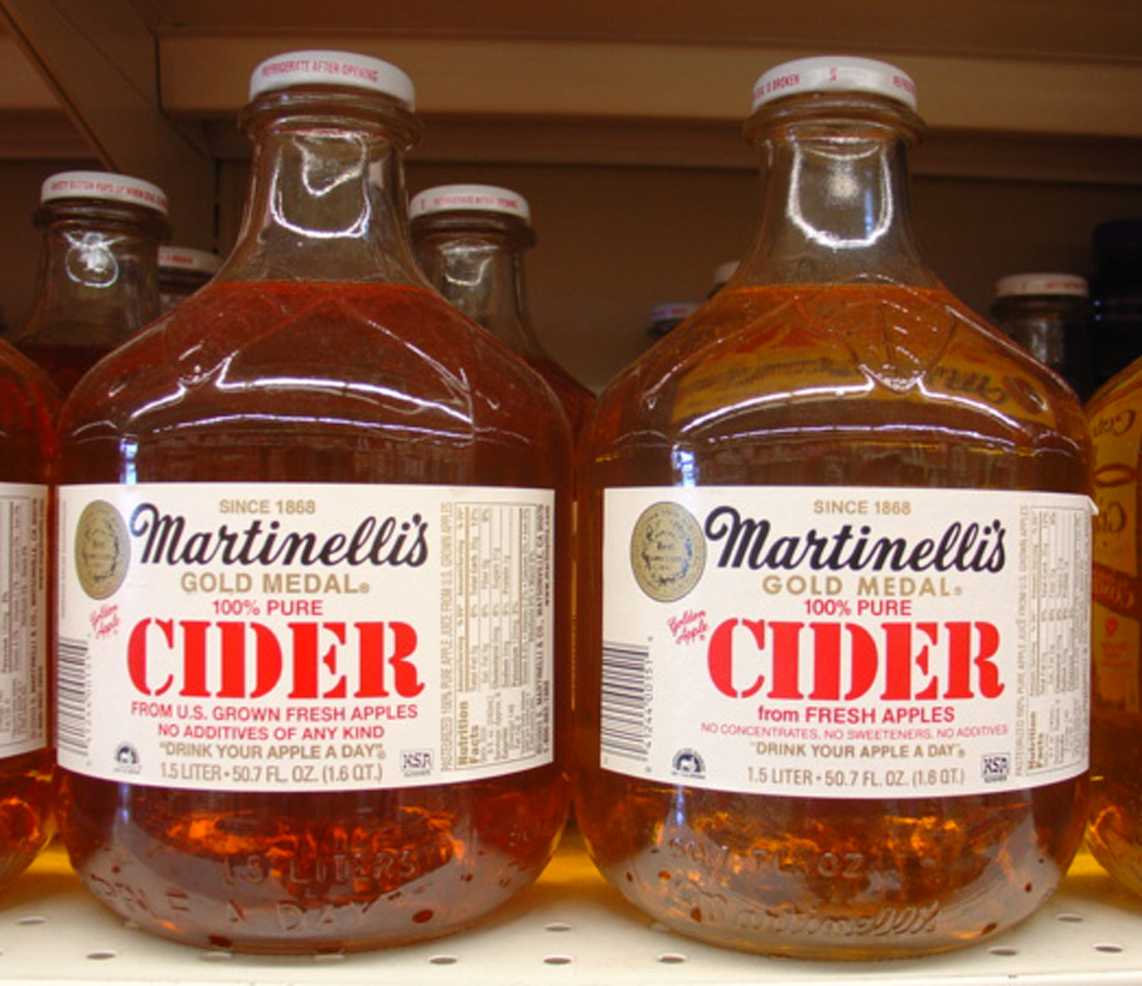
Environmental products
Medical products
What is Biotechnology?
Who uses biotechnology?
What products does biotech yield?
Biotechnology is the application of biology, chemistry, and engineering research and manufacturing techniques to create products or services to improve the quality of human life.
Industrial products
Agricultural products

Slide 3
Biotechnology: Science of the Future
We are in “The Age of Biotechnology.”
Employment of biotech scientists is projected to grow over 11% percent from 2012 to 2022, faster than the average for all occupations (US Dept. of Labor, 2014)
Biotechnology is practiced by:
Medical Scientists
Biological Technicians
Medical and Clinical Lab Technologists
Biochemists
Biophysicists
Biomedical Engineers
Microbiologists
Epidemiologists
Research and Development Scientists
Process Development Scientists
Biomanufacturing Specialists/Operators
Bioinformaticians

Slide 4
Biotechnology: Science of the Future
Biotechnology scientists will be needed for the next 100 years:
The aging baby-boom population and the demand for lifesaving new drugs and procedures to cure and to prevent disease will drive demand for biologists, biochemists, and biophysicists involved in biomedical research.
Greater demand for clean energy will increase the need for biochemists that research and develop alternative energy sources, such as biofuels.
A growing population and rising food prices will fuel the development of genetically engineered crops and livestock that provide greater yields and require fewer resources.
Efforts to discover new and improved ways to clean up and preserve the environment will increase the demand for biotechnologists.
As the amount of biological data continues to grow and computer analytical techniques and software continue to become more sophisticated, the number of dedicated bioinformaticians will continue to grow.

Slide 5
Biotech Education Important in the US
The US is the largest market of biotech products and services (medical, agricultural, industrial, environmental, research, defense) and has thousands of biotechnology firms and private industry, academic and government agencies using biotechnology
Between 2001 and 2010, the U.S. bioscience industry grew by 6.4%, adding more than 1.6 million jobs. By comparison, total employment for all private sector industries in the US fell by 2.9 %.
Employment of biochemists and biophysicists (important, well-paying jobs) is projected to grow 19 % from 2012 to 2022. The average annual salary of a biotechnology worker is $81K versus $35K for other professions.
All US metro areas have significant biotech research and manufacturing.
Biotech education gives students a variety of academic and career options.

Slide 6
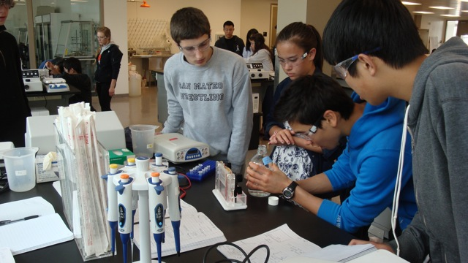
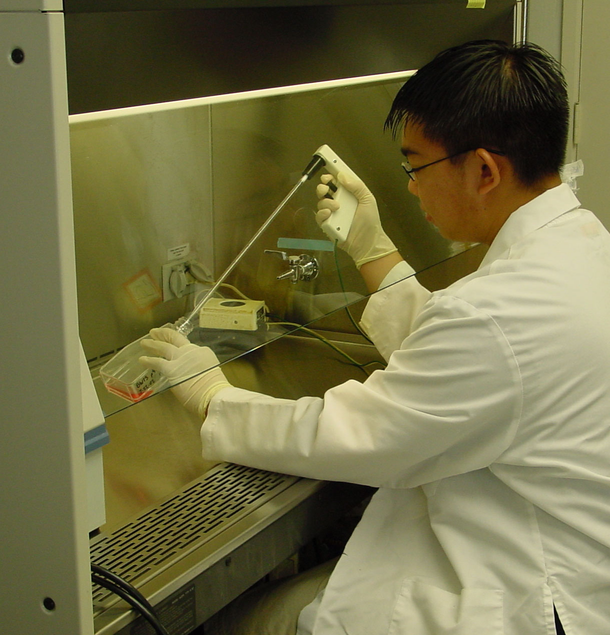
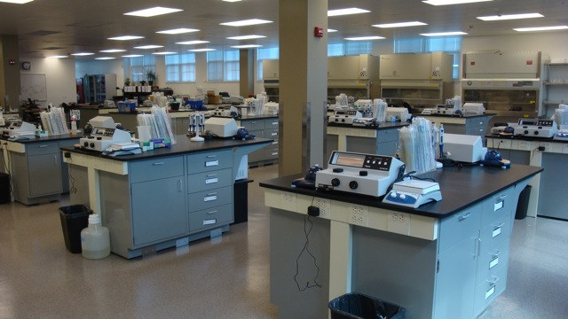
What a Biotech Lab Class Looks Like
Students:
Doing high level, relevant science
Curious and engaged
Performing high-tech lab work
Processing and sharing data
Practicing critical thinking
Exploring their place in the future
Biotech is STEM

Slide 7
Key Features of an Excellent Biotechnology Education Program
Relevant curriculum supports biotech laboratory process, skill development and workplace awareness
Comprehensive text with concepts and activities that support biotechnology literacy, understanding of scientific processes, bioscience vocabulary development, and biotech workplace awareness
Lab manual that focuses on the development of biotech laboratory skills, lab confidence, self-directedness, and appropriate workplace ethic.
Teacher/Student Encore CD for instruction, reinforcement, and remediation.
Instructor’s Guide, Course Planner, IRC, websites, and teacher workshops with continuing support for both instructors and students.
www.emcp.com/biotech
www.gbiosciences.com/BTSNM.aspx
www.BiotechEd.com

Slide 8
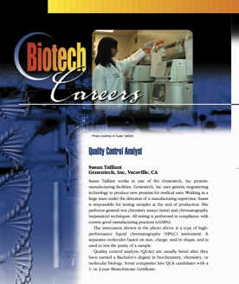
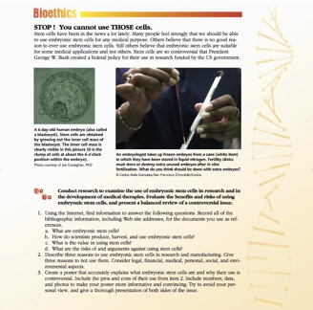
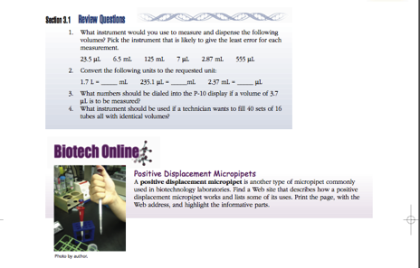
Features of the Textbook
Chapter Features
Biotechnology Career Focus
Chapter Learning Objectives
Vocabulary/Key Terms
Section Review Questions
Biotech Online Extension Activities
Chapter Summary
Lab Skills Summary
Thinking Like a Biotechnician Questions
Biotech Live Activities/Projects
Bioethical Dilemmas
Also available as e-Book (1- or 6- year license)

Slide 9
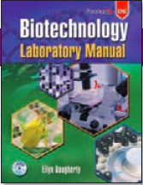
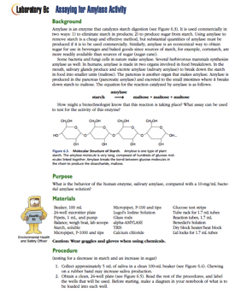
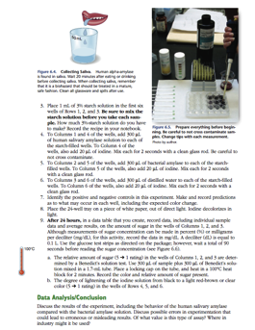
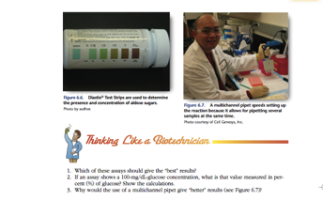
Features of the Lab Manual
Lab Chapter Prelude/Introduction
Laboratory Activities
  Background, Purpose, Materials List
  Procedures (in short easy to follow steps)
  Data Analysis/Conclusion
  Thinking Like a Biotechnician Questions
Scientific Methodology and critical thinking emphasized

Slide 10
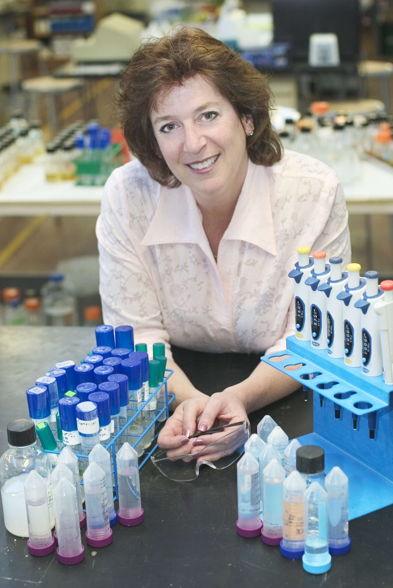
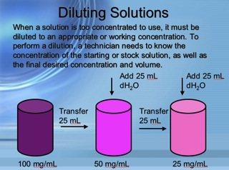
Encore CD
PACKAGED with TEXT and LAB MANUAL
Lab Tutor - 25 lab skills PPT presentations (narrated) and instructional video clips
Narrated Glossary and Image Bank
Flash Cards and Crossword Puzzles
Quizzes
Link to Internet Resource Center
“Julia Child” like lab video clips

Slide 11
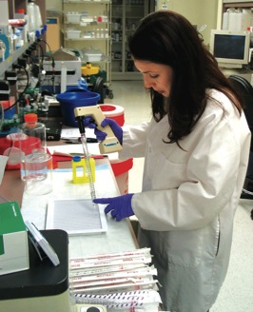
Features of the Instructor’s Guides
Part 1 “Instructor’s Guide” (How to Start a Program)
Program Overview
Starting a Biotechnology Program
Authentic Assessment
Feedback to the Author
Additional Student Resources
  Safety
  Metrics Review
  Excel Data Tables Tutorial
  Excel Graphs Tutorial
  Writing Conclusions
  Internet Tutorial
  Glossary of Key Terms
Part 2 Course Planner = Lesson Plans (How to Implement a Program)
  For the teacher: what to say and how and when to say it (if needed)

Slide 12
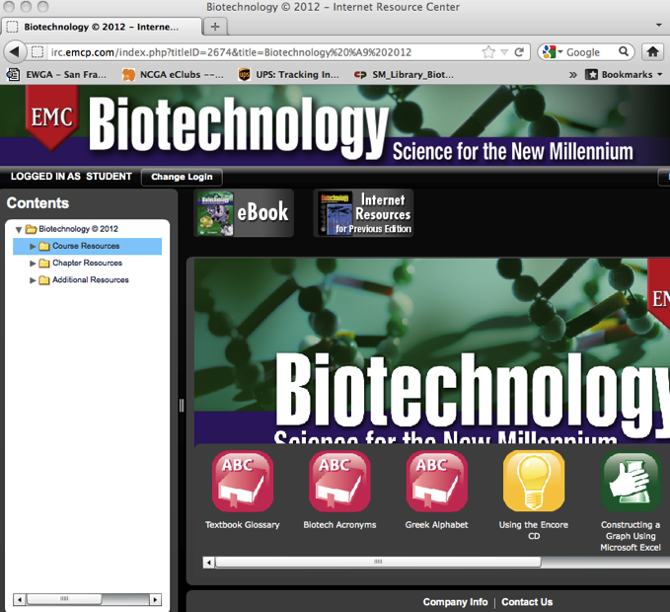
Student Internet Resource Center
Text Lecture Hall
  Learning Outcomes
  Chapter Summaries/ Glossaries
  Web Links
  Biotechnology Acronyms
  Successful Web Searching
Student Center
  Using the Encore CD
  Communicating Online
  Course Success
  Library
Testing Center
  Tips for Taking Tests
  Lab Manual Quizzes

Slide 13
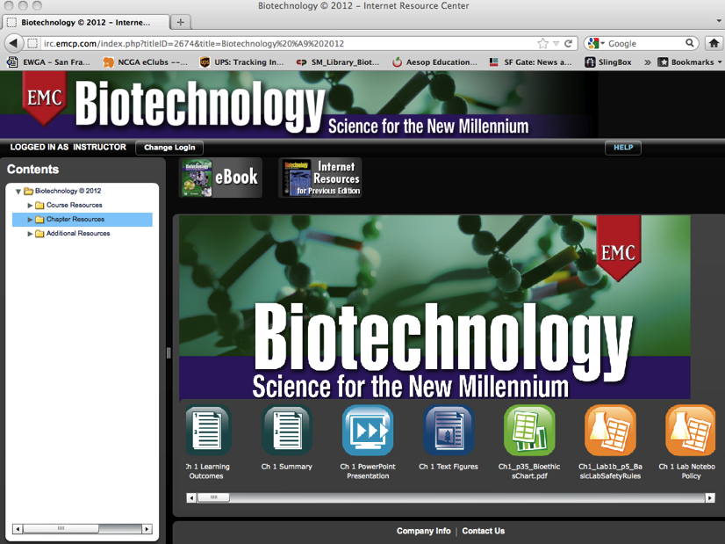
Instructor Internet Resource Center:
Course Planning Tools
  Course Plans (Concepts, Concepts & Lab, Lab)
  Lesson Plans (Text)
  Lesson Plans (Lab Manual)
Course Presentation Tools
  PowerPoint Presentations
  Image Bank (illustrations)
  Resources (charts/tables)
Course Evaluation Tools
  Guidelines for Authentic Assessment
  Chapter Exercise Answers
  Unit Tests and Answers
  ExamView Test Generator Guide

Slide 14
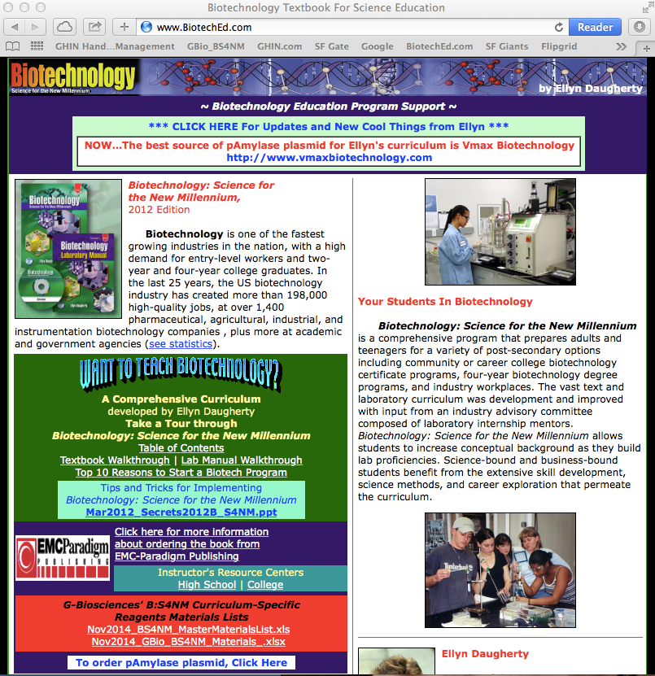
Author’s Teacher Support Website
www.BiotechEd.com
New Activities
Possible Lab Results/Photos
Helpful Hints
Program Updates
Teacher Training Workshop Dates
Teacher Training PPTS
Link to G-Bio Lab Materials
Internet Resource Center Link
Biotechnology News Link

Slide 15
Biotechnology:
Science for the New Millennium
The most comprehensive, flexible, relevant curriculum available.
> Curriculum maybe used for any length program
(semester, year, 2-years or more)
> Curriculum may be customized to any student population
(medical, environmental, industrial, R&D biotech programs)
(processed-based or concept based)
The most support available for any biotechnology curriculum.
In addition to training and good curriculum we have:
> The IRC and Teacher support website (www.BiotechEd.com)
> Teacher workshops and professional development by author/consultant
> Excellent customer service and support
Ellyn Daugherty
Simon Holdaway
Colin Heath, G-Biosciences, cheath@gbiosciences.com
EMC Customer Service

Slide 16
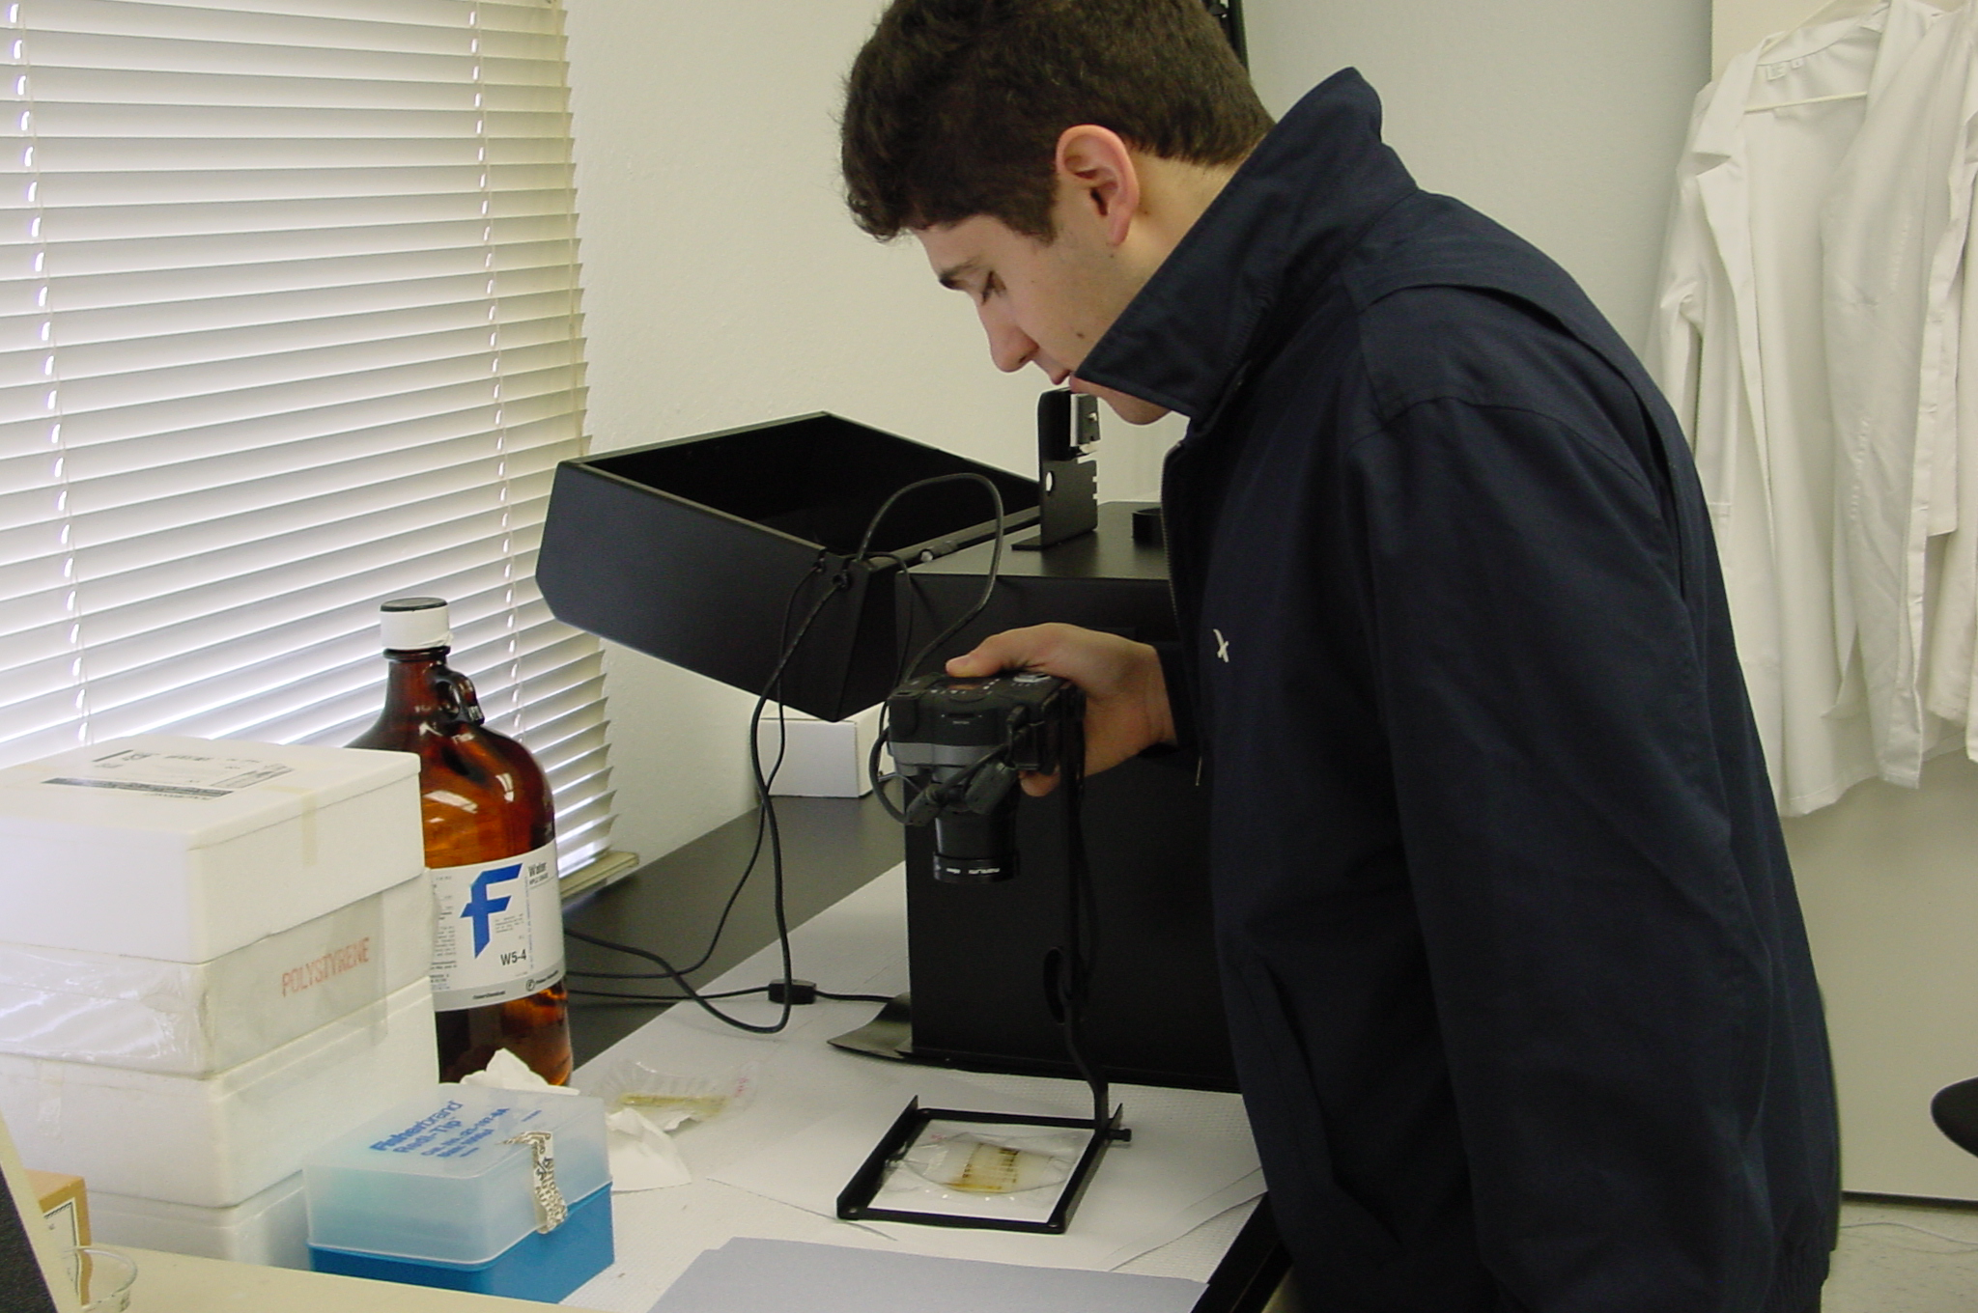
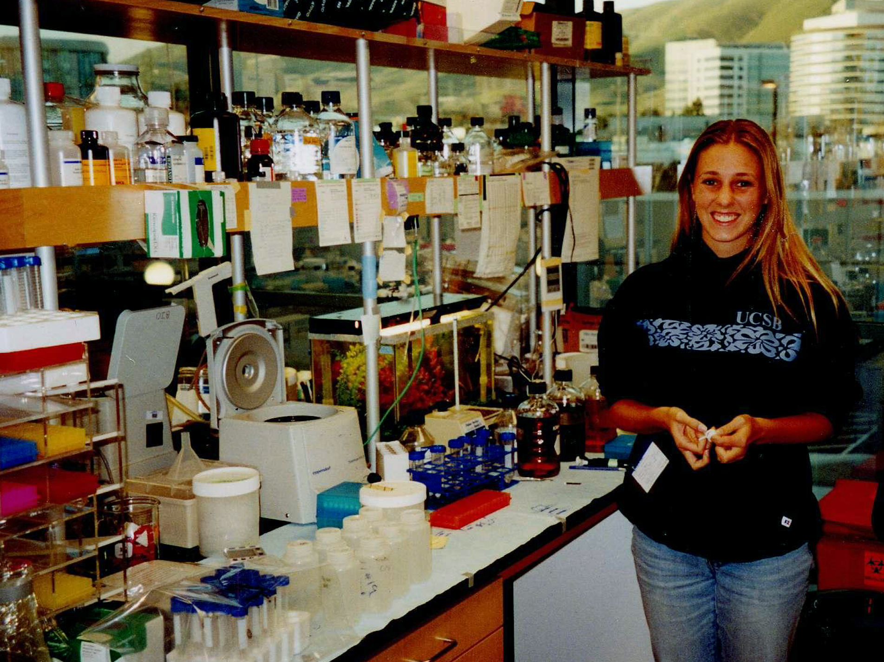
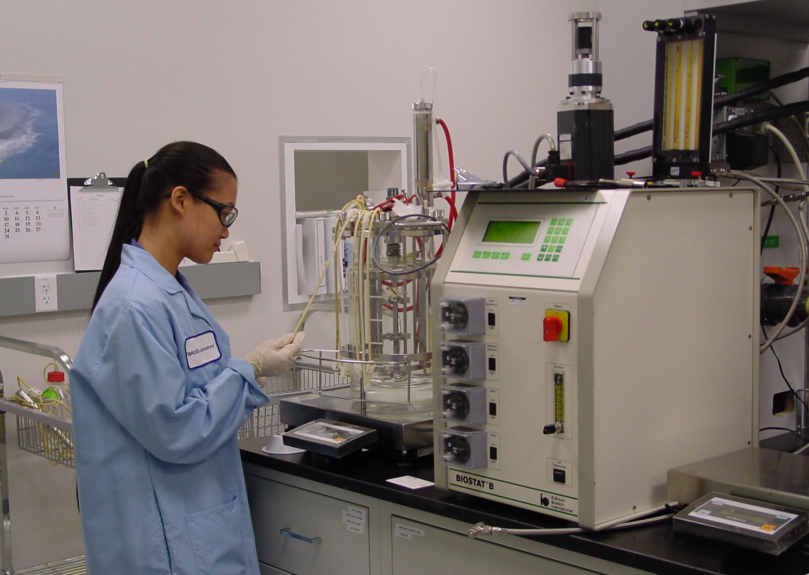
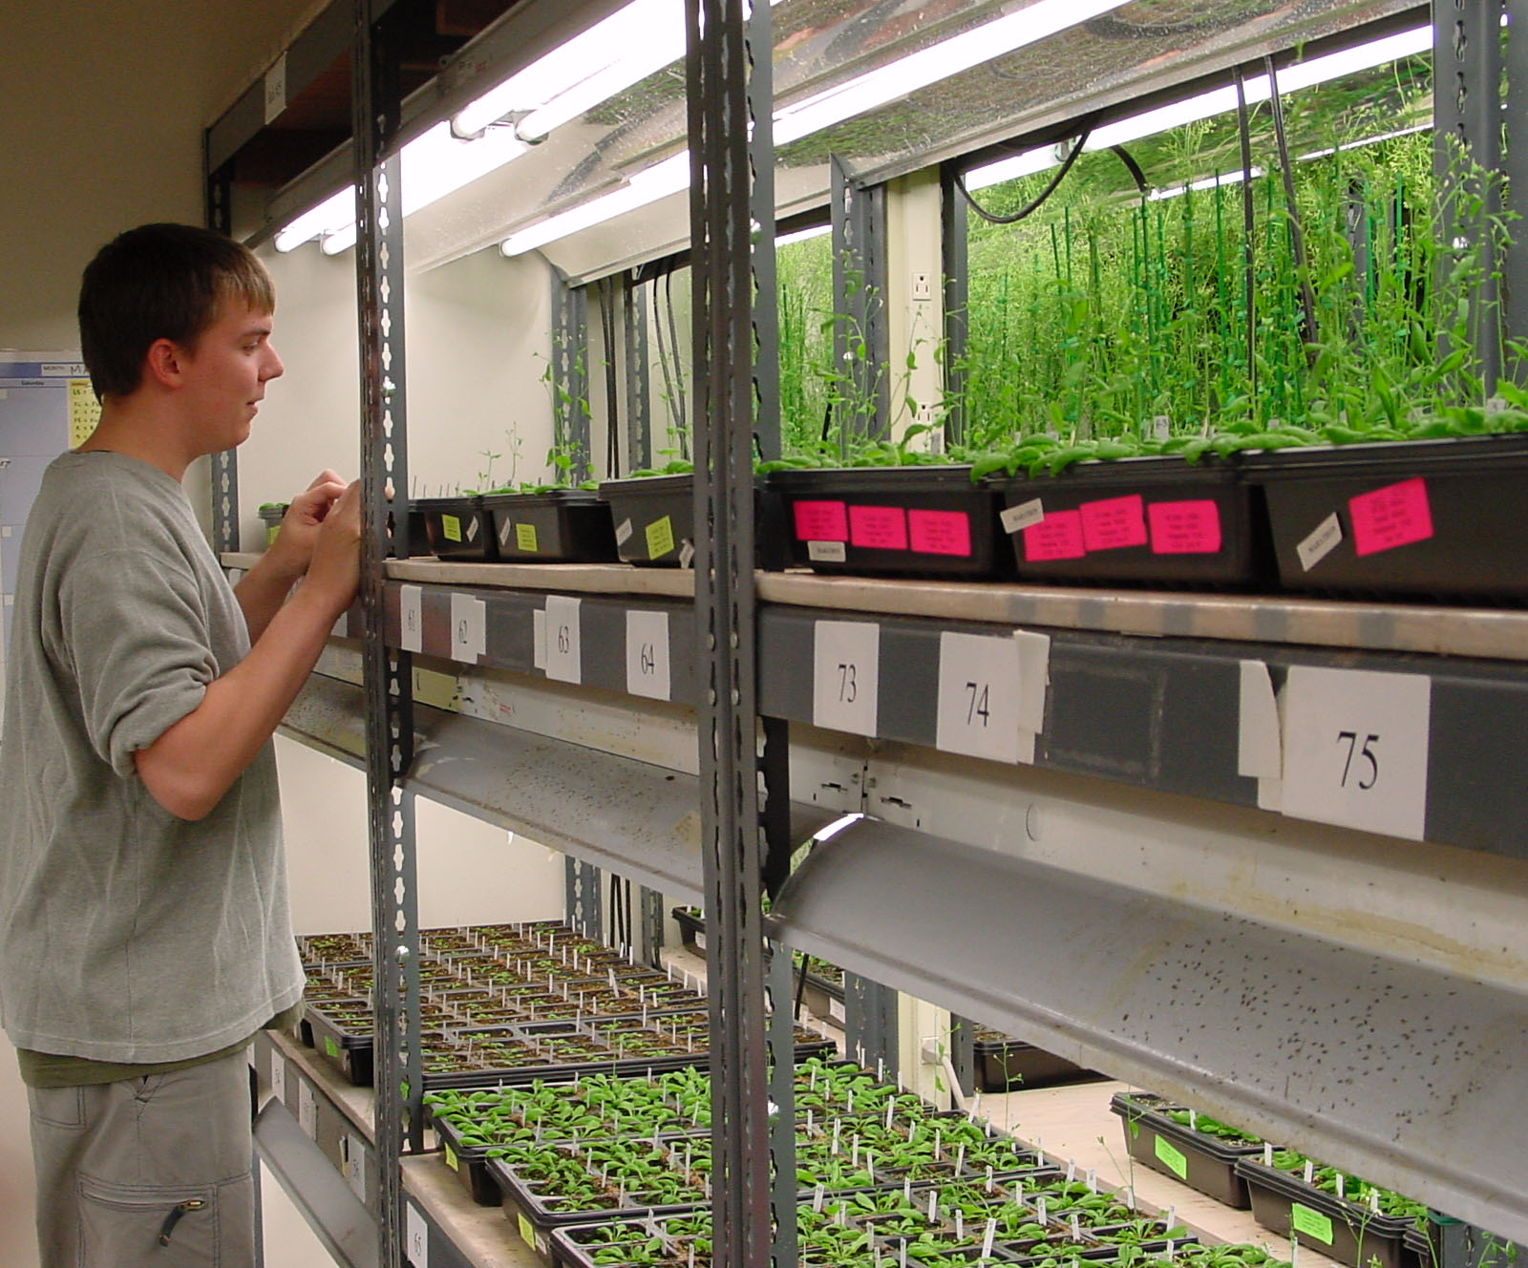
Research and Development
Quality Control
Students are
Biotech is Good for Everybody
Business Biotech
Biomanufacturing
Biotechnology is an opportunity to teach science in a way that results in
science literacy, research skills & career awareness for virtually every student.

