Slide 1
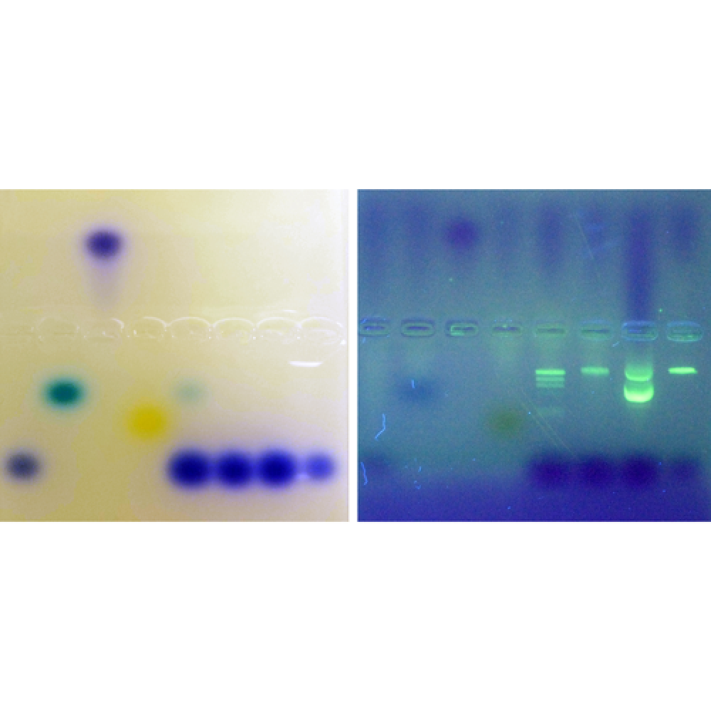
Biotechnology Basics™ by Ellyn Daugherty
Gel Box Science
Sponsored by Fisher Science Education and G-Biosciences
G-Bio Lab Kit # BBED-4j FSE # S41618
Ellyn Daugherty Ellyn@BiotechEd.com www.BiotechEd.com
Biotechnology: Science for the New Millennium, 2E
To request preview copies of BS4NM,
fill in the BS4NM card for drawing and put a * on top

Slide 2
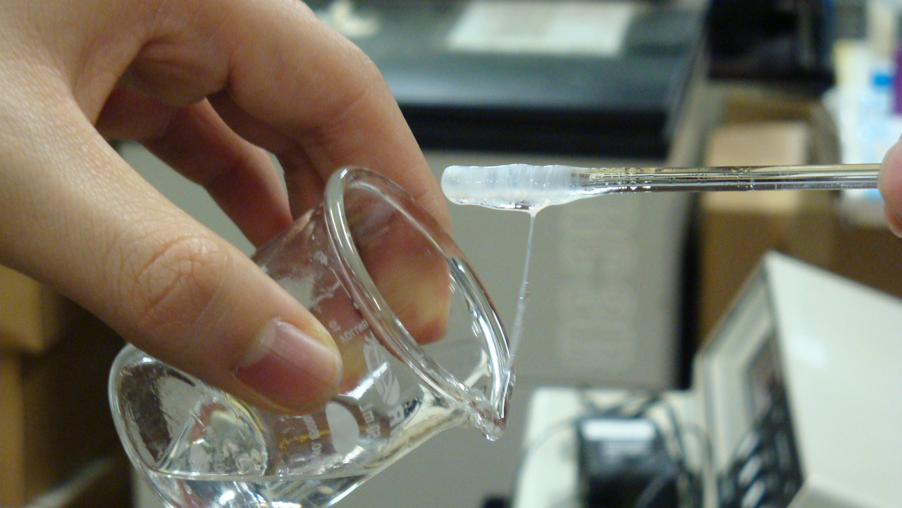
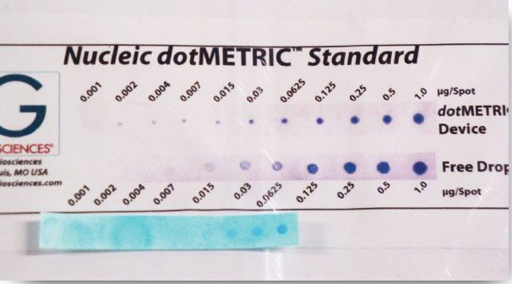
Biology Courses are the Recruiting Ground
for Biotechnology
“Biotechnology coursework increases the numbers of scientists, research associates, lab technicians, and science-literate citizens needed in our rapidly changing science-based society.
Where do Biotechnology programs get their students?
...usually from Bio classes where something “turns them on”
Biotechnology Basics™ by Ellyn Daugherty
brings a 3-4 week unit of introductory biotechnology activities into biology courses where time and funding are limited.

Slide 3
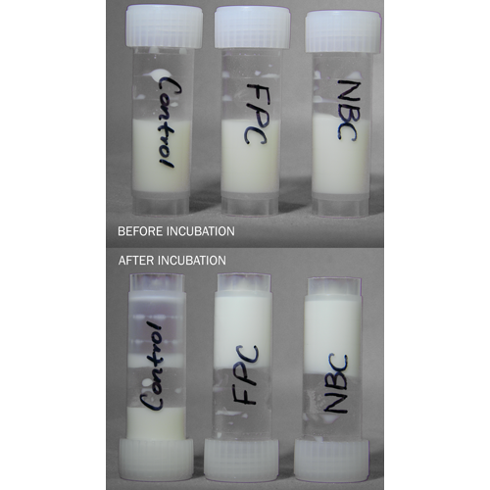
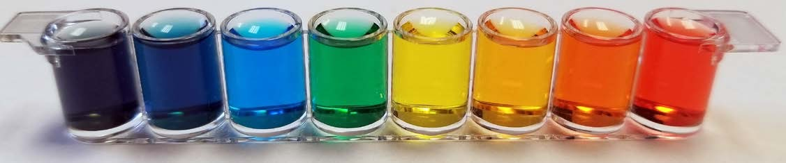
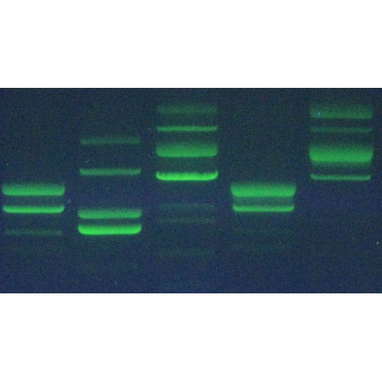
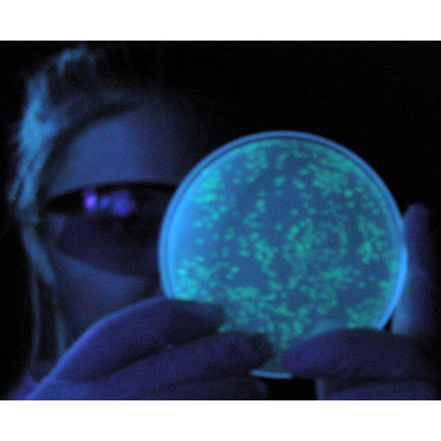
Biotechnology Basics™ by Ellyn Daugherty
Kits and Activities Specifically for Biology
or other Science Classes
Cheese Biotechnology
Micropipet Mastery
DNA Spooling with a Twist
Gel Box Science
Crime Scene DNA Gels
Genetic Engineering

Slide 4
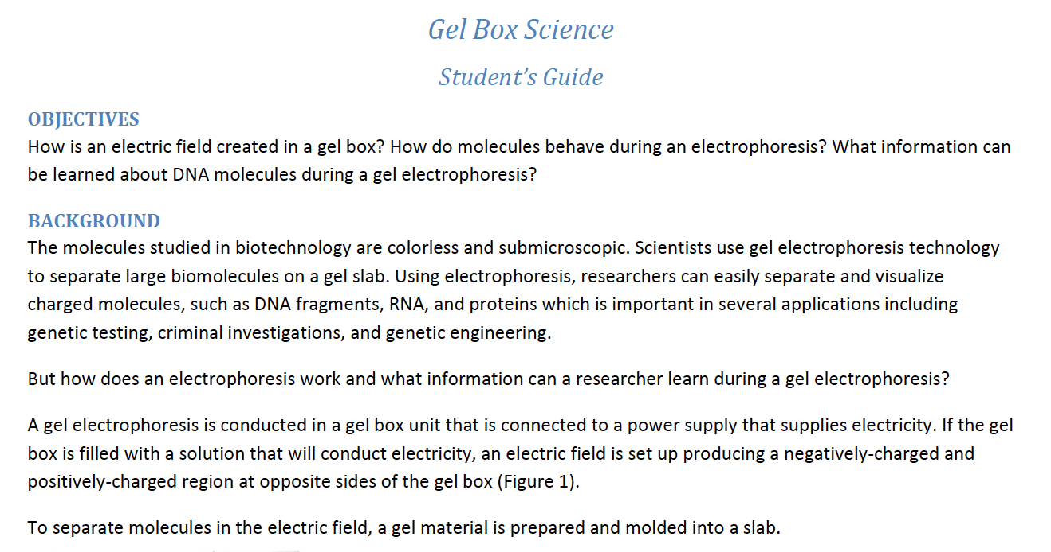
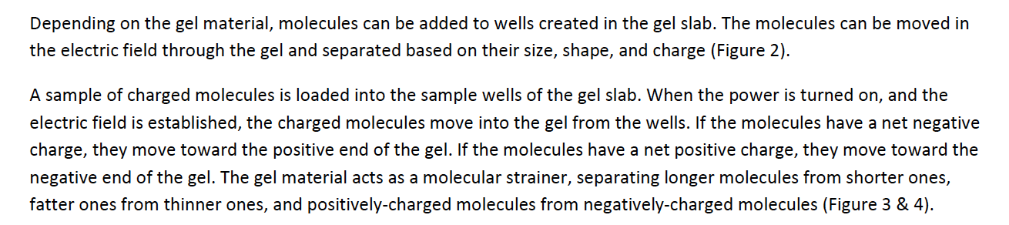

Slide 5
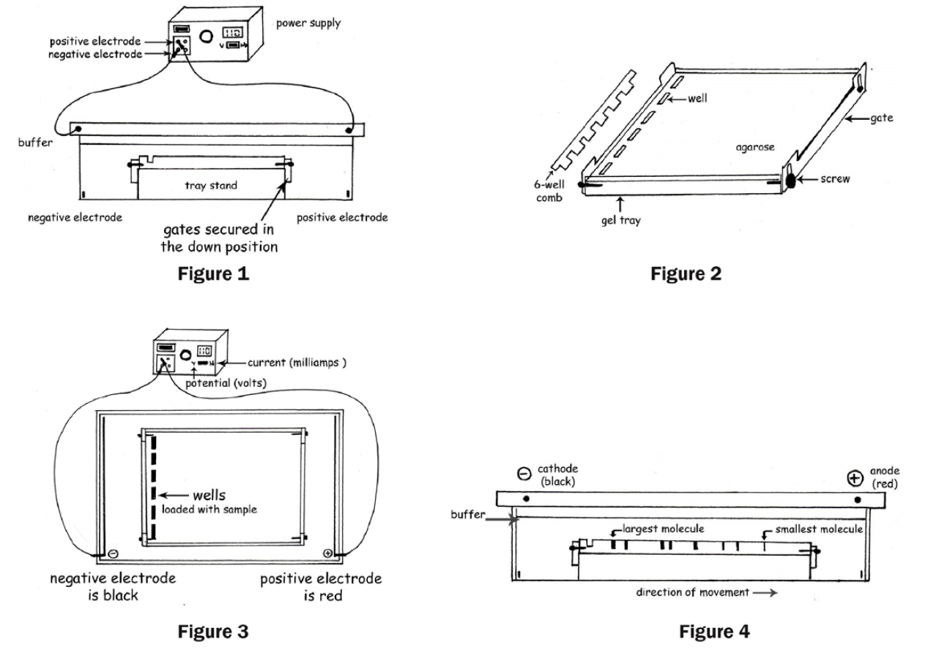

Slide 6
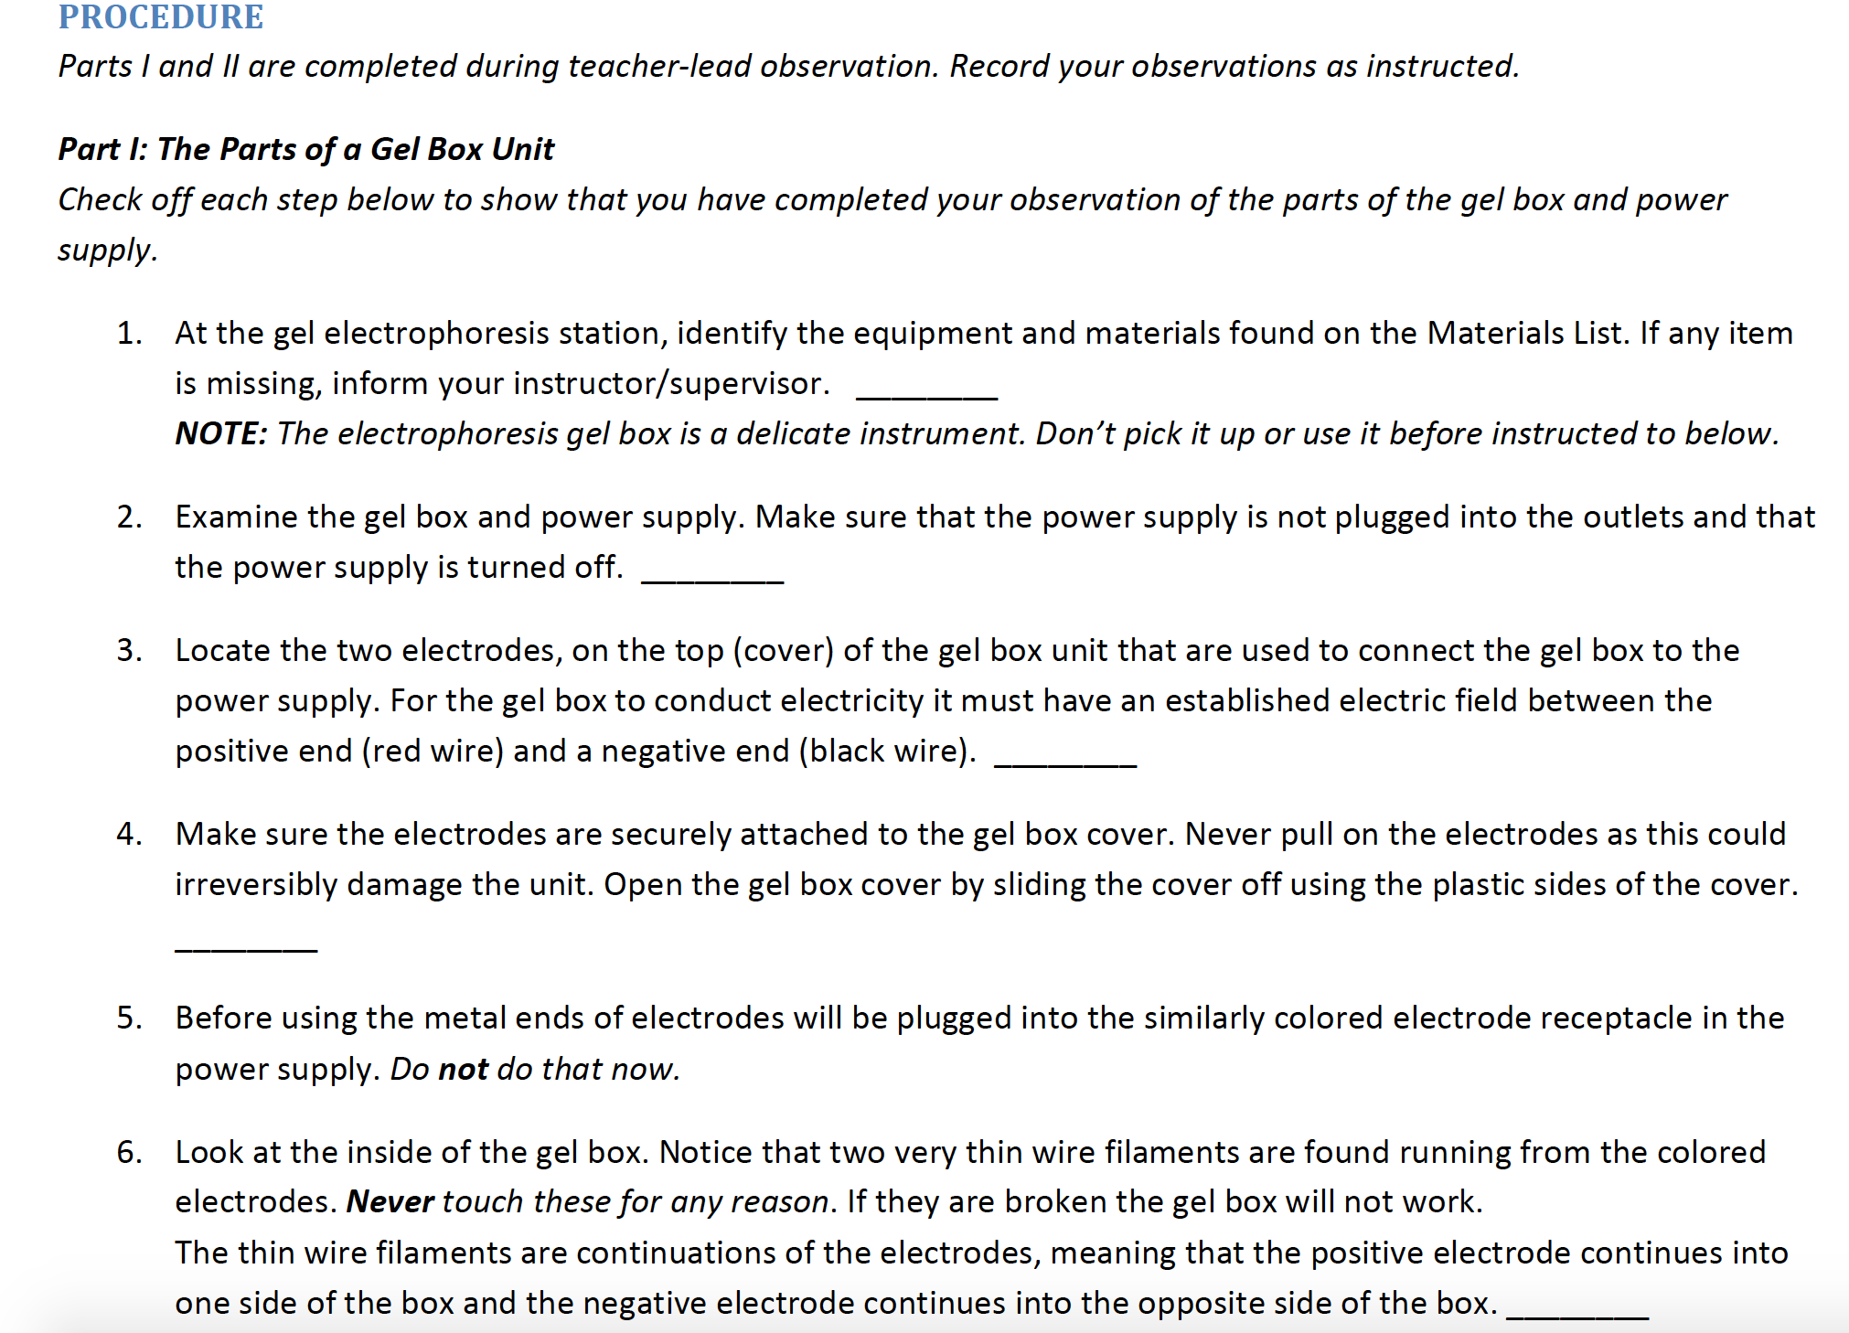

Slide 7
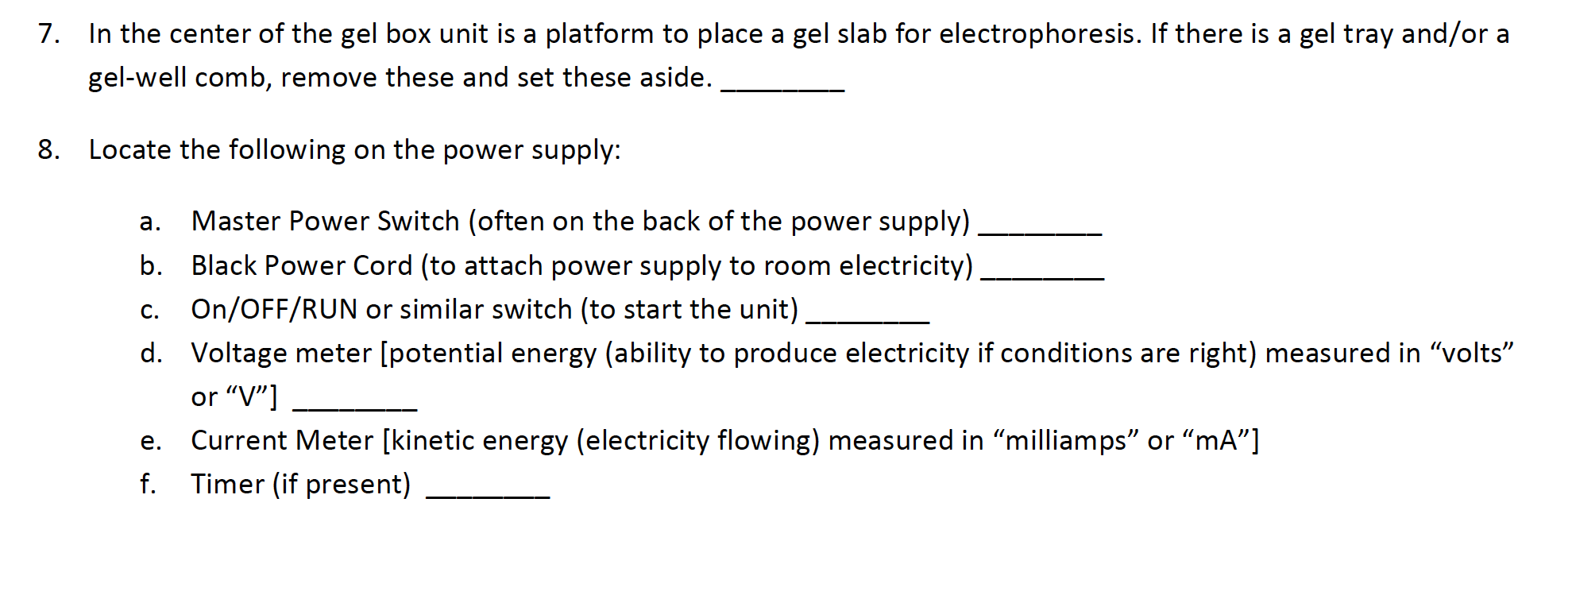

Slide 8
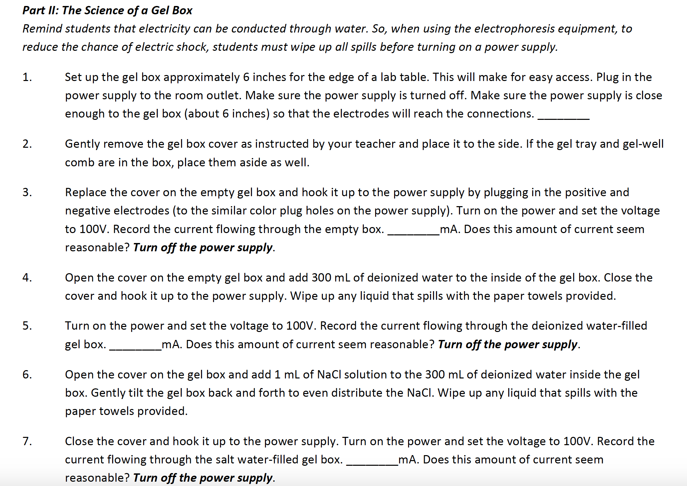

Slide 9
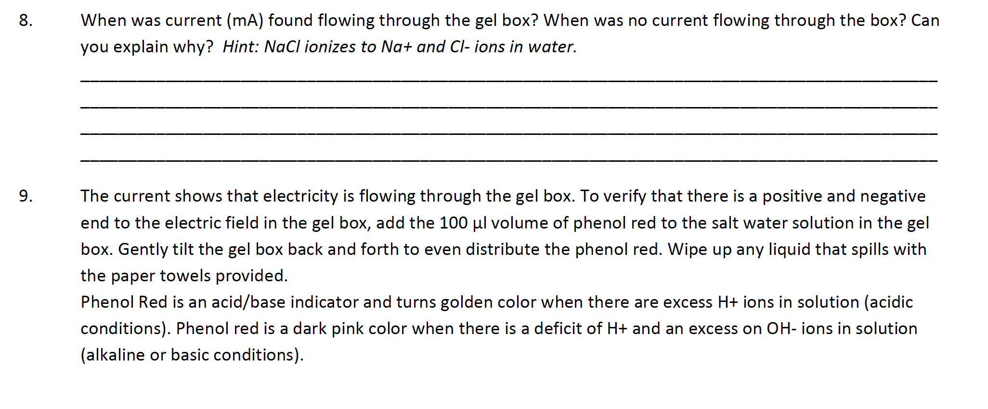

Slide 10
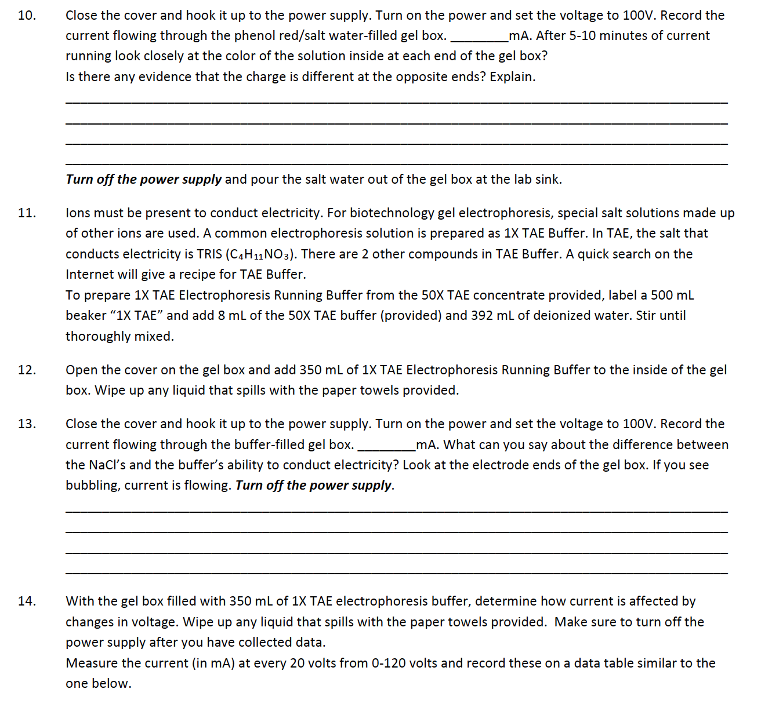

Slide 11
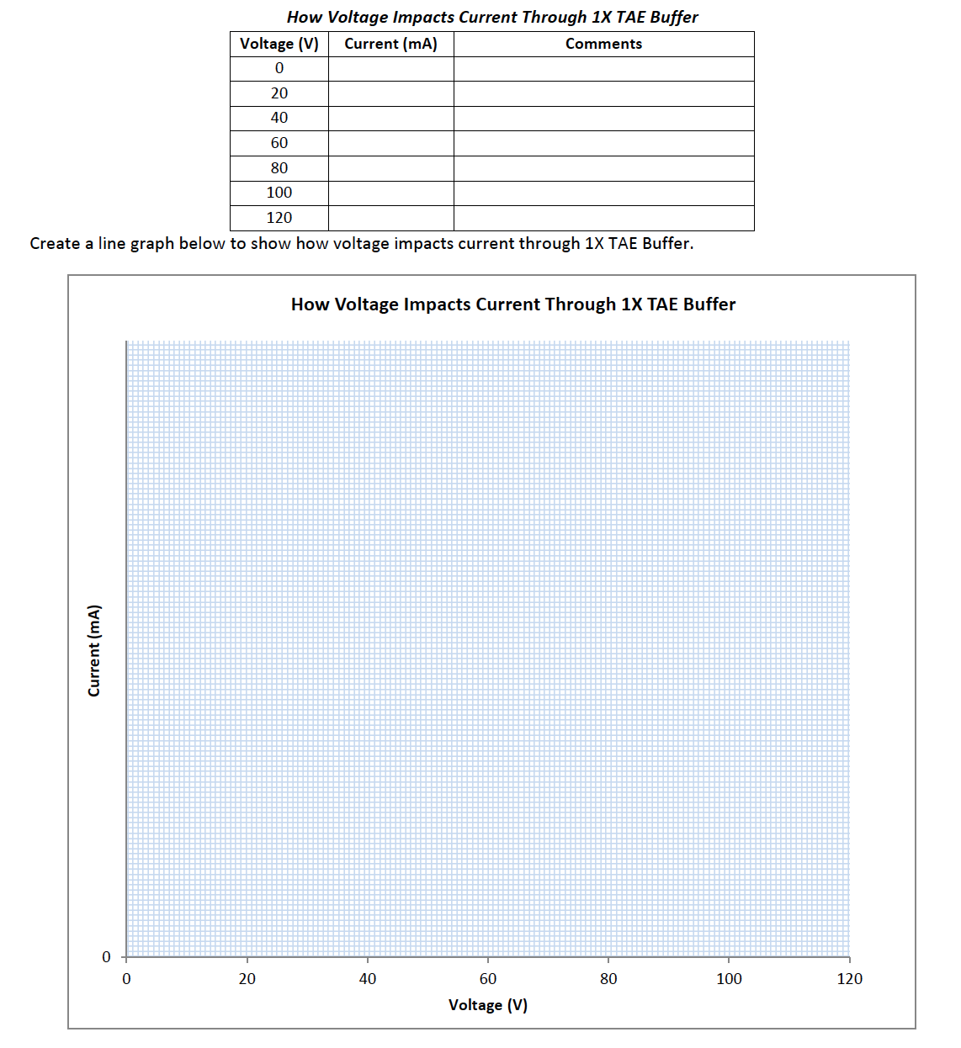

Slide 12
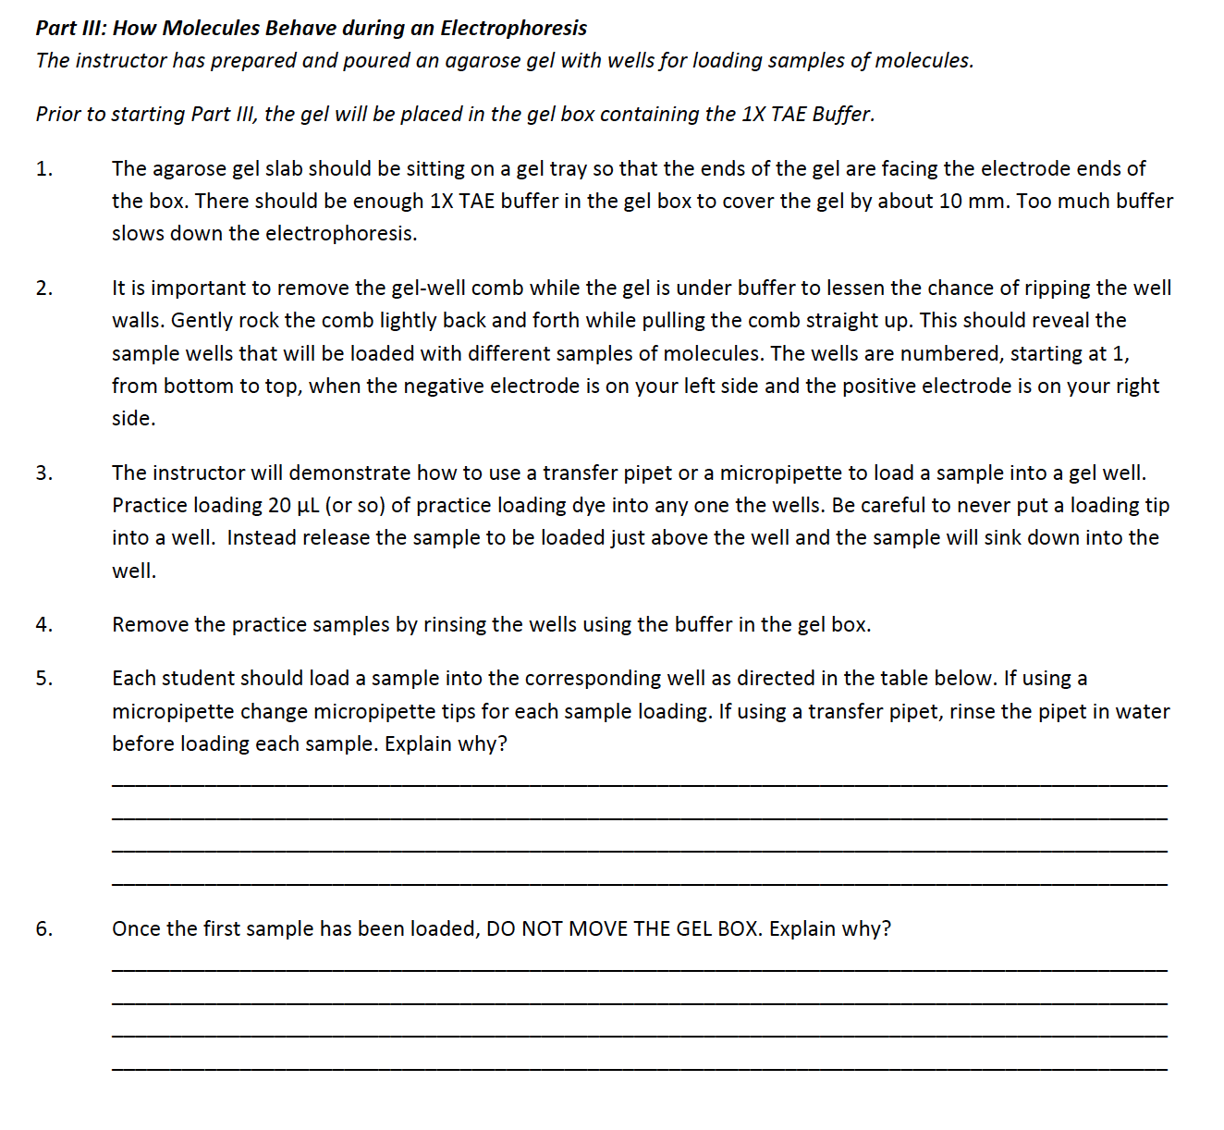

Slide 13
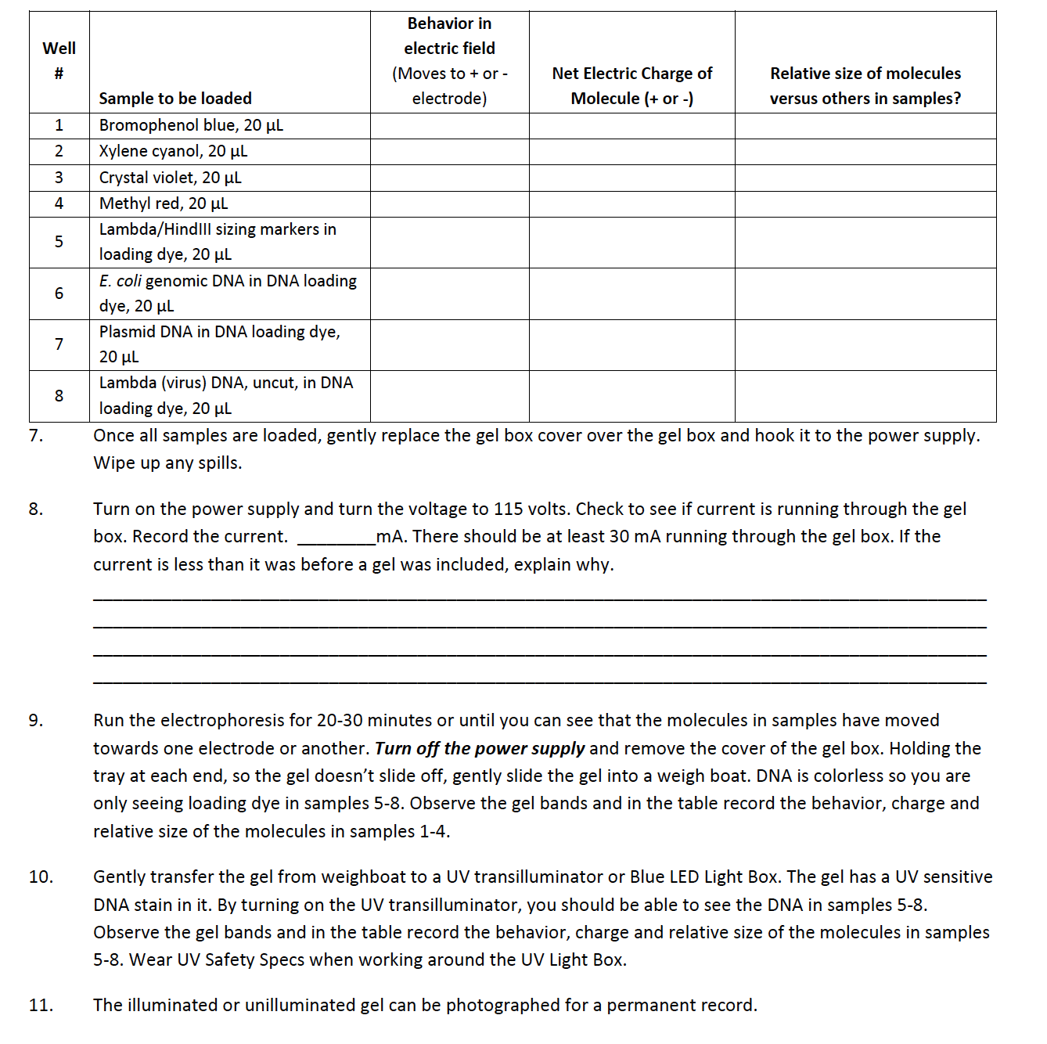

Slide 14
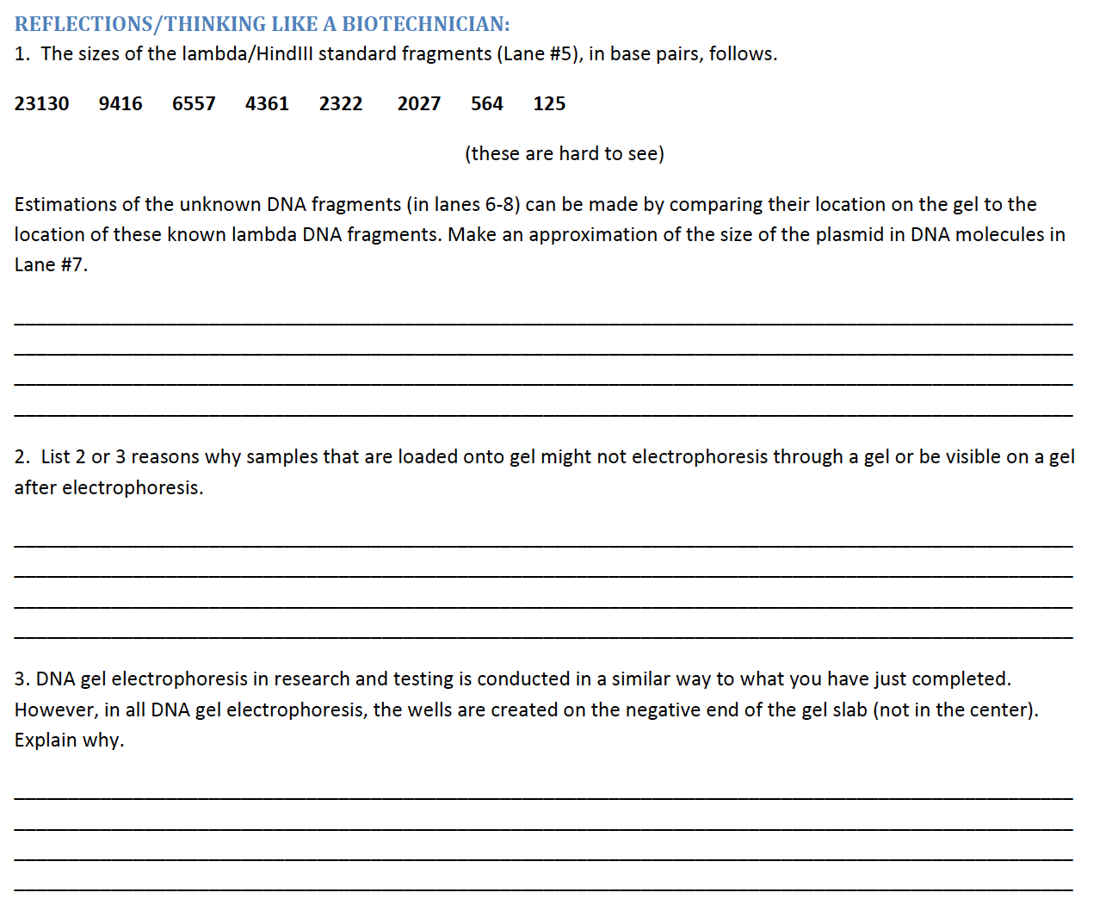

Slide 15
What a Biotech Unit in Biology Might Look Like
“What is Biotechnology?” Internet Activity (on BiotechEd.com)
  Cheese Biotechnology Lab Kit BTNM-1C
Biotechnology Utilizes Tiny Amounts of Reagents
  Micropipetting Mastery Lab Kit BBED-3B
DNA is the Flash and Proteins are the Cash of Biotechnology
  DNA Spooling with a Twist Lab Kit BTNM-4B
DNA Analysis Using Gel Electrophoresis
  Gel Box Science Lab Kit BBED-3B
  Crime Scene DNA Gels Lab Kit BBED-4M
Manipulating Protein Production Through Genetic Engineering
  Genetic Engineering Lab Kit BBED-309
Bioethics and Career Exploration (on BiotechEd.com)

Slide 16
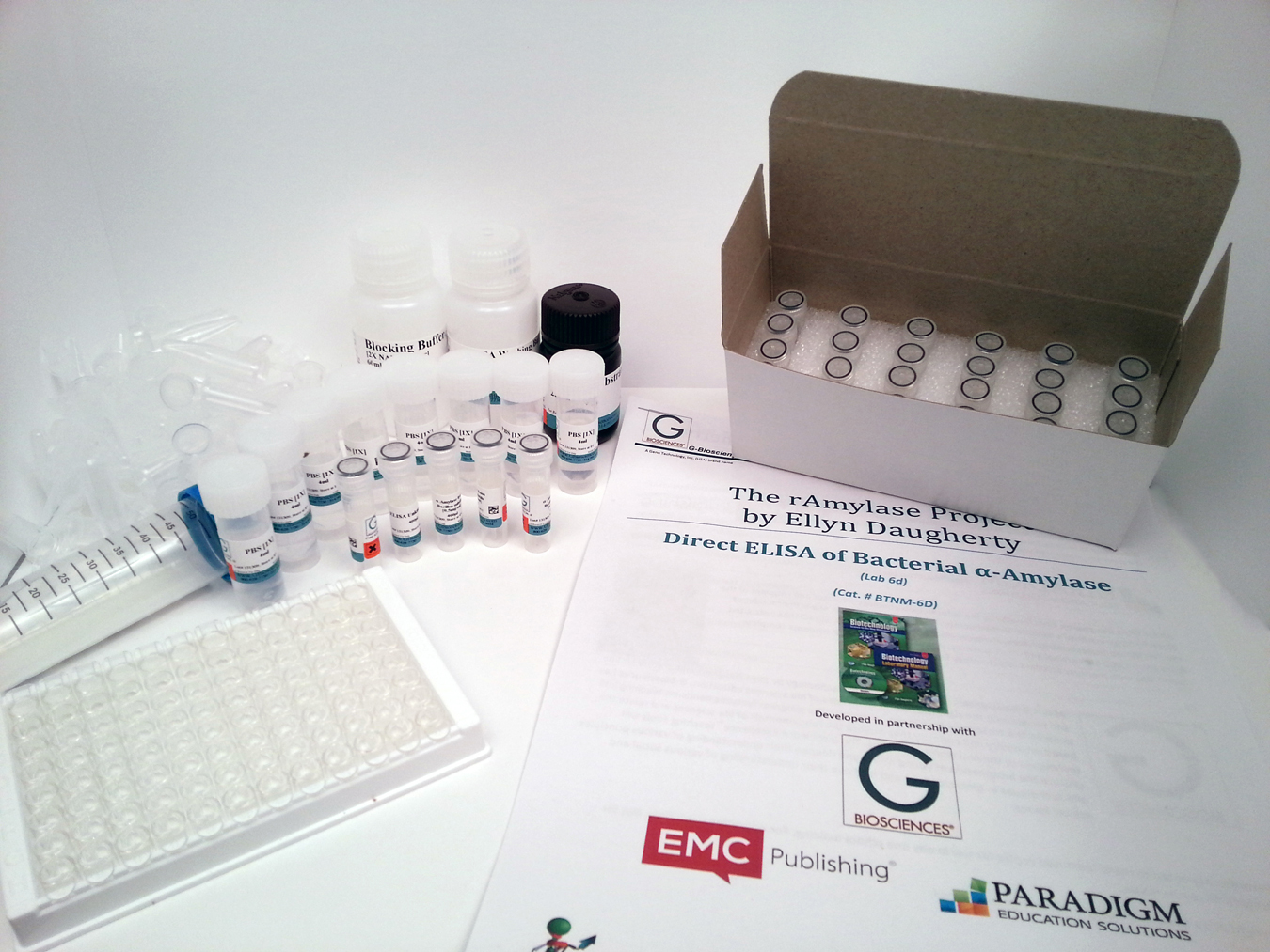
G-Biosciences’ BS4NM and BBED Lab Kits
Written by a teacher for teachers
Kits are designed for 8 lab groups
Majority of reagents are pre-aliquotted for easy distribution to student groups and to save teacher prep time
Kits are often save time and money.
Protocol is downloadable from G-Biosciences website.
Increases the options for student biotech lab skill development.

Slide 17
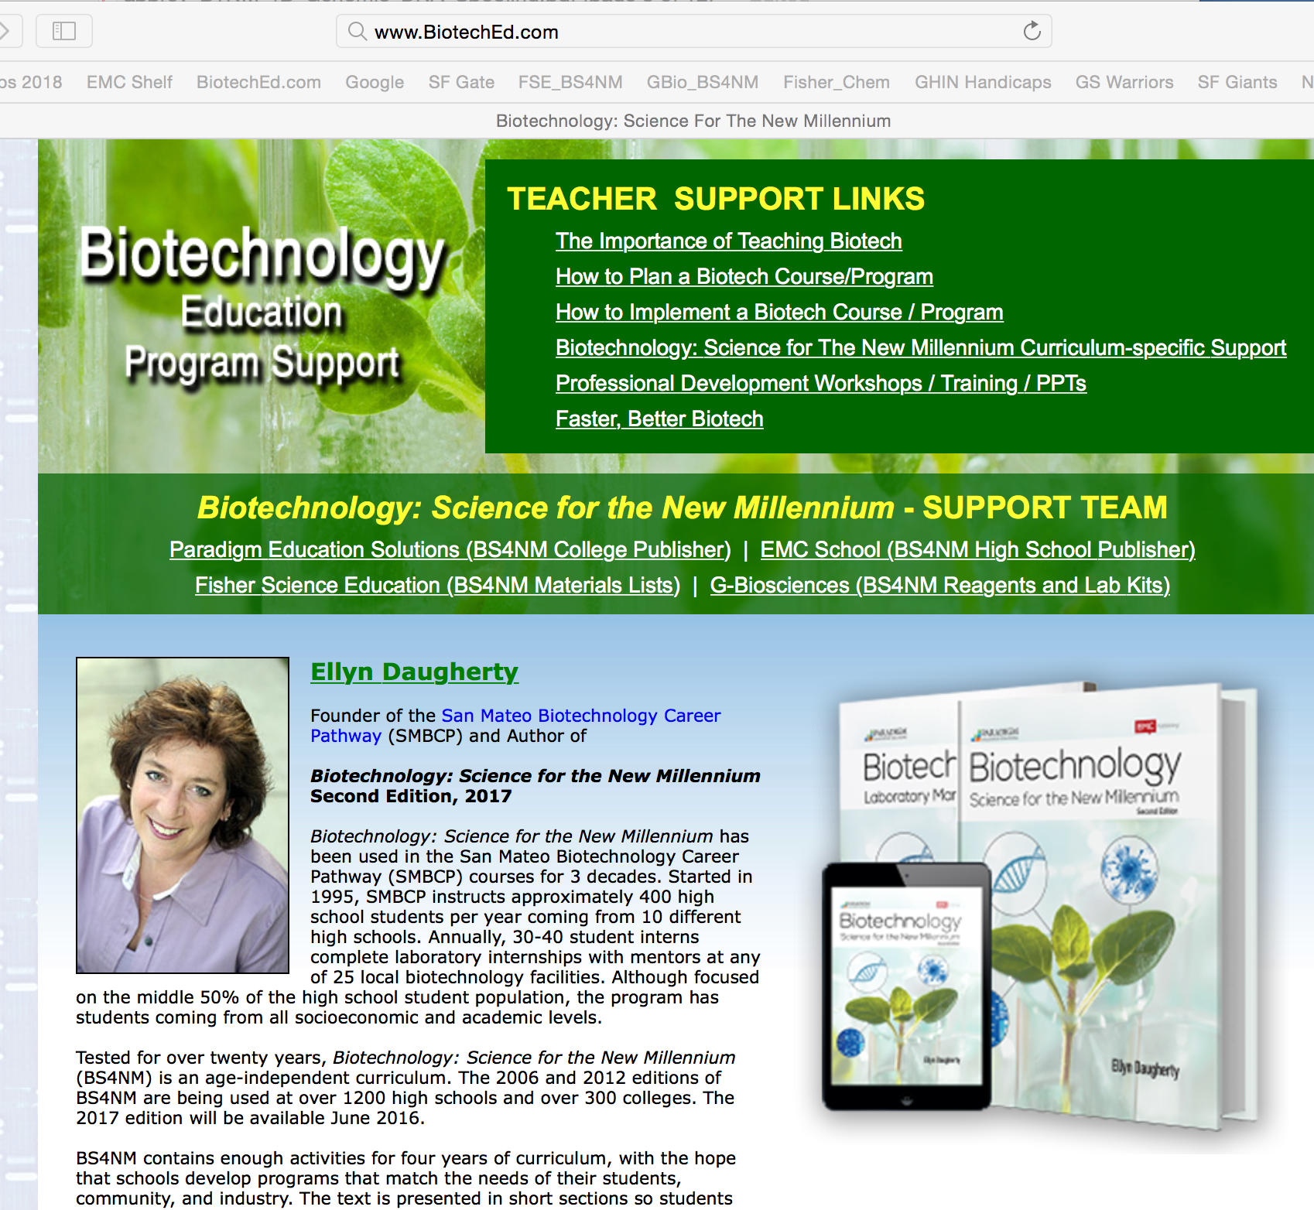
FSE
G-Bio
    BS4NM and BBED Lab Kits available from G-Biosciences
    www.gbiosciences.com/BTNM
    Or through Fisher Science Education
    www.FisherEdu.com/BS4NM
Unless biology educators give their students experiences in the processes of biotechnology, how are students supposed to know they are interested in biotech careers and how can they be expected to make academic decisions that lead them to those careers.”

