Slide 1
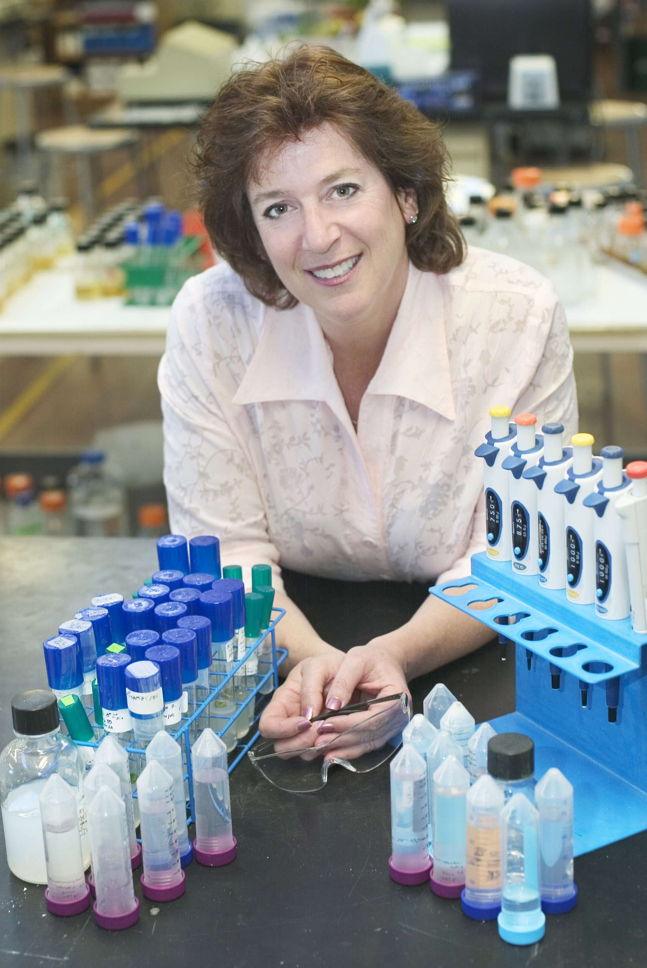

Carnegie Learning Biotechnology Education Professional Development
Biotechnology:
Science for the New Millennium
Studying Molecules and Disease using
Computer Modeling and other Bioinformatics
Ellyn Daugherty
www.BiotechEd.com
Ellyn@BiotechEd.com
650-400-9424
Diane Sigalas
Biotechnology, Livingston HS
Livingston, NJ
dsigalas@livingston.org

Slide 2
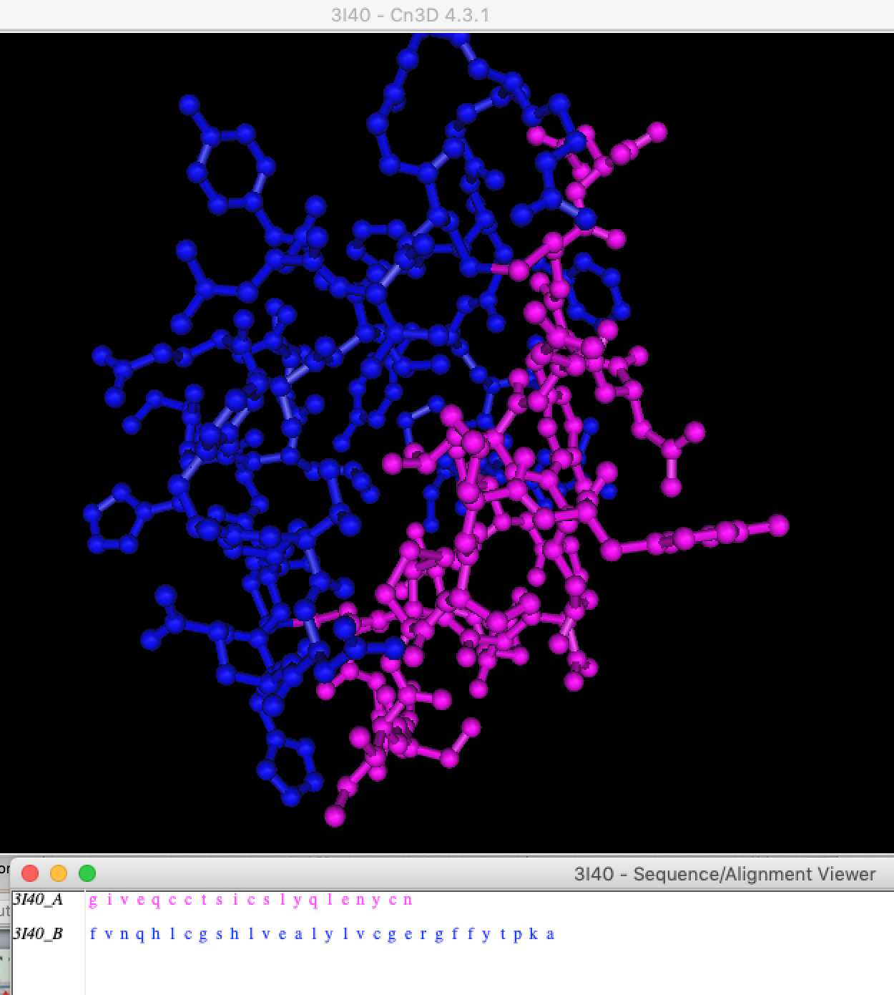
BS4NM, 2E
6 Biotech Online (BO) and Biotech Live (BL)
Molecular Modeling and Bioinformatics Activities
Computer-generated Molecular Models (p. 54)
NCBI and Bioinformatics (p. 141)
Viewing 3-D Structure of a DNA Molecular Model (p. 142)
Determining the AA Sequence of Insulin (p.175 paper model) Extension: Cn3D of 3I40 Human Insulin A and B chains
Studying Protein (Amylase) 3-Dimensionally (p. 204)
Who Passes the BRCA1 Test? (p. 397)
PCR Primer Design (p. 432)
For another Zoominar
Alpha and beta chains of human insulin (3I40)
Space-filling model (rainbow) amylase (1BLI)

Slide 3
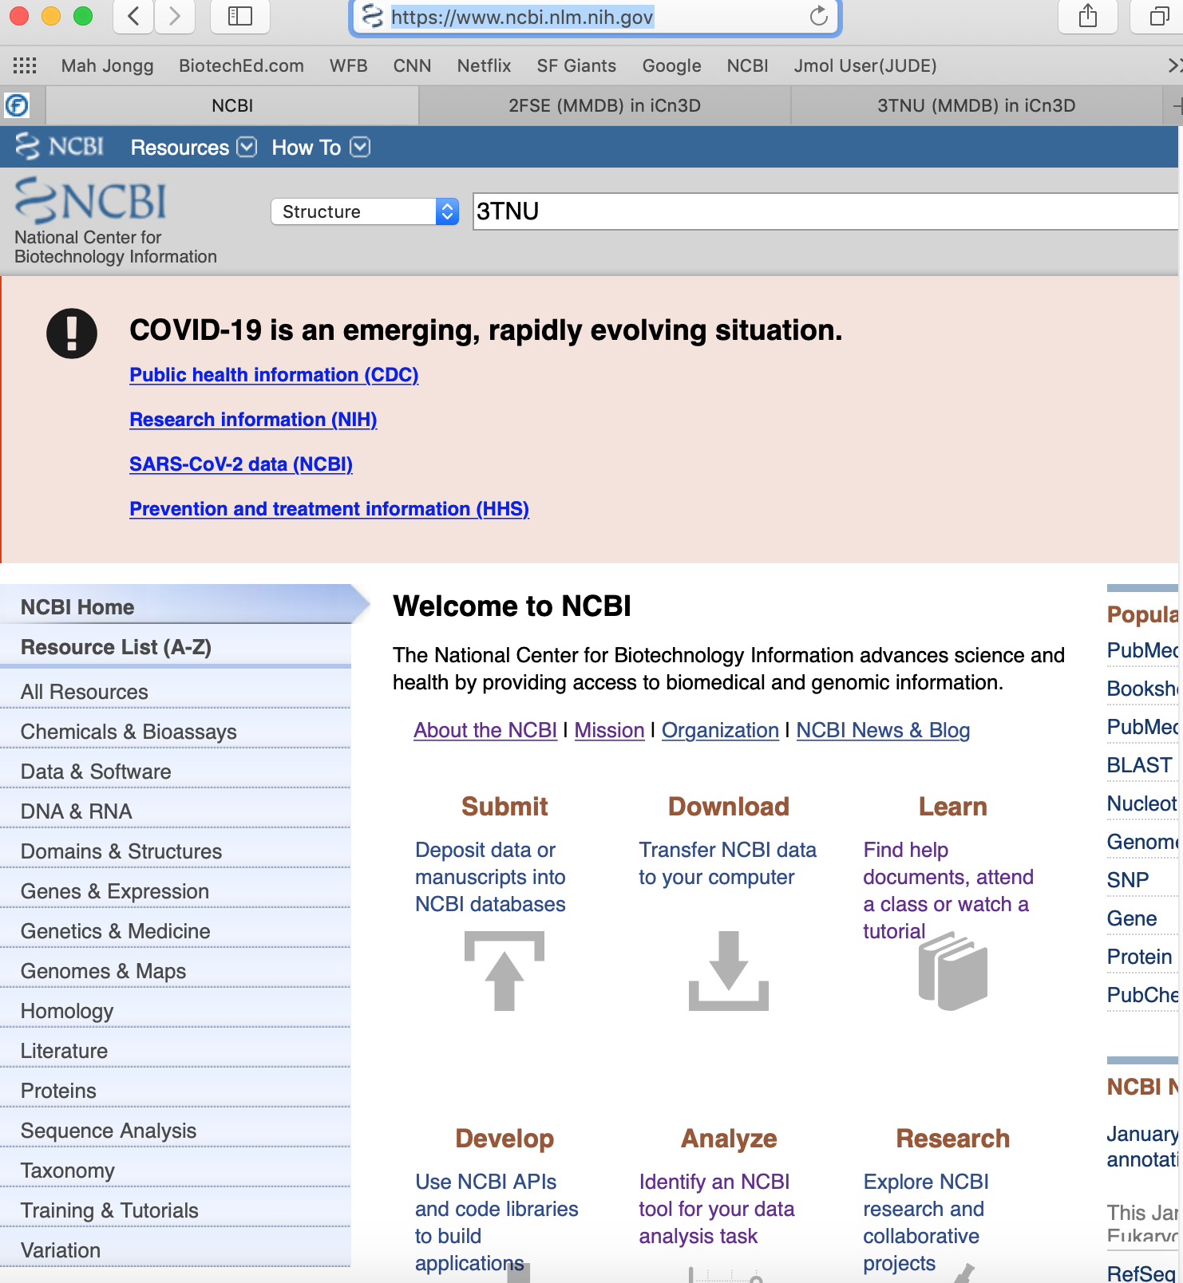
Computer-generated Molecular Models (BS4NM, BO p. 54)
Introduces what 3-D models are and how you can visualize them
Uses Cn3D, free from NCBI https://www.ncbi.nlm.nih.gov/
For 2 familiar structural proteins, a collagen and a keratin – learn how to retrieve and view them
To see a Keratin polypeptide, pick: “3TNU”
To see a collagen polypeptide, pick: “1O91”
And 2FSE to see collage bound by a MHC complex associated with RA

Slide 4
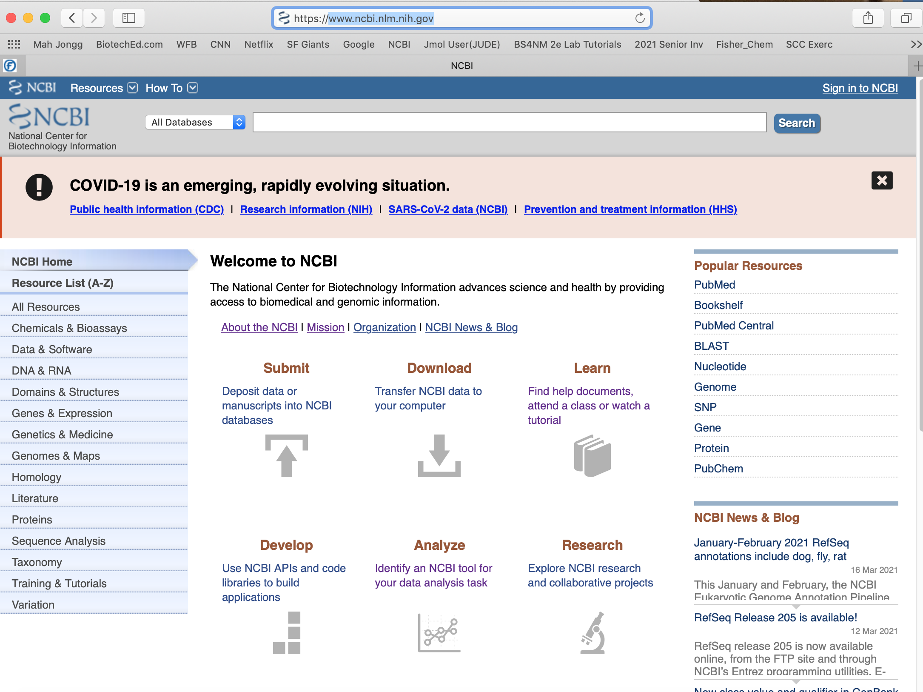
NCBI and Bioinformatics (BS4NM, BL p. 141)
Start @ https://www.ncbi.nlm.nih.gov/
*
*
Tools:
Cn3d
Genetic Codes
BLAST
AA Explorer
*

Slide 5
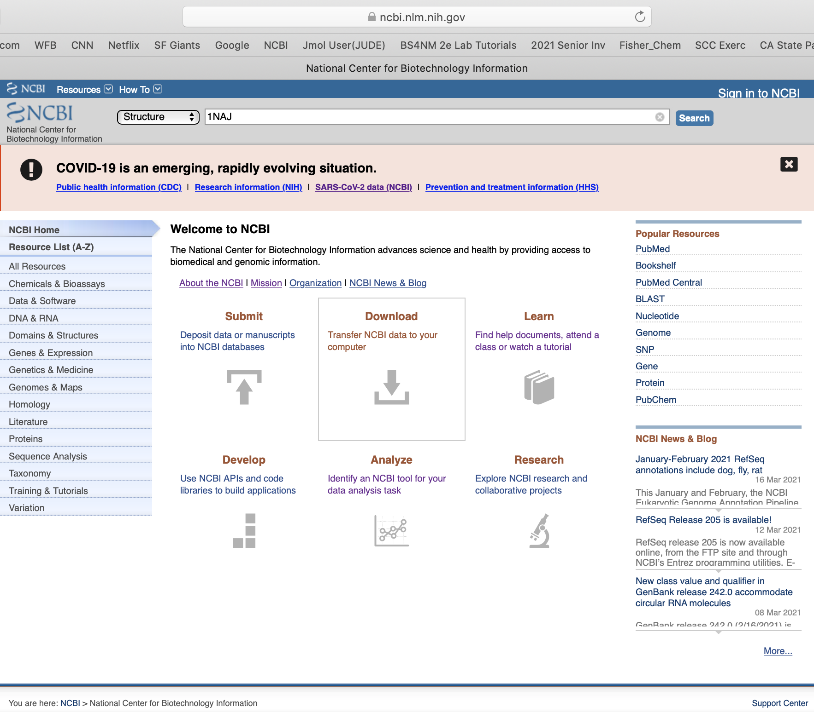
Viewing the 3-D Structure of DNA (BS4NM, BL p. 142, 144)
Several Molecular Modeling Programs/Apps:
Cn3d – free, “my” scientists use this one
Molecule World – small $, ☺ for iPad/iPhone
Jmol – Diane uses this one
PyMol
Each one needs structural data to analyze to create the model.
Data comes from:
X-ray Crystallography/Diffraction
NMR
AA or Nucleotide Sequencing
Researchers share structural data for their molecules of interest, that data is given an identification code by.
Protein Database (PDB)
Molecular Modeling Database (MMDB)
Structure
1NAJ

Slide 6
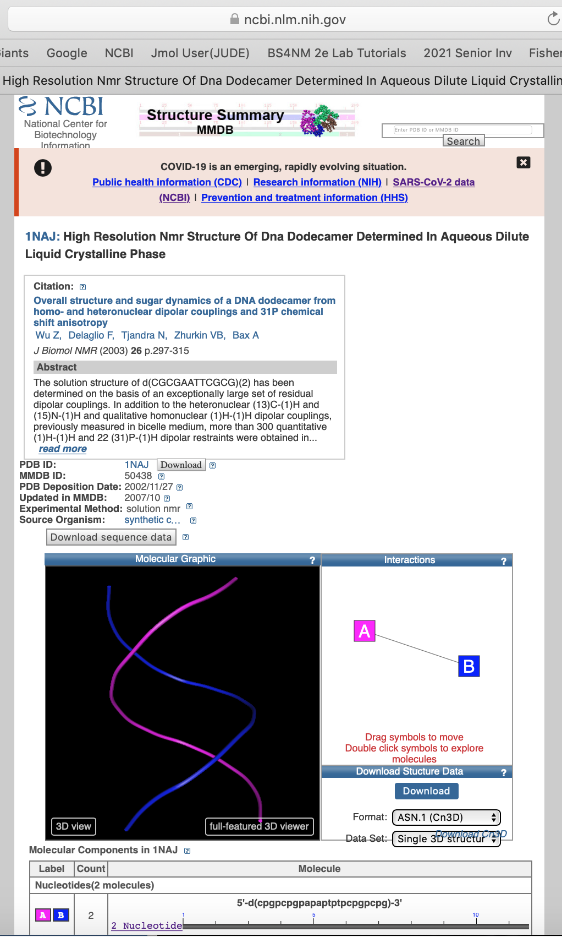
https://www.ncbi.nlm.nih.gov/Structure/pdb/1NAJ
Cited Publication & Summary Abstract
Data source:
Source Organism
Experimental Method
Data shared
*
Download
to
Cn3d
*

Slide 7
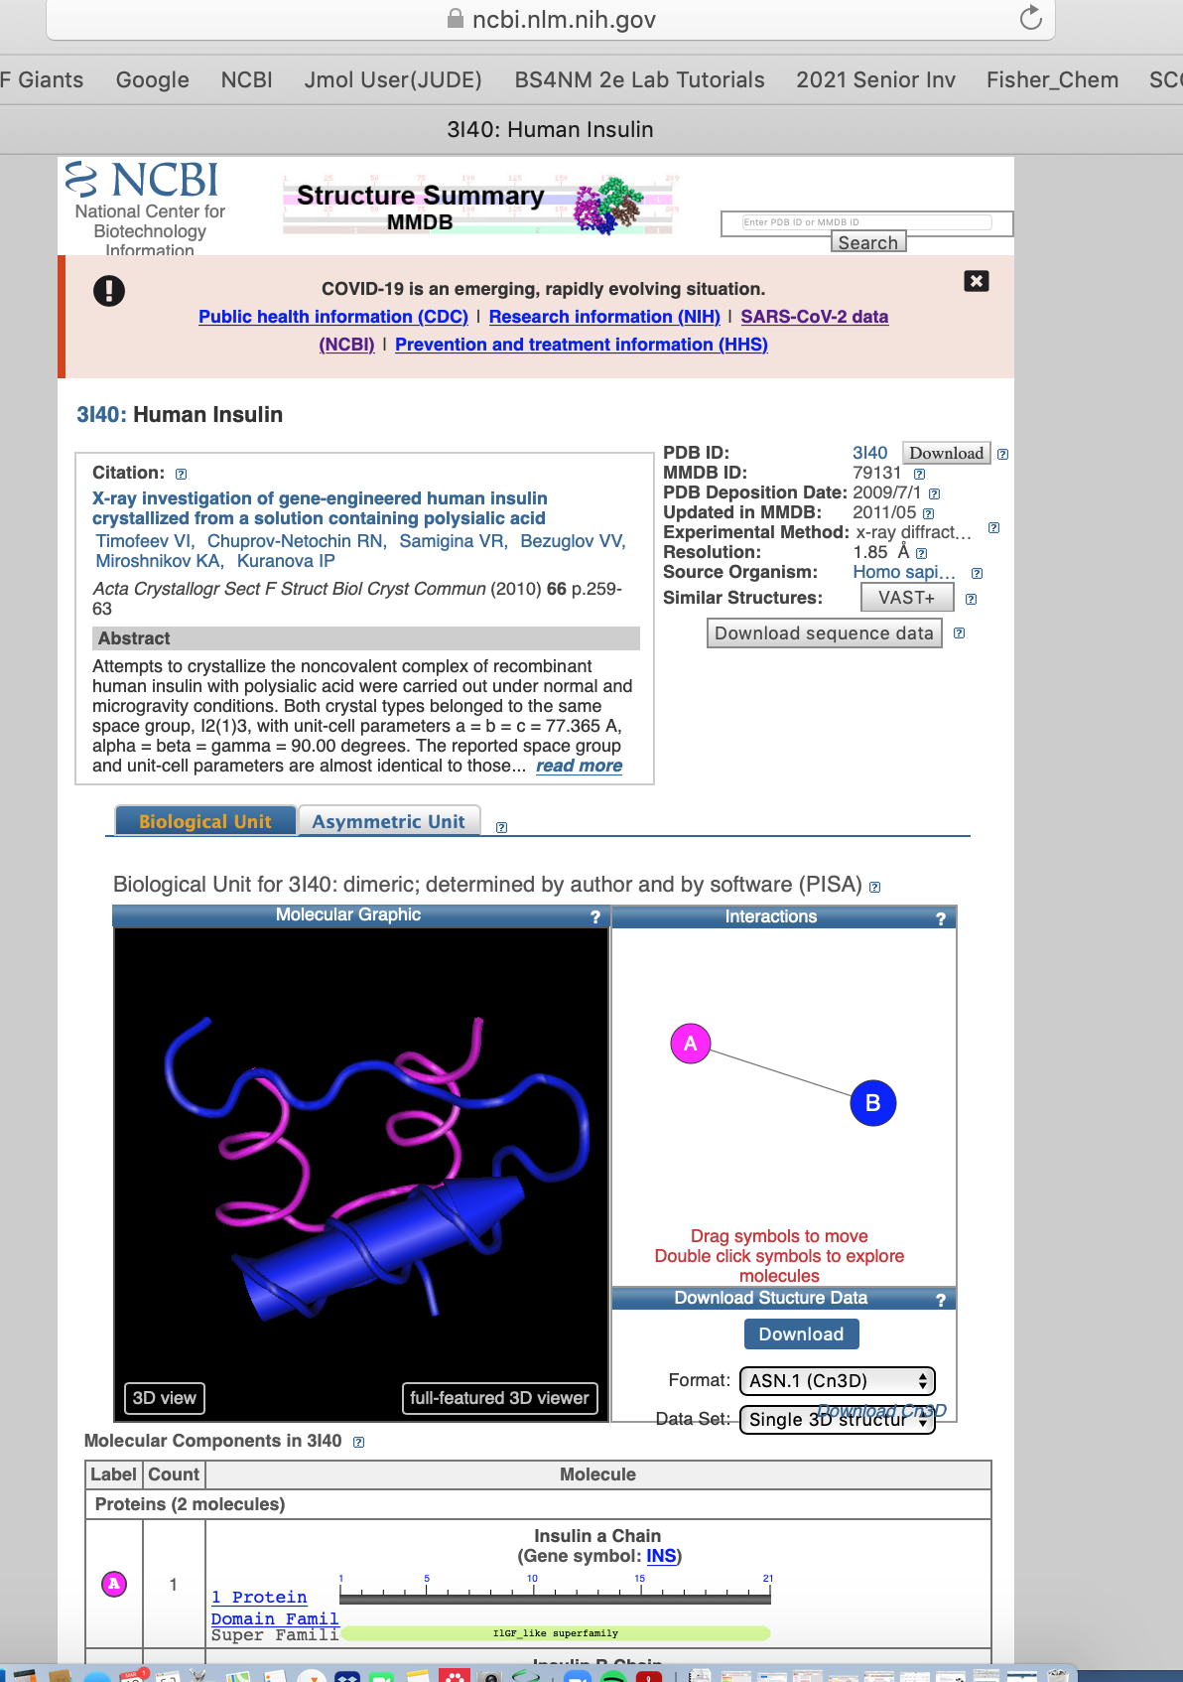
3-D Structure of Insulin (BS4NM, BL p. 175)
Using a paper model, students:
Transcribe pro-insulin gene
Translate pro-insulin mRNA
Create pro-insulin polypeptide
Do post-translational modification (excise some AAs)
From bonds to fold and connect alpha and beta insulin chains
Check it out on Cn3d
Structure
3I40
https://www.ncbi.nlm.nih.gov/Structure/pdb/3I40

Slide 8
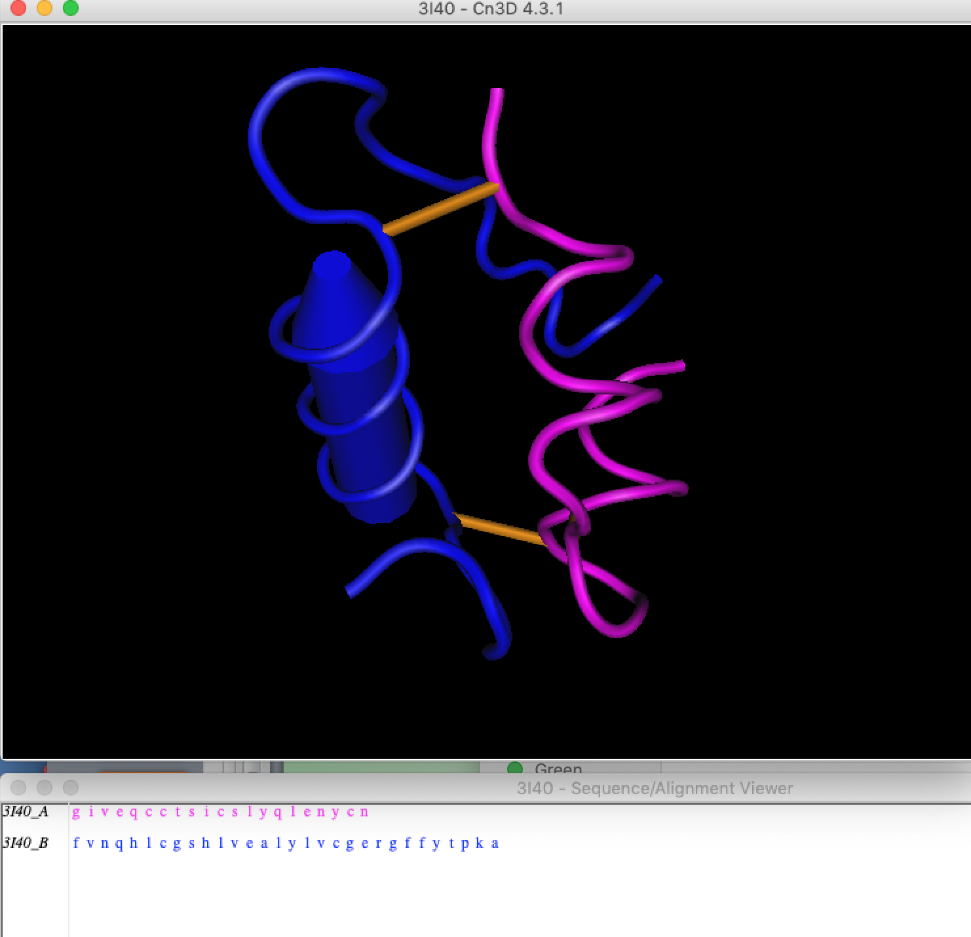

Slide 9
Studying Protein (Amylase) 3-Dimensionally (BS4NM p. 204)
Ball and Stick model - color-coded amino acids in amylase (1BLI)
Structure: 1BLI

Slide 10
Space-filling model in rainbow rendering - amylase (1BLI)

Slide 11
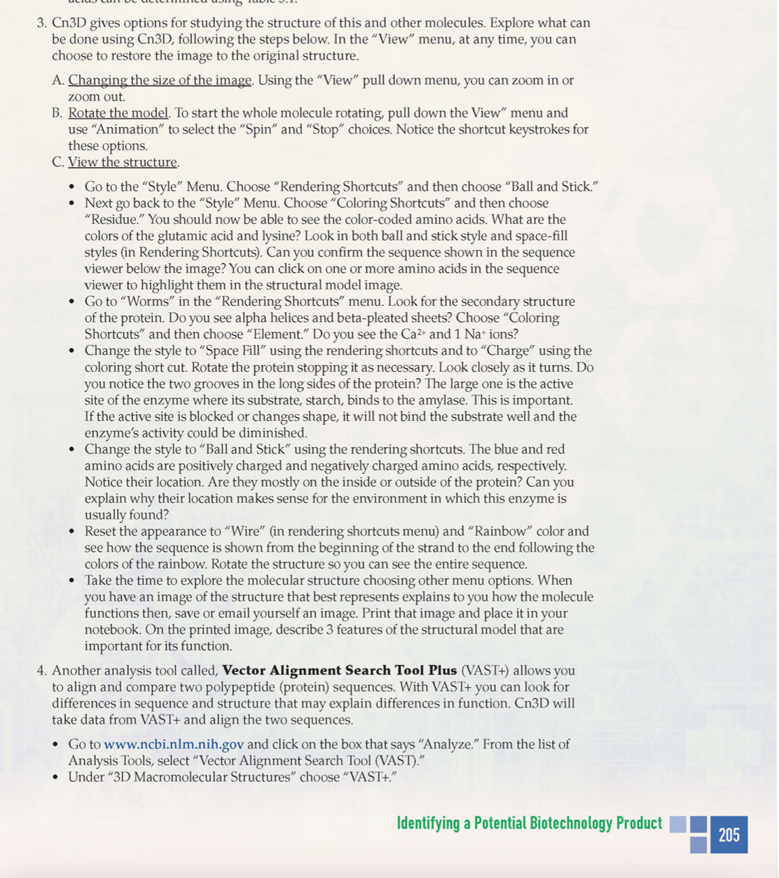
VAST can compare two protein structures
wild-type alpha amylase superimposed with heat-resistant engineered alpha-amylase

Slide 12
Native alpha amylase superimposed with heat-resistant engineered alpha-amylase
See yellow loop - due to additions in the 1E3Z polypeptide
Intended Mutation Produced using PCR

Slide 13
In this view, you can see that the starch substrate still binds at the active site.
See yellow loop - due to additions in the 1E3Z polypeptide

Slide 14
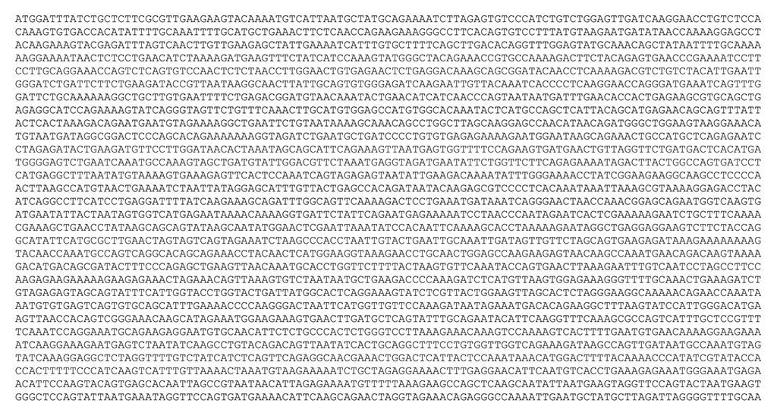
Who Passes the BRCA1 test? (BS4NM, BL p. 397)
Does Deborah carry the BRCA1 breast cancer gene?
Scenario – Some relatives known to have had an aggressive breast or prostate cancer
BCRA1 mutation is inherited as an autosomal dominant gene.
Deborah wants to know more to make informed decisions.
Use a pedigree chart and family history to assess risk of inheritance
Use NCBI Nucleotide databases to analyze family’s DNA for the mutation.
Use NCBI Protein databases to analyze family’s protein data for mutation.
Use Cn3d to see how the mutation changes the tumor suppression gene.
1JNX = BRCA domains of the non-mutated version of the BRCA1 protein.
1N5O = BRCA domains of the M1775R mutation of the BRCA1 protein.

Slide 15
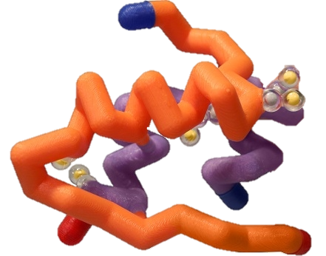


Insulin Modeling
Goal: Show you how I utilize BS4NM to launch off into an in-depth topic of insulin. Not going to show you everything (bc ) but I will show you an overview!

Slide 16
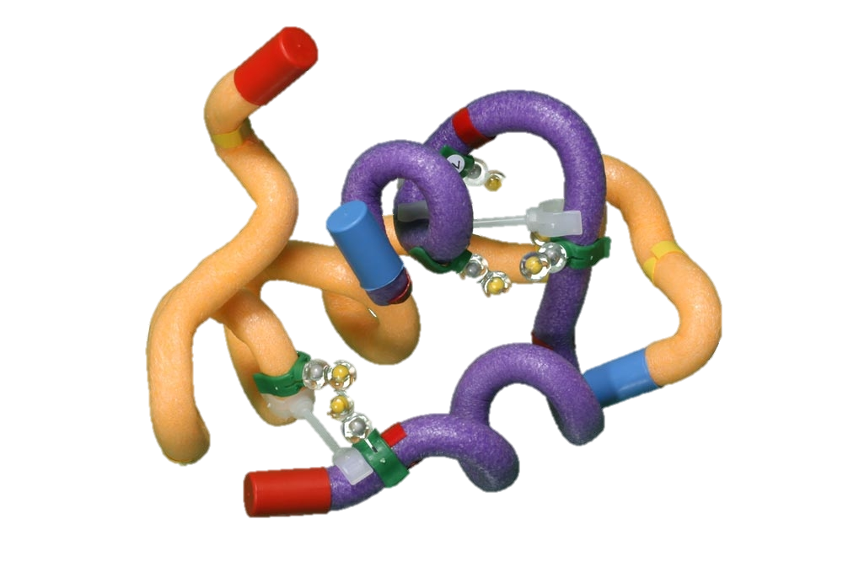
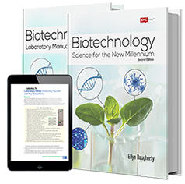

Teacher Notes
Generalized Lesson: (Class Time = ~3 weeks)
Lectures
  Flow from preproinsulin to mature insulin
  Importance of protein folding/processing
  How to Jmol “201” (Review)
    First introduction during Ch. 2 in BS4NM
Labs
  BS4NM
    Activity 5.1, Activity 5.2, Activity 5.3
  Wet Labs
Modeling Activities
  Reading Analog Papers (How to Read a Paper)
  Jmol
  Scientific Poster Presentations

Slide 17
Insulin Folding
Typically I will do this with this kit from 3D Molecular Designs and model it as a group in Jmol for review.

Slide 18
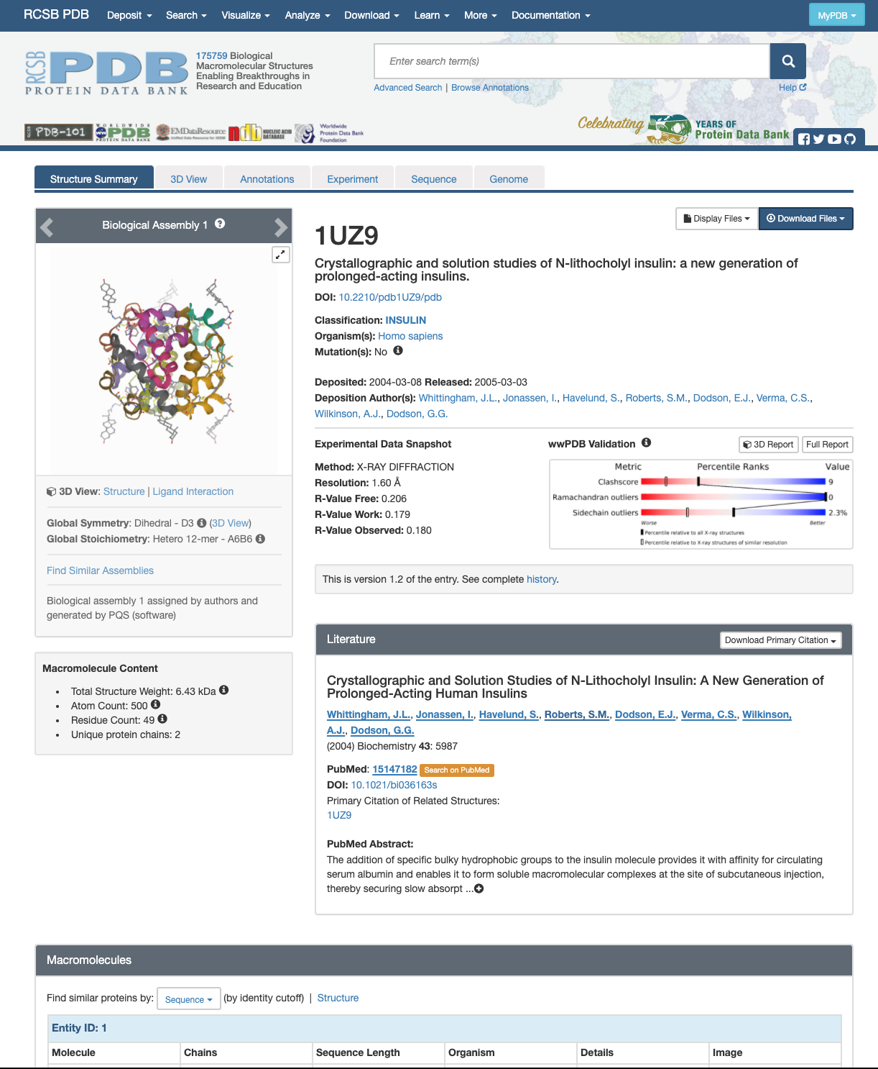
Looking up proteins in PDB
Search Bar
File Name
Paper Title
Authors
Species found in
PubMed ID
Abstract

Slide 19
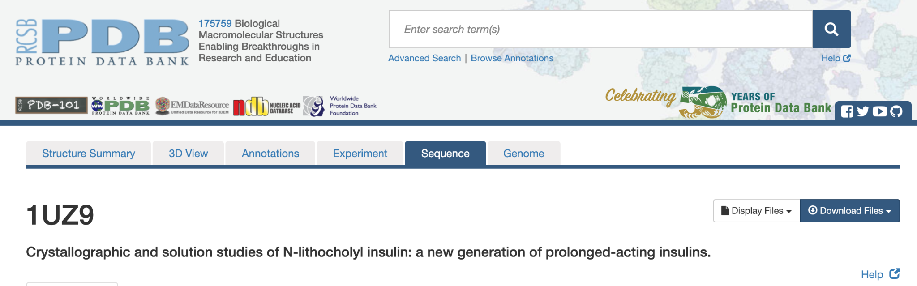
PDB: Sequence Tab

Slide 20
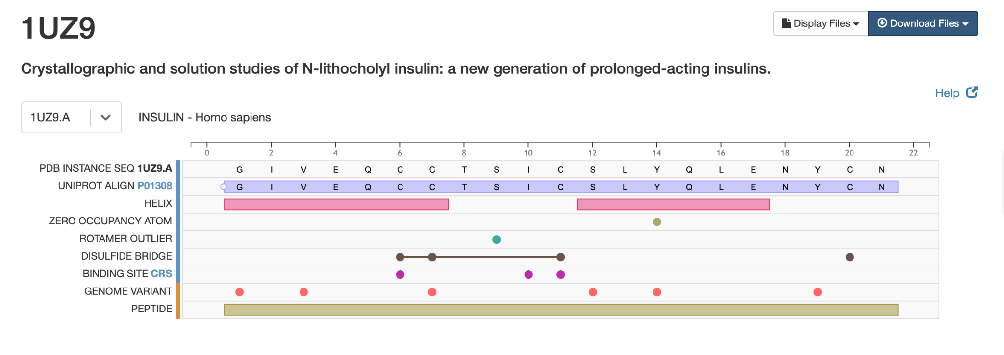
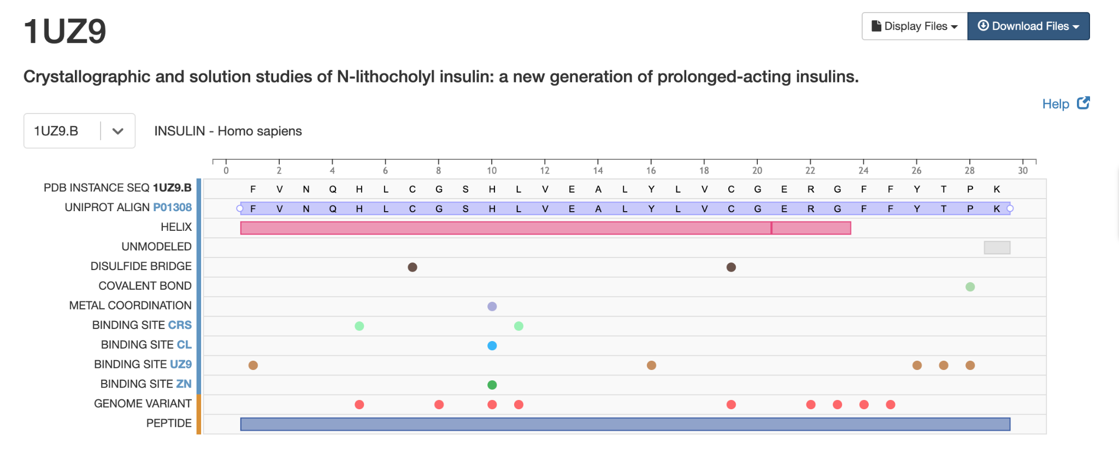
PDB: Sequence Tab
Gives information by chain.
Also gives information about residues bound to the chain and where they interact with the protein.
You have to change the chain selection in the drop down bar.

Slide 21
PDB: Ligand Info
Go back to the Structure Summary page (main page for the entry)

Slide 22
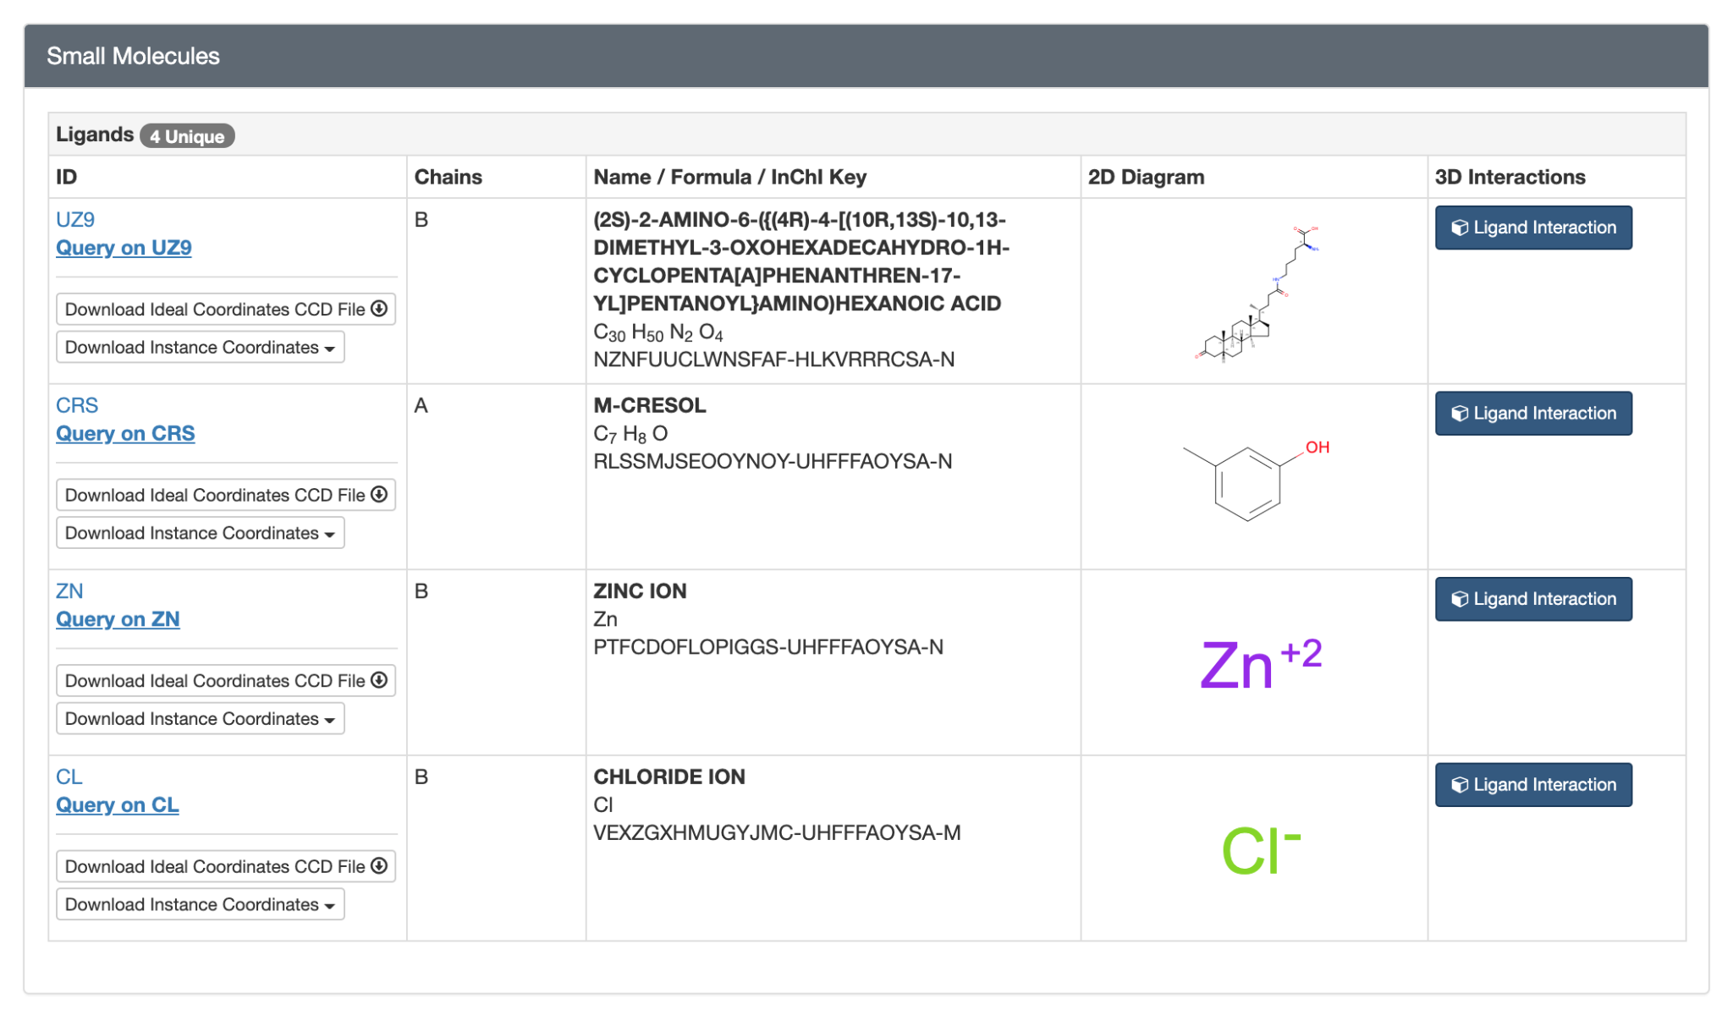
Scroll Down… Keep Scrolling
Find “Small Molecules”
Ligands
  A small molecule that is able to bind to proteins by weak interactions. In some cases, a ligand also serves as a signal triggering molecule.
Many pharmaceuticals are executed via ligands (or other changes to the native protein)
These ligand names will be used in jmol.
I suggest writing them down!

Slide 23
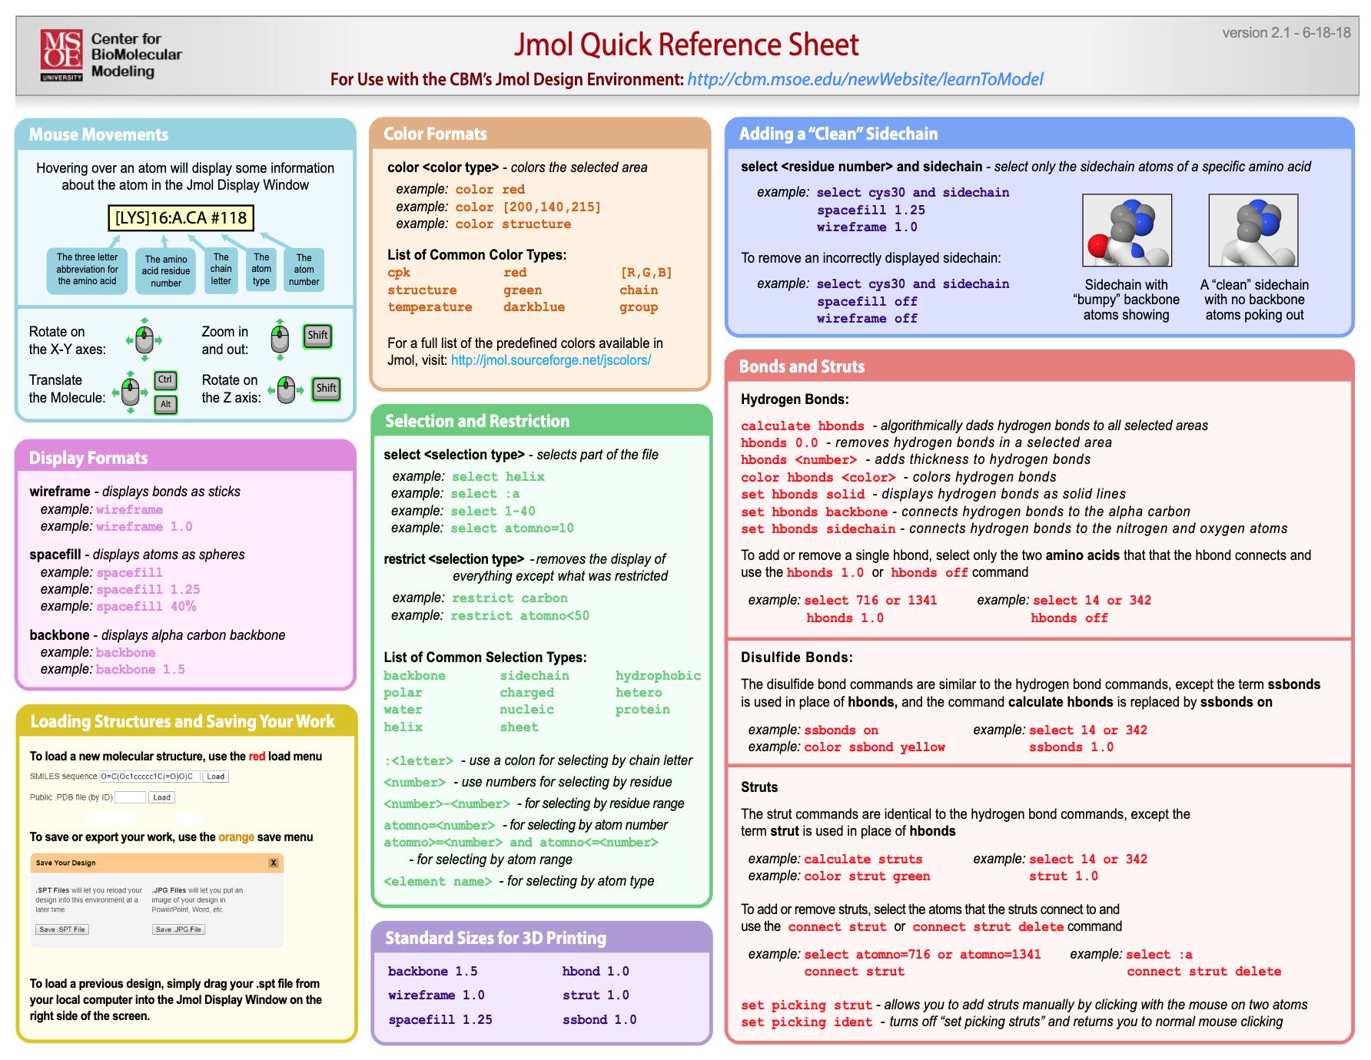

Slide 24
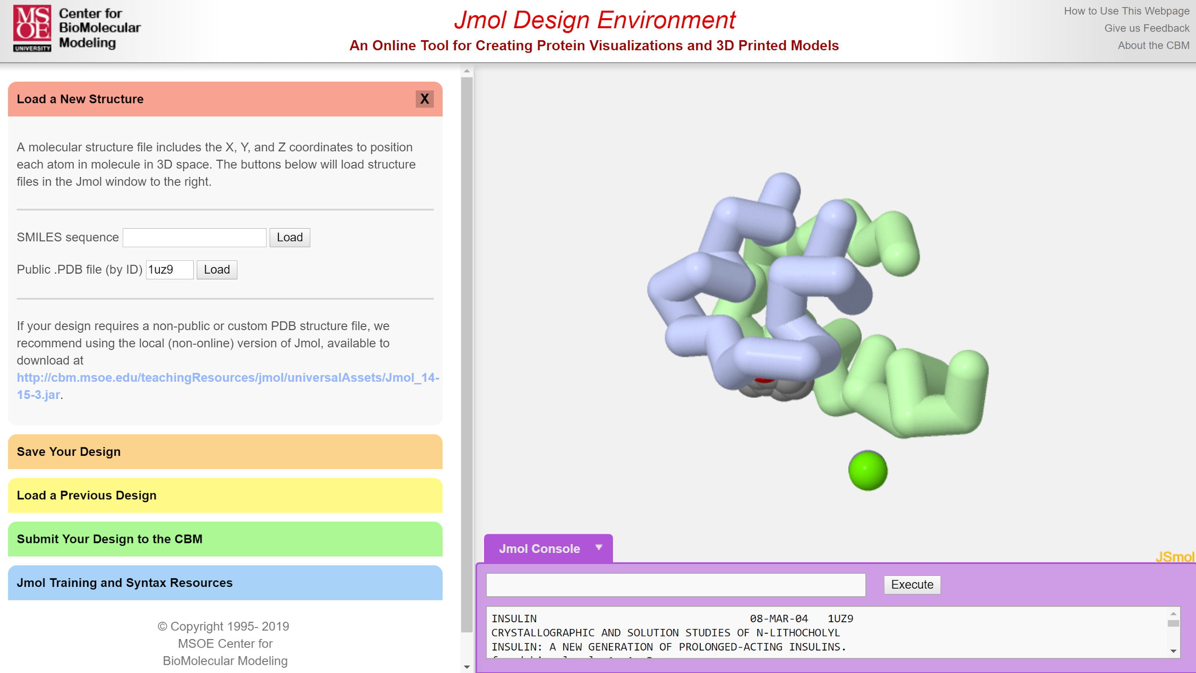
Type in file name.
Hit load

Slide 25
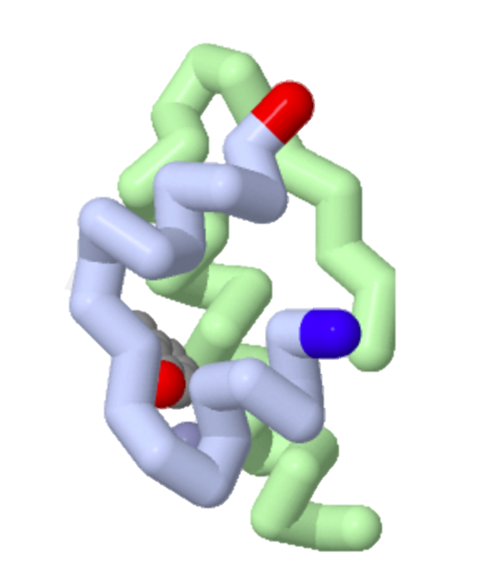
Color N and C Term
Have open the structure view in PDB!
Hover over residue
Codes
  select :a
  select gly1
  color blue
  select asn21
  color red
This stands for chain a. Think back to PDB where we saw the different chains that make up the protein.
This stands for the first amino acid, which happens to be glycine.
This command will change the color of the select item, in this case - gly1

Slide 26
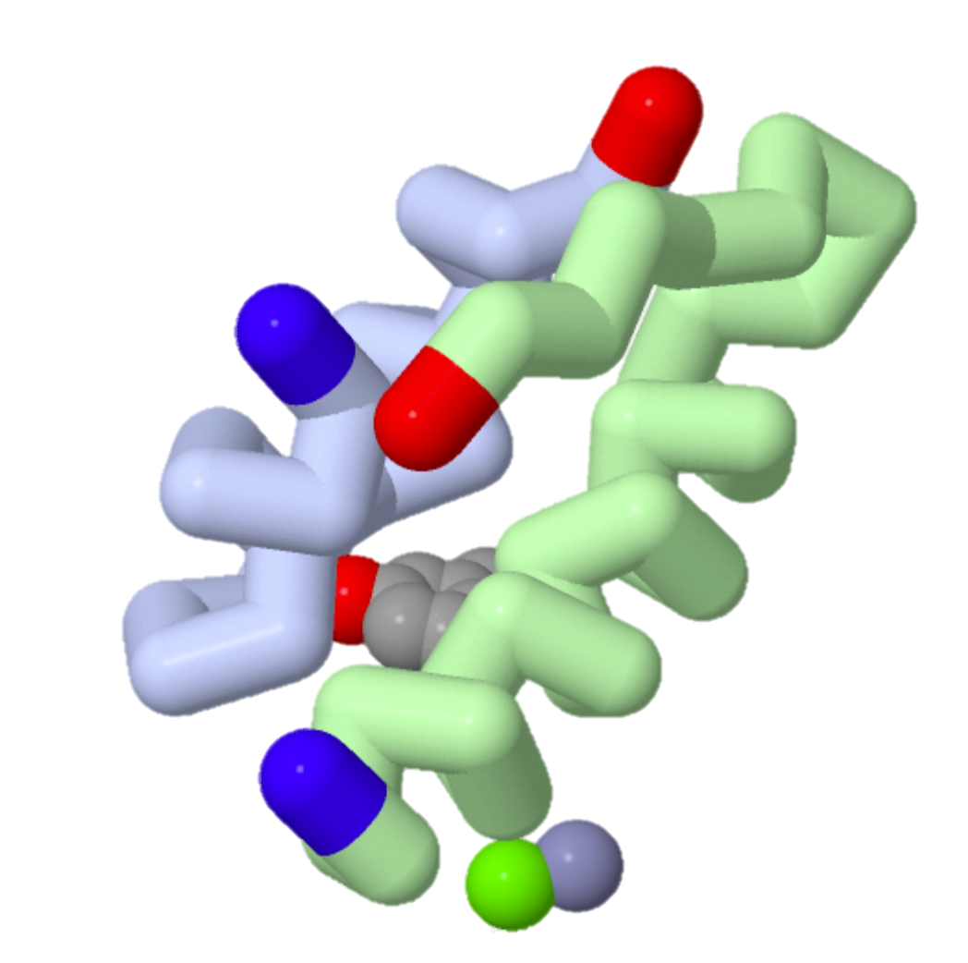
Can you figure out :b?
It’s tricky… use PDB!

Slide 27
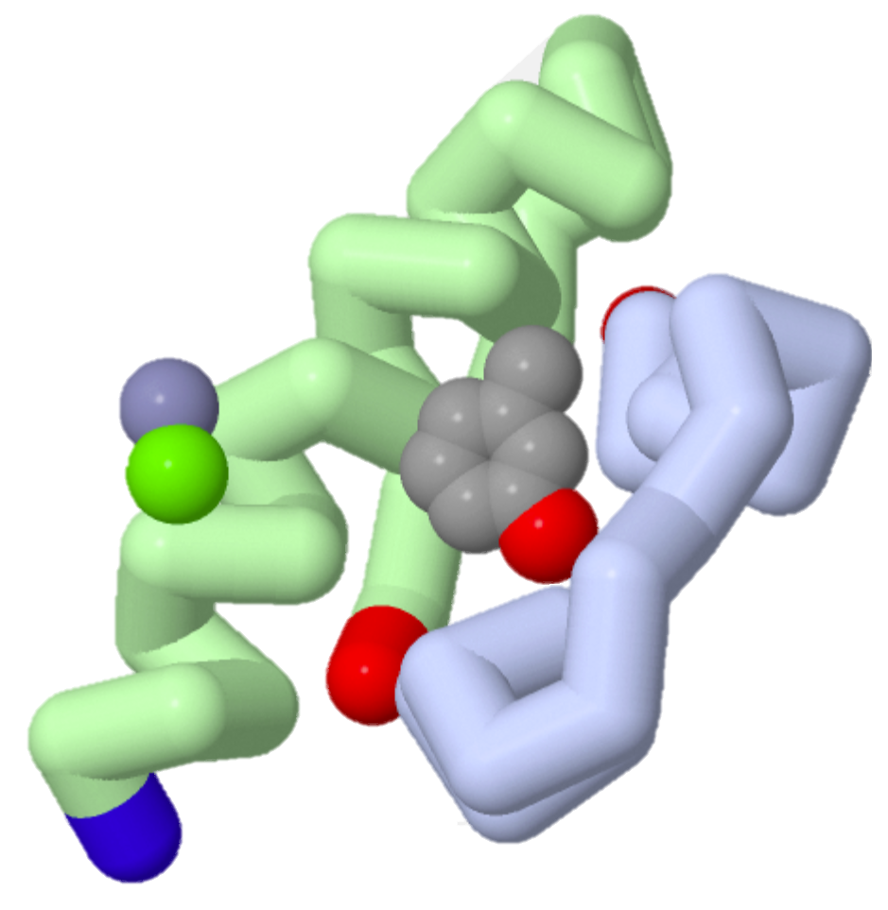
What ligands are shown?

Slide 28
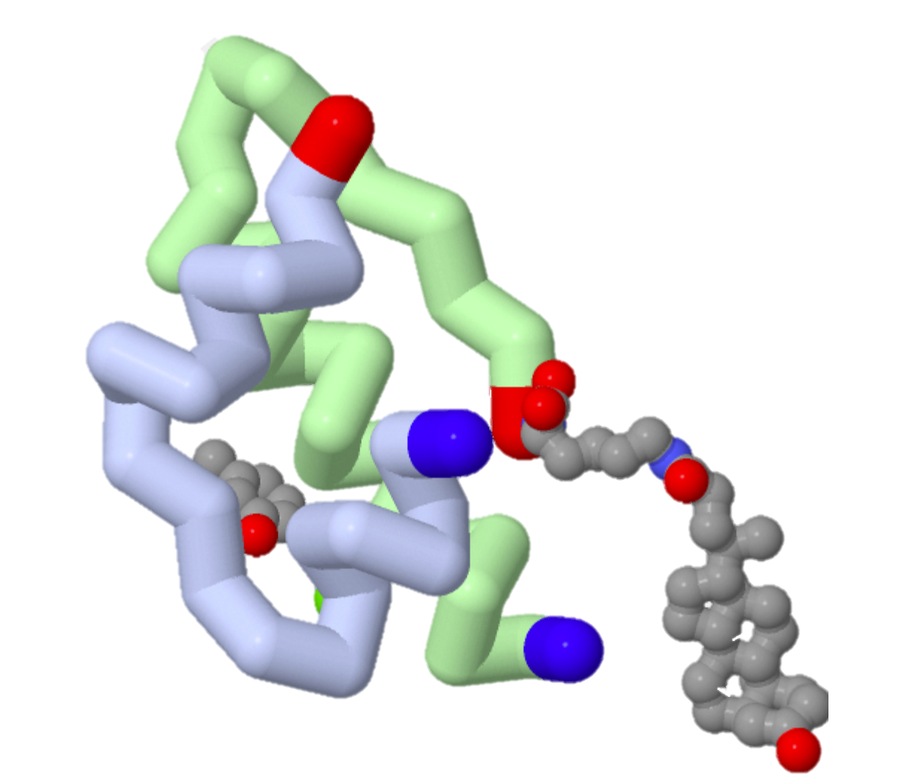
Can you figure out how to fix it?
If you want to find it, first you must select it.
  select UZ9
  spacefill 1.0
  color cpk
What do you think the “spacefill” code does?

Slide 29
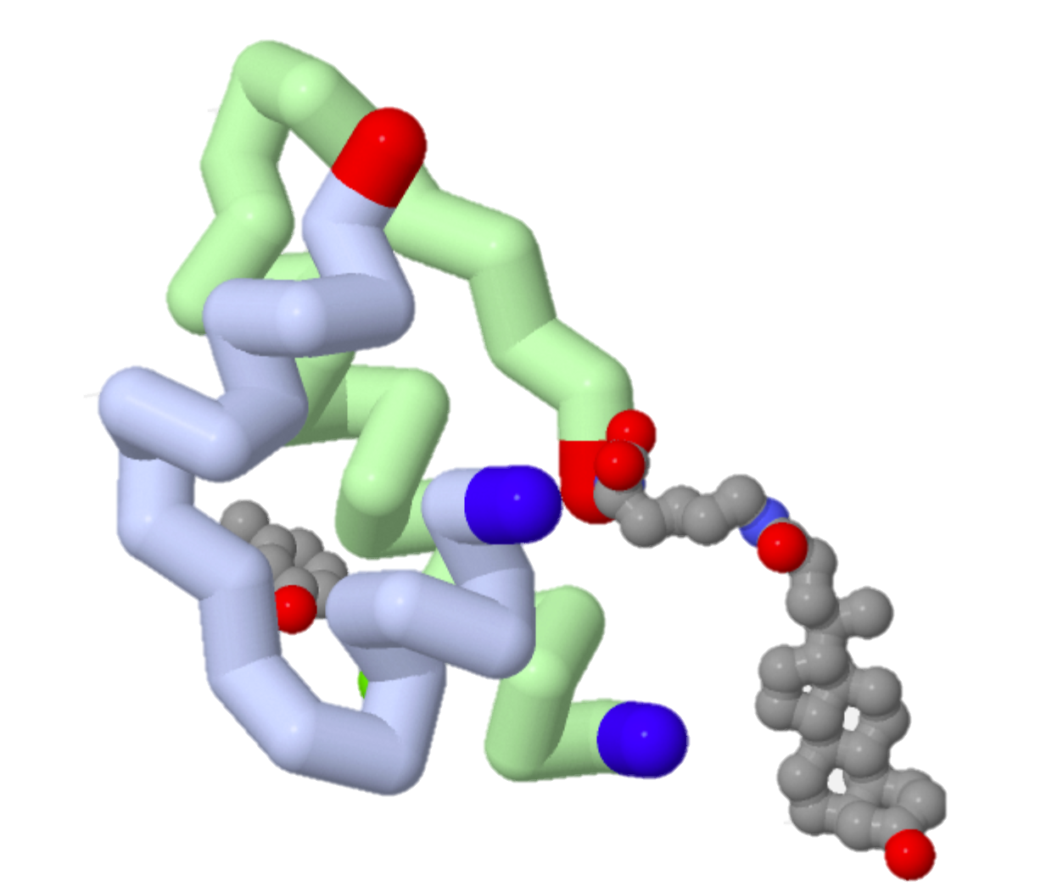
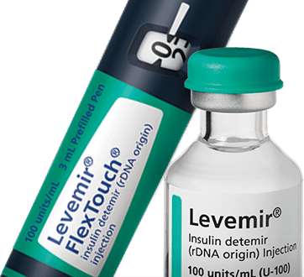
What did you just make?
1UZ9 is the insulin associated with the drug Levemir, a basal insulin.

Slide 30
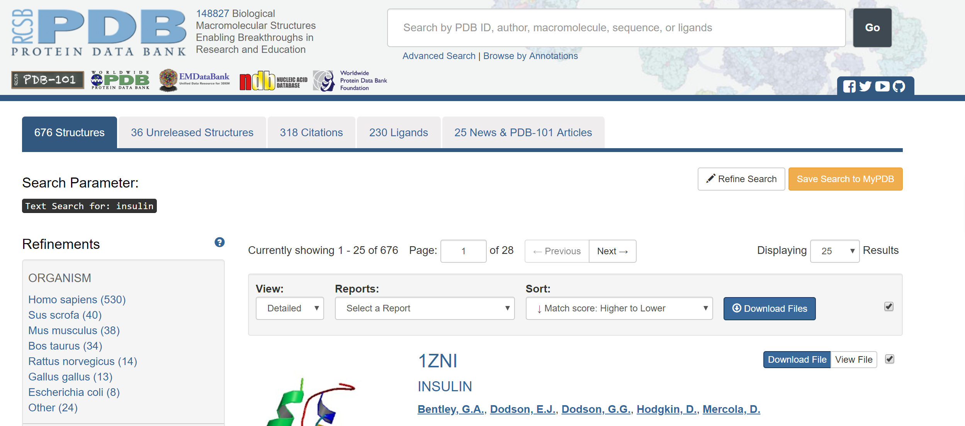
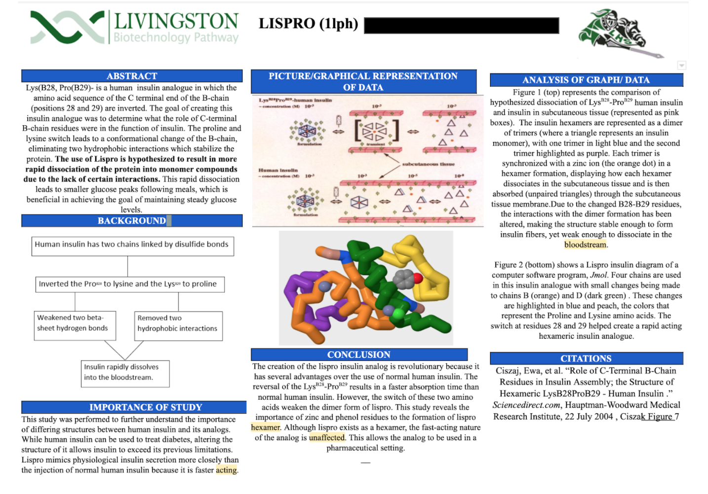
What comes next?
Students will pick an insulin analog and read associated papers on it.
They will then model their analog in Jmol.
Present in a scientific poster format.

Slide 31
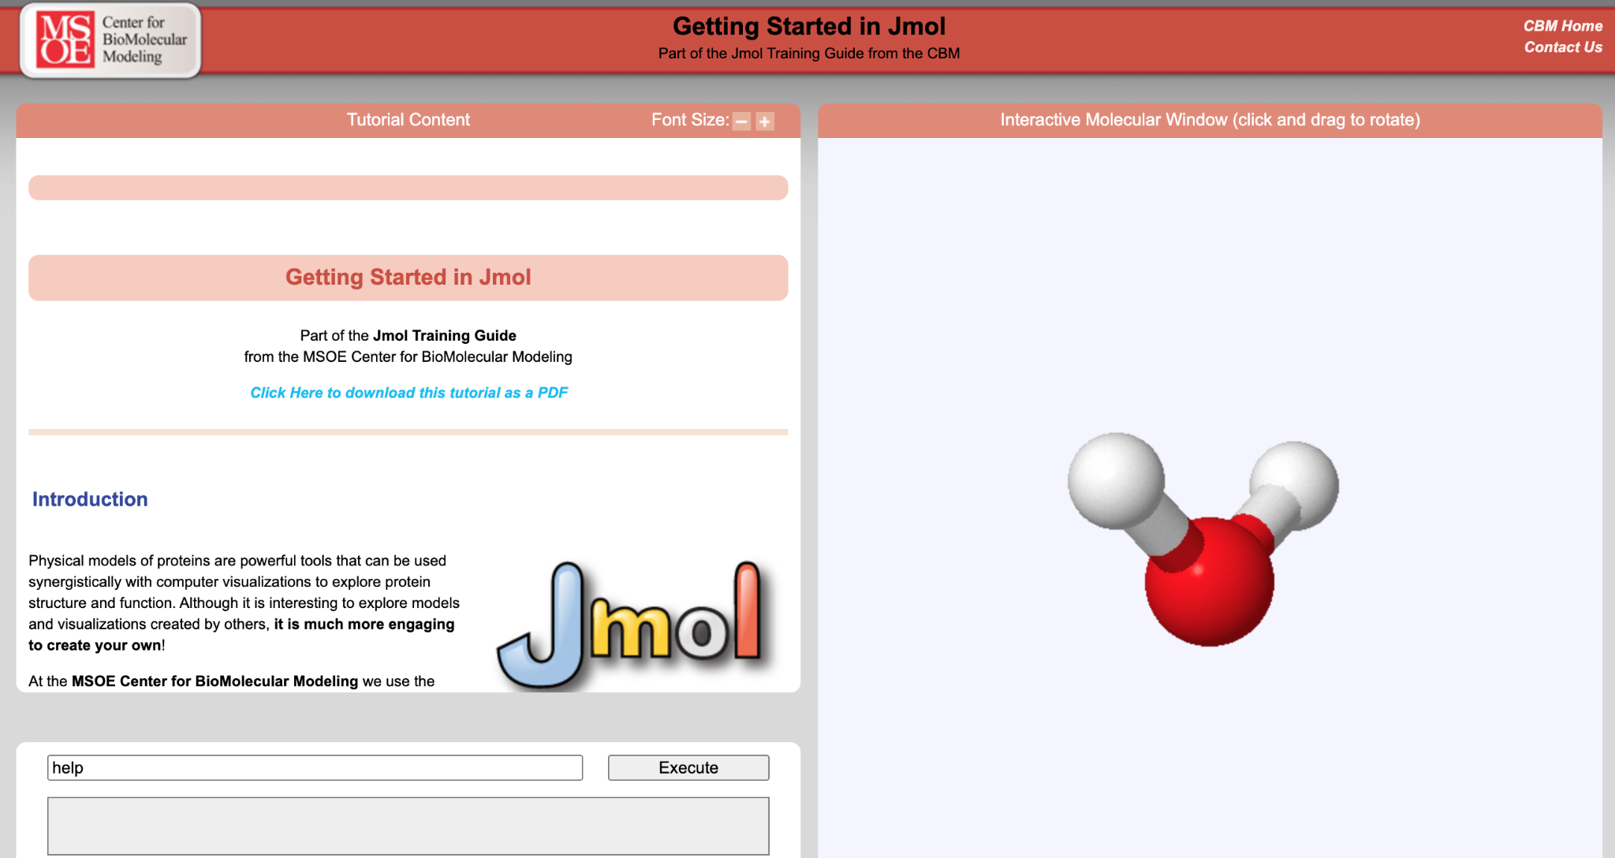
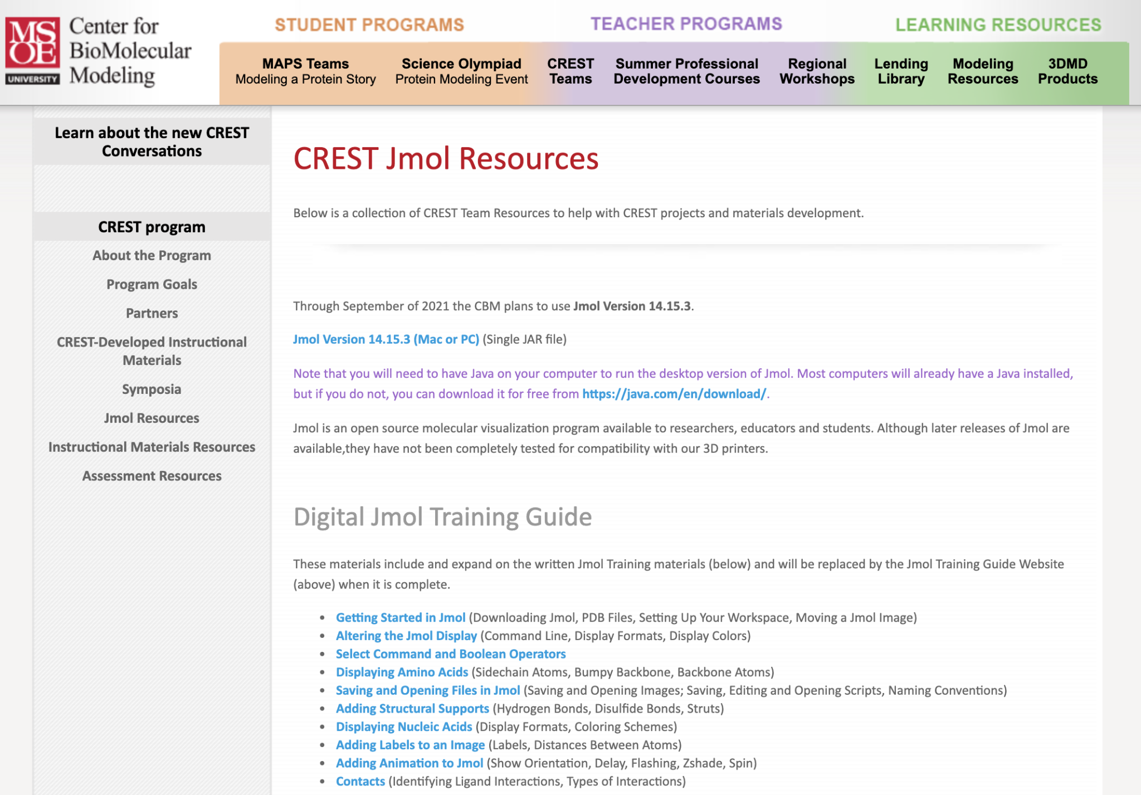
Jmol Tutorials
Getting Started in Jmol
Digital Jmol Training Resources
Jmol Color Charts

